Slide 1
TSEPAMO STUDY
Newborn Surface Examination and Congenital Anomalies
Health Care Professionals Training
MODIEGI D DISEKO

Slide 2
The Tsepamo Study
Primary aims::
  (1) Evaluate adverse birth outcomes (stillbirth, preterm, SGA, neonatal death) by HIV-status and ART regimen
  (2) Determine if there is an increased risk of neural tube defects (NTDs) among infants exposed to efavirenz (EFV), dolutegravir (DTG) and other ART regimens started prior to conception compared to infants born to HIV-uninfected women

Slide 3
STUDY SITES
Since August 2014, we have had a surveillance study of birth outcomes at 8 maternity wards in Botswana
  Gaborone, Francistown, Molepolole, Serowe, Mahalapye, Selebi-Phikwe, Maun, Ghanzi
  Covered about 45% of all births in the country
Starting June 2018, we expanded to 10 more surveillance sites
  Bamalete Lutheran Hospital, Palapye Primary Hospital, Deborah Retief Hospaital, Kanye SDA Hospital, Athlone Hospital, Bobonong Primary Hospital, Gumare Primary Hospital, Goodhope Primary Hospital, Tutume Primary Hospital, Letlhakane Primary Hospital
  Covering about 70% of all births in the country

Slide 4
Data Collection Process
  Data will be collected for every birth >24 weeks gestation that occurs on the hospital grounds
    Trained Research Assistant will review available outpatient records and maternity obstetric cards
    For HIV-infected women we will collect information to confirm what is written in the maternity logbook and to look up in IPMS/PIMS
    For Congenital Abnormalities will attempt to consent mother for photo of the infant’s abnormality
  Data Collection for Congenital Abnormalities
    Nurse Midwife/R/Nurse will notify our research assistants for all potential abnormalities (stillbirth and live birth)
      RA available by telephone 24/7 (except when on holiday) and will attempt consent when she returns to duty if the mother is not yet discharged
    RA will consent mother for anonymized photo
      If no consent obtained, the RA will ask for further clarifications and descriptions from the midwife or doctor who saw the baby
    Anonymized photo will be reviewed by our birth defects expert and categorized
    RA or other study staff can provide feedback to hospital nurse midwives on diagnosis if uncertain
    Mother will be able to obtain expert diagnosis if she wants it at 3 months
    Our head nurse midwife will be available by phone for any difficult cases, clinical questions from maternity staff

Slide 5
Congenital Abnormality (CA)
Also known as…
“Birth Defect”
“Congenital Defect”
“Congenital Anomaly”
“Congenital Malformation”

Slide 6
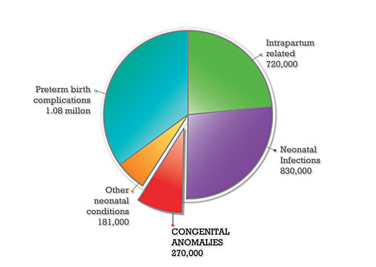
Important Cause of Neonatal Deaths

Slide 7
What is a CA?
Structural (the way the body looks) OR Functional (the way the body performs) abnormalities that are present at the time of birth
Structural abnormalities can be external (outside the body) or internal (inside the body)

Slide 8
Why do CAs Occur?
About 50% of the time, UNKNOWN reason!
Genetics: Runs in the family or consanguinity
Infections: Syphilis and Rubella
Nutritional Deficiencies: iodine, folate
Maternal Health: obesity, diabetes, cancer therapy, hypothyroid
Exposures: Alcohol, Smoking, Cocaine
Exposures: Pesticides, waste dumps, mines
Medications: Epilepsy drugs, ?Efavirenz, ?Cotrimoxazole, ?Fluconazole, ?Tetracycline, ?Enalapril

Slide 9
Why do CAs Occur?
Remember, it’s never 100%
  Even with known exposure to chemicals, maternal conditions, infections only a SMALL % of these babies go on to develop abnormalities
  We don’t know why some do and some don’t!

Slide 10
When do Abnormalities Occur?
Early Fetal Development is when most develop:
  FIRST TWO MONTHS:
    Cells Multiply
    Internal Organs begin to develop
    Heart starts to beat
  Third Month:
    Nostrils, mouth, lips, teeth buds, and eyelids form
    Fingers and toes are almost complete
    Eyelids are fused shut
    Arms, legs, fingers, and toes have developed
    All internal organs are present—but aren’t ready to function
    The genital organs can be recognized as male or female

Slide 11
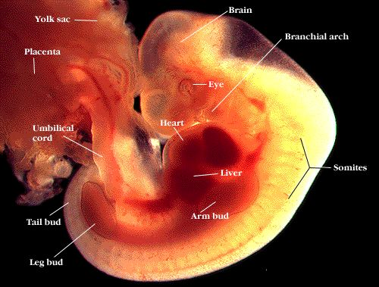
First Month of Development

Slide 12
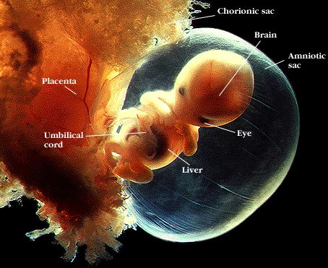
Second Month of Development

Slide 13
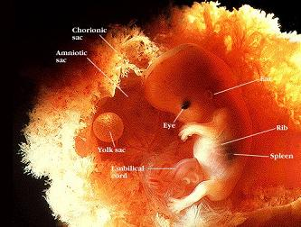
Third Month of Development

Slide 14
Later Development
By the end of the second trimester (27 weeks) most all of the organs have developed and are now just growing
Brain continues to develop
Few Congenital Abnormalities Develop

Slide 15
Where are the common CAs?
Those that can be seen on newborn exam
  Fingers, Toes, Arms, Legs
  Genital Organs
  Stomach Wall
  Mouth (Lip and Palate)
  Head and Spine
Those that can’t be seen on newborn exam
  Heart Defects
  Defects of the kidneys
  Defects in the brain

Slide 16
Approach to the Newborn Surface Examination

Slide 17
The purpose of newborn physical examination is to asses the baby’s transition from intrauterine life to extra uterine life and also to identify congenital malformations and actual or potential disease. It may also assist to identify any birth injuries.
The exam should be conducted within 72 hours of delivery.

Slide 18
Procedure
The examination is best done when the baby is asleep or calm, in a warm environment.
A brief screening examination should be conducted checking the face, eyes, mouth, chest, abdomen, spine and limbs to exclude major abnormalities.
A comprehensive newborn examination involves a systematic inspection from head to toe

Slide 19
Helpful Hints for the Infant Surface Exam
Weight
  Zero Scale
  Undress Baby,
  Record weight in GRAMS
Length
  Ensure baby is in an outstreached position by applying pressure to both knees
  Measure from top of head to bottom of foot
  Record length in centimeters

Slide 20
Skin
  Examine ALL skin
  Look for rashes, scars, skin tags, large bullae, color of skin
  Describe Rashes: flat, raised, red, pustular; place on the body and size/extent of the rash
  If you find areas of open tissue--cover these areas with sterile dressing
  Some skin findings are are normal like blue or dark marks on the buttocks or back (sometimes referred to as Mongolian spots)
  Hair at the base of the spine is common and does not need to be recorded EXCEPT if it is lying on top of a buldge

Slide 21
Head
Head Circumference
  Measure in the widest part of the head
  Recorded in Centimeters
Head
  Look at the shape and size of the skull/head, please describe anything abnormal
  Cone shaped skull can be normal from birth process
  Run fingers over the scalp to feel for defects
  One-sided soft tissue swelling could be a birth injury particularly if it is easily depressible
  Accumulation of blood under the membranes on both sides of the head can look like two bumps but does not cross the suture line
  Examine the fontanelles (anterior usually pulsating), is it depressed, hollow or buldging?

Slide 22
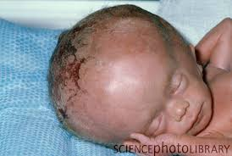
Hydrocephalus

Slide 23
Face
  Examine the face for obvious abnormalities-is there a Small chin, narrow forehead, malposition of eyes?
  Reddening between the eyes is normal in a newborn, but if it covers a significant portion of the face it should be recorded
  Are both nostrils open? Check one at a time
  Examine shape and size of ears to look for missing parts, lack of opening..a small sinus at the pinna can be normal
If baby is opening eyes, try to see if white or grey film over the eyes that could be cataract, but don’t force open the eyes

Slide 24
Face cont
Mouth, Lips and Palate
  Check the mouth: are the tongue and lips discoloured or blue (emergency)?
  Do not remove natal teeth
  Check for cleft lip

Slide 25
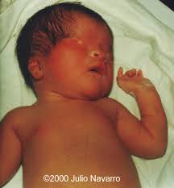
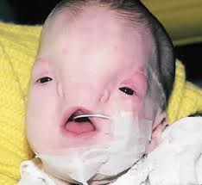
Severe Facial Defects

Slide 26
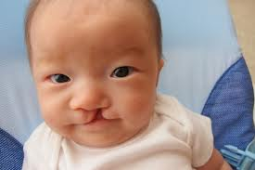
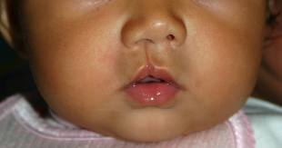
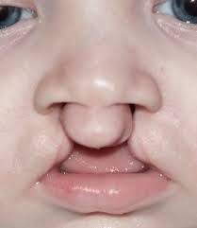
Mouth And Palate
Cleft Lip

Slide 27
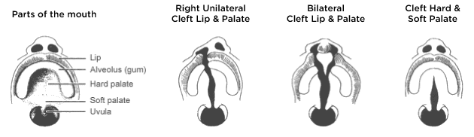
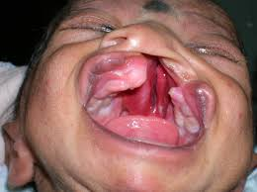
Mouth and Palate
Cleft Lip and Palate

Slide 28
Neck
  Gently lift the chin, look for sinus tract which typically occurs on the side of the neck
  Reddening of the skin at the back of the neck is usually normal

Slide 29
Chest
  Does it appear Symmetrical? Are there Extra nipples?
  Does the chest look normal with breathing?
  Feel the pectoral muscles, should be firm muscle tissue.

Slide 30
Abdomen and Anus
  Observe shape of abdomen, a distended abdomen could signal a major problem
  Are there any abnormal openings or defects in the abdominal wall? Are any bowel contents protruding?
  A Midline buldge above the umbilicus, covered in skin, is called diastasis recti-this is normal
  Umbilical hernia: if it is large may need further treatment

Slide 31
Abd cont
  Is umbilicus draining pus or blood or red around it?
  Raise and cross legs to look at anus, look for anal opening or signs that baby has passed meconium, do not insert finger

Slide 32
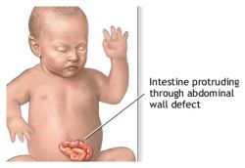
Stomach Wall
Gastroscehsis

Slide 33
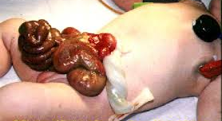
Gastroschesis

Slide 34
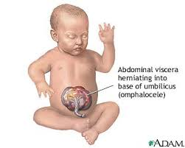
Abdominal Wall
Omphalmocele

Slide 35
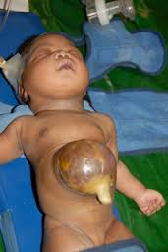
Omphalmocele

Slide 36
Hips and Genitalia
  Extend legs to see if legs are the same length
  In boys, look for urethral opening in the penis, if it is not at expected site, record where it is (hypospadias)
  In boys, palpate scrotum, have both testes descended? Is there a fluid sac (hydrocele)?
  In girls observe the vagina-are either the outer or inner labia fused?
  In girls, look to see if vaginal orifice is open, do not insert finger

Slide 37
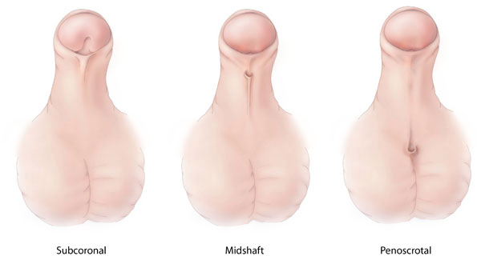
Genital Organs
Hypospadius (opening in the penis for the urethra at an unsual site)

Slide 38
Genital Organs
Ambiguous Genetalia

Slide 39
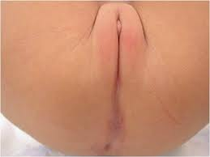
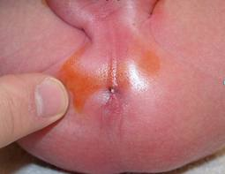
Genital Organs
Imperforate Anus (no hole at the rectum)

Slide 40
Fingers and Toes
  Extend newborn fingers around your finger, count the number, check for nails, look for short digits or webbing/fingers that appear stuck together
  Check palm for tranverse palmar crease (only 1 not 2 creases)
  Place thumb on the bottom of the newborn foot to look at toes. Count toes, look for webbing or toes that appear stuck together

Slide 41
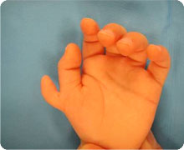
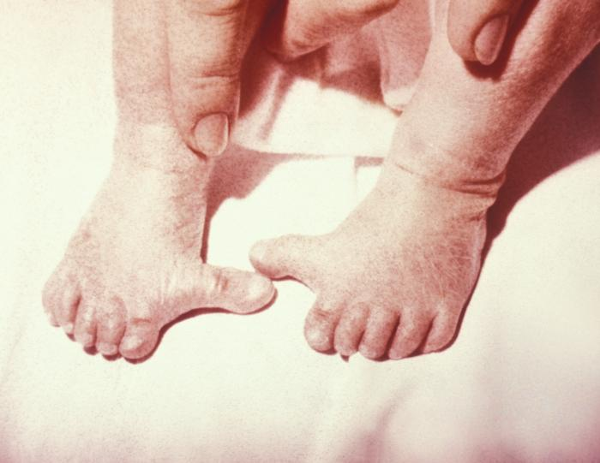
Fingers and Toes
Polydactaly (an EXTRA Finger or toe)

Slide 42
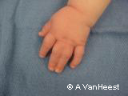
Fingers and Toes
Syndactaly (fingers or toes merged together)

Slide 43
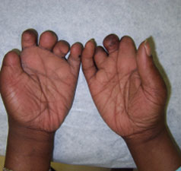
Fingers and Toes
Hypoplastic (very very small) fingers and toes

Slide 44
Arms and Legs
  Observe the length, shape and symmetry
  Is there any unusual bending of legs or feet?
  Turn feet towards midline, if lots of resistance is met, this could be clubfoot

Slide 45
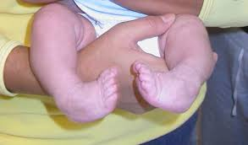
Legs and Arms
Club Foot (Talipes)

Slide 46
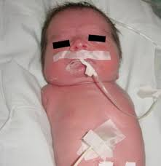
Legs and Arms
Amelia: Complete absence of a limb

Slide 47
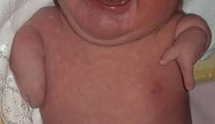
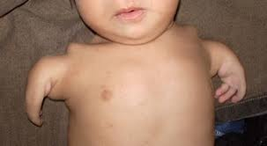
Legs and arms
Phocomelia: Absence of a limb but hand or foot present

Slide 48
Spine
  Gently lift baby up and turn over, with one hand under chest
  Run finger along spine, note if spine is straight and if there are any lumps or bumps or buldges or defects in skin

Slide 49
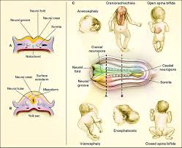
Neural Tube Defects

Slide 50
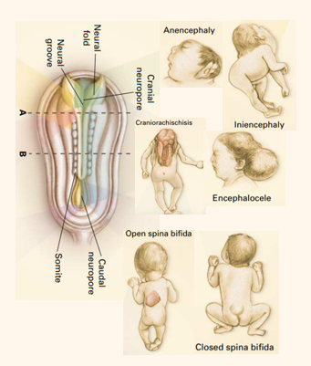
What are neural tube defects?
Neural Tube Defects are birth defects all caused by problems during the formation of the neural tube in the developing embryo
These occur in about 1 per 1000 births (0.10%) worldwide
Risk increases for mother with folate-deficiency, insulin-dependent diabetes, and due to taking some medications for seizures (sodium valproate/valproic acid

Slide 51
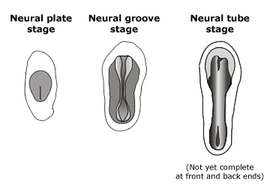
When in pregnancy do neural tube defects form?
Neural tube formation is one of the earliest events in the embryo
  If the neural tube does not close properly-→ Neural Tube Defect
Neural Tube Defects develop in the first 28 days after conception (ie by 6 weeks gestational age!)
Cranial neuropore closes on 25th day after conception; caudal neuropore normally closes ~ 2 days later

Slide 52

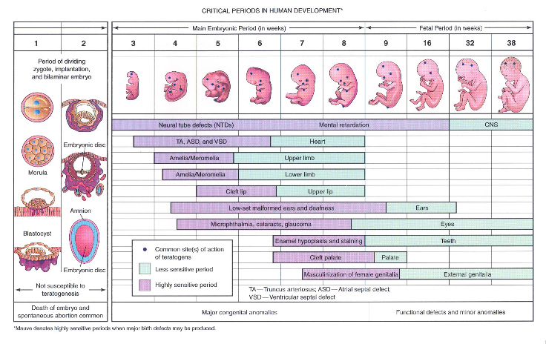
Most women don’t know they are pregnant during the risk period for neural tube defects
So when we want to evaluate whether medications CAUSE NTDs, we look at the risk in medications women start before pregnancy

Slide 53
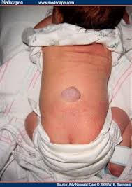
Closed Spina Bifida

Slide 54
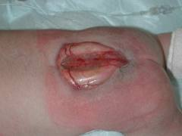
Open Spina Bifida

Slide 55
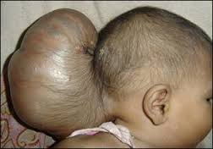
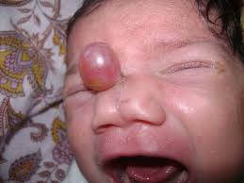
Encephalocele

Slide 56
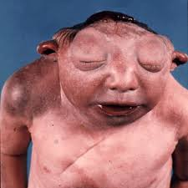
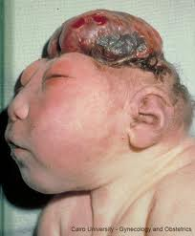
Anencephaly

Slide 57
There are many, many more
But fortunately very rare
We are happy to provide advice for diagnosis or clinical management
  Contact Modiegi (Study coordinator 71848453)

Slide 58
CHALLENGES
Unreported abnormalities
Incomplete abnormality description
Unspecified HAART

