Slide 1




Tsepamo Operations
WHO Pregnancy Surveillance Sub-Group
23 September 2022
Roger Shapiro, MD, MPH
Rebecca Zash, MD
Tsepamo is funded by NIH / NICHD:
R01HD080471 (2014-2018)
R01HD095766 (2018-2022)
P01HD107670 (2021-2026)

Slide 2
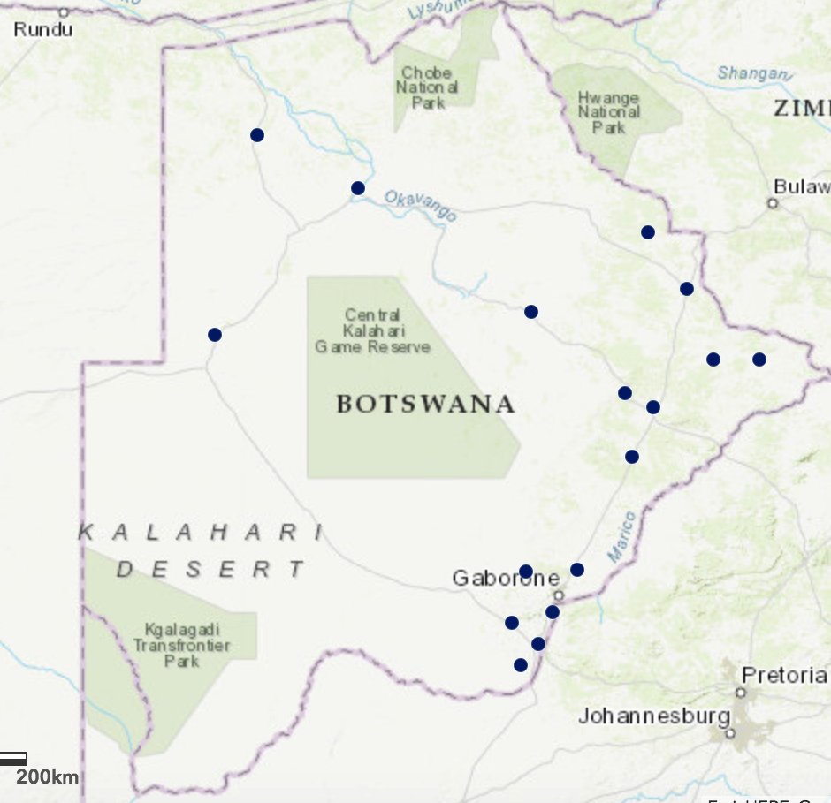
Tsepamo Study Overview
Surveillance at 16-18 maternity wards throughout Botswana
  8 original sites opened in 2014
    ~ 45% of births in Botswana
  Expanded to 18 sites in 2018
  ~ 72% of births in Botswana
  2 sites closed at present (for cost)
  23-26 Research Associates (RAs)
    1-3 RAs per site
Tsepamo Sites in Botswana
Factors that make Tsepamo possible:
>95% of women deliver in a healthcare facility
Obstetric record available at delivery for >99% of women
No/minimal prenatal diagnosis or termination of pregnancy

Slide 3
Tsepamo Data Capture Logistics
Pre-hospital
L&D
Maternity Ward
Use logbook to confirm all deliveries
(open record for each delivering woman in REDCap)
Study team confirms ARVs and key data for WLHIV
(updated data can be added to obstetric card)
At discharge home, obstetric card collected by study team for entry
cards held for study team on weekends, holidays
If card is missing (rare), use just logbook data to maintain denominator
If infant admitted to hospital ward, record is kept open for 28 days
Electronic capture of additional data can be added in REDCap at a later time if linkage available
Pre-hospital deliveries (excluded)
L&D or Maternity
Nurse calls study team if congenital abnormality detected

Slide 4
Research Assistant Workload
It takes ~ 10-30 minutes to extract an obstetric card into REDCap
    longer for WLHIV, shorter if not
    ~ 10-15 new deliveries can be captured per day per RA
      Includes catching up on missed surveillance (holidays, weekends) to avoid gaps
    If RA works ~ 230 days per year, hospitals with ~ 3000 births per year or less can be staffed with 1 RA
      If only recording WLHIV, much less work!
Additional daily tasks include:
    daily maternity logbook check
    follow-up of open records in NICU
    direct patient confirmation of key data for WLHIV (optional)
    consenting/interviews/photos when congenital abnormalities
      Could be restricted to major abnormalities or NTDs
    data queries/cleaning
    periodic central trainings

Slide 5
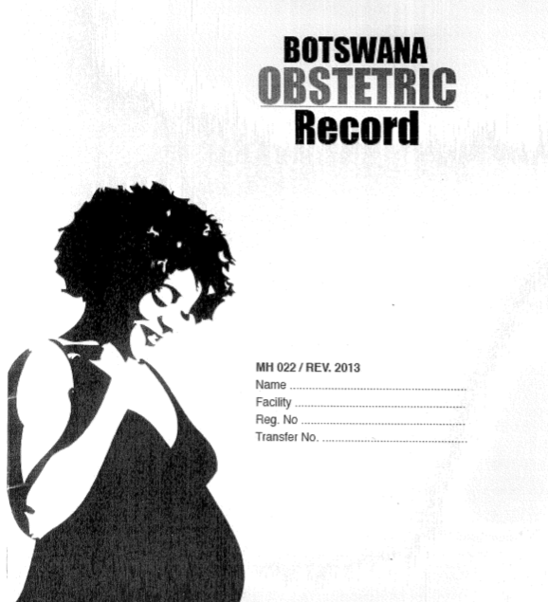
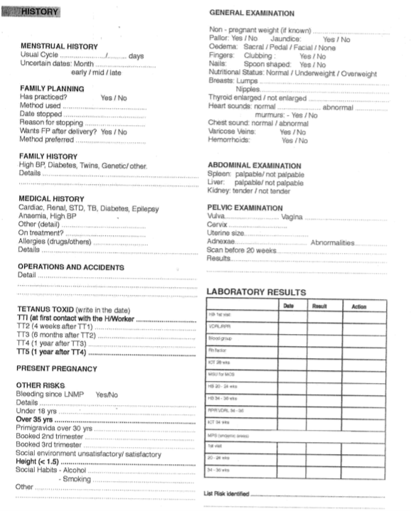
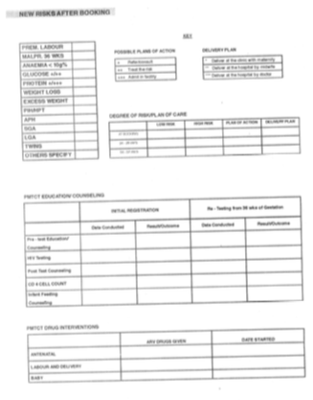
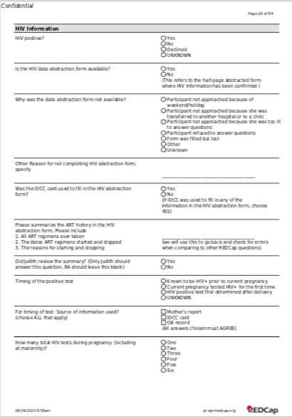
Data Collection: Extraction from obstetric card to REDCap Database that matches the card
Each hospital gives us dedicated space
RAs each have a MacBook Air with cellular internet service to connect to REDCap

Slide 6
Data Collection: Important Issues
REDCap entry has up to 89 pages to enter per record!
  Skip logic is critical to save time
Data quality dependent on obstetric record, except for critical confirmed data and data following consent for congenital abnormality
Some fields not useable, especially when “blanks” are frequent on obstetric record
  Blanks may mean “not asked” or “not applicable” or “no”
  Cannot fix this easily
If there is a problem with a key field (such as the names of the ARVs), can be fixed 2 ways:
  1) at the source: meet with/train antenatal clinic staff
  2) at maternity: ask women to confirm ART regimen

Slide 7
Procedure for Congenital Abnormalities
Surface exam is part of routine care by midwives
  Training by Tsepamo team on surface exam (using WHO materials)
When an abnormality noted, the midwife contacts the Tsepamo RA
  Midwife receives cell phone credit of ~ $2
  Tsepamo team consents mother for a photograph
    No identifiers, photo file linked to the REDCap record
  Additional “congenital abnormalities form” completed
Photographs of major abnormalities (and unclear findings) are reviewed regularly
  Review by Dr. Lew Holmes, who is blinded to exposure information
Statistics maintained for missed contacts (weekends, holidays), refused consents, and consents

Slide 8
Limitations of Surveillance for Abnormalities
Surface exam only:
  Unable to evaluate for cardiac defects (common) or other internal organ defects (rare)
  Unable to include defects that are not consistently and reliably evaluated
    Undescended testes
    Isolated cleft palate
    Hip Dysplasia
  Challenge to classify some abnormalities by still photos
Surveillance of stillbirths and severe abnormalities can be difficult; nurses/RAs may not want to disturb the mother with questions/consent
  Requires trust among Tsepamo team and maternity staff, and the right approach with mothers
Psychological impact on Tsepamo research assistants

Slide 9
Data Collection: Optional Link to electronic records and to multiple pregnancies for the same woman
Starting in 2018, we obtained approval to collect OMANG numbers in a secure manner
  Unique identifier in Botswana, used for all medical records
Allows confirmation of CD4 and VL in electronic IPMS system
  Time consuming
May be more or less helpful in different countries depending on electronic vs. paper records

Slide 10
Data Collection: Confirmation of records at delivery
With the additional step of confirming the HIV and ART history with mothers (and their outpatient record) from July 2022:
% with CD4
  Without confirmation: 12.5%
  With confirmation: 25.9% (up to 36.6% with outpatient record)
% with VL
  Without confirmation: 75%**
  With confirmation: 80%
% with ART switch during pregnancy
  Without confirmation: 0%
  With confirmation: 4.0%
% with ART switch prior to pregnancy
  Without confirmation: 0%
  With confirmation: 55.6%

Slide 11
Tsepamo Cost
Research Assistants in Botswana: ~ $12,000/yr
Study/Program coordinator: ~ $35,000-$60,000/yr
Senior QA/QC manager: ~$18,000/yr (could be a senior RA)
Data manager: ? if needed with cloud-based EDC
Expert adjudication of abnormalities (~ 5% FTE)
Database Costs: REDCap is free
Additional costs:
  Internet/cell
  Laptops/phones/cameras
  Reimbursements to nurses for cell notifications
  Transport and housing for site visits and periodic trainings
  Travel costs if RAs cover > 1 site
  Space (donated by hospitals)
  PPE during COVID
We never rely on government nurses for data collection

Slide 12
Tsepamo Cost
Cost is heavily dictated by the number of RAs needed to achieve coverage
  Larger delivery sites allow more efficiency
  In Botswana:
    8 hospitals → 45% of births (~15 RAs)
    18 hospitals → 70% of births (~25 RAs)
    Beyond 18 hospitals highly inefficient
      Smaller delivery sites require < 1 RA per site (can cover multiple sites if travel possible)

Slide 13
Tsepamo future analyses
Botswana to update HIV and PrEP guidelines in 2022
  Tsepamo Plus funded through 2026
Planned analyses will focus on newer antiretrovirals
  Evaluate birth outcomes (including congenital abnormalities)
  Link to government vertical transmission data in 2022-2023
  Evaluate weight gain in pregnancy
  Depending on the final guidelines and rollout, we plan to collect data on:
    TAF
      88 exposures to TAF (81 from conception) to date
    PrEP
      146 on PrEP during pregnancy (almost all TDF/FTC)
      Expect CAB-LA soon
    2-drug therapy (DTG/3TC)

Slide 14
Tsepamo can share!
Tsepamo Study protocol, REDCap structure, QA/QC reports, are available for other sites
We have shared the dataset with WHO (DTG Central Registry and Central Pregnancy Registry)
We welcome visitors

Slide 15
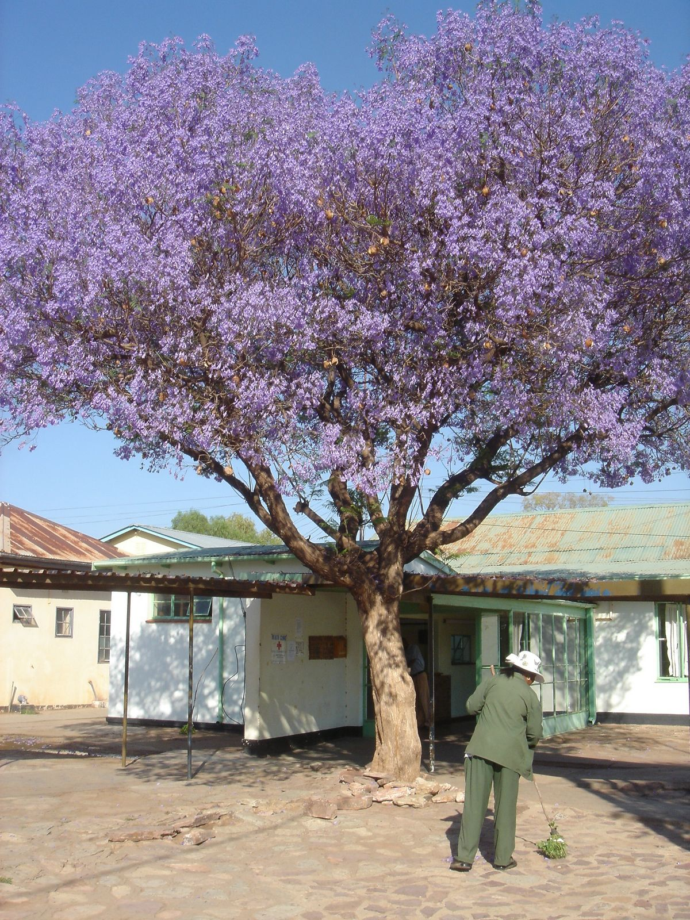
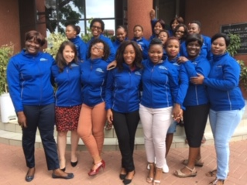
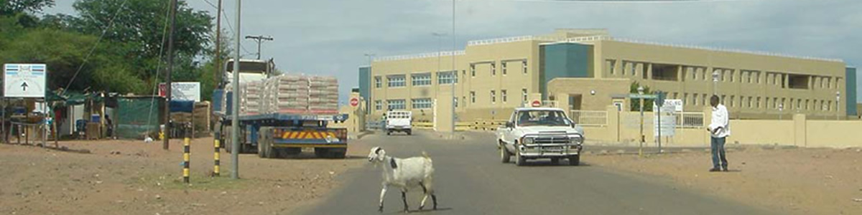
Thanks!

