Slide 1
Network-based testing toolkit training modules
Module 9: Monitoring & adverse events in network-based testing

Slide 2
Learning objectives
By the end of this module, participants will be able to:
Monitor, analyze and interpret indicators for tracking the coverage, identifying gaps, and improving the quality of network-based testing services.
Explain how to report testing data when implementing integrated network-based testing approaches.
List the different quality monitoring and accountability tools that can be employed to remediate any gaps in the provision of safe and ethical network-based testing.
Define an adverse event in the context of network-based testing services.
Describe the components of an adverse event monitoring system.
List some steps for documenting, investigating, reporting, and remediating adverse events, and identify how these steps can integrated within network-based testing services in your setting.

Slide 3








Importance of network-based testing services
NBT
Is one of the most strategic and efficient method for identifying individuals who are in need of testing and other services
Positivity (%) increases
No NBT
NBT
1-2%
35-62%

Slide 4

Routine programmatic review is NECESSARY to ensure that network-based testing is implemented with fidelity, scale, and quality.

Slide 5
Programme monitoring:
basic concepts

Slide 6
What is programme monitoring?
Continuous data collection process
Measures programme progress towards achieving goals and objectives
Answers the question "What have we done?"
UNAIDS Global AIDS Monitoring http://www.unaids.org/en/dataanalysis/knowyourresponse/globalaidsprogressreporting

Slide 7


Why conduct programme monitoring
Monitoring IS for:
Monitoring is NOT :
  Programme improvement
  Accountability and transparency
  Providing information to inform scalability and reproduction of the programme
  Making decisions and problem solving
  To negatively criticize peers and their work
  To please donors or stakeholders
  To exercise power and keep other people busy collecting data and writing reports
  A static system that never changes

Slide 8

Benefits of programme monitoring
Identify strengths to scale up effective strategies
Identify programme gaps and challenges
Identify opportunities to improve the programme
Used to develop corrective action plans and solutions
Improve efficiency
Determines the quality of services provided
Promotes accountability and transparency

Slide 9







Data management cycle
1. COLLECTION
2. ANALYSIS
6. UTILIZATION
3. VALIDATION
5. DISSEMINATION
4. REPORTS

Slide 10







Programme monitoring and data quality
Completeness
Important for data to be of sound quality.
The data is suitable for USE in program operations, decision making and planning
High-quality data is an accurate representation of REALITY and what is happening in the field
DATA QUALITY
.
.
.
.
.
.
Integrity
Accurate
Timeliness
Valid
Consistent

Slide 11







Tracking NBT services: Suggested indicators
1
Number of eligible clients in the last quarter. Define “Eligible Clients”
2
Number of Eligible clients offered network-based testing services
3
Number of eligible clients who accept network-based testing services
5
6
8
9
10
11
Number of partners, children, family, and other contacts listed by eligible clients
Number of contacts successfully contacted (disaggregated by approach: social network, partner services, family/household services)
Number & types (HIV, HBV, HCV, syphilis, other STIs) of tests offered contacts
Number of contacts receiving each test type through network-based testing
Number of contacts testing positive for each type of test
Number of newly diagnosed contacts linked to treatment
12
Number of newly diagnosed contacts linked to prevention services (condoms, PrEP, VMMC)
4
Number of eligible clients who did not accept network-based testing services
7
Number of contacts not located

Slide 12
Tracking NBT services: suggested indicators
Number of newly diagnosed partners/family members/contacts
14
Number of eligible clients screened for GBV/IPV
15
Number previously diagnosed partners/contacts who are re-engaged in care
17
18
20
Number of partners/contacts tested through secondary distribution of self-test kits
Number of partners/contacts tested with self-tests who return for further testing
> >Other country specific indicator
16
Number of adverse events due to network-based testing services
19
Number of partners/contacts tested with self-tests confirmed positive or provided with further care
13

Slide 13
How to interpret the cascade for quality improvement
Quarter | Linkage
FY22 Q1 | 95%
FY22 Q2 | 97%
Large drop here could suggest inadequate
Personnel, coverage should be 100%
High/low acceptance may suggest issues around counseling messages, building rapport with client
Ratio of no. Partners elicited to no. Of index clients reached should be ≥1
Large drop off here could indicate HR issues/ data monitoring issue, operational procedure issues
Start: Number of newly diagnosed with HIV, or previously diagnosed and have high/unsuppressed VL
= 2,908
=3,276
Aim for 10 + % for sex partners
(Adols. & Adults ≥15y)
Aim for ≥95% linkage to care
89%
91%
86%
93%
1.2
1.2
94%
87%
30%
28%
97%
95%

Slide 14
Network-based testing services reporting tools

Slide 15
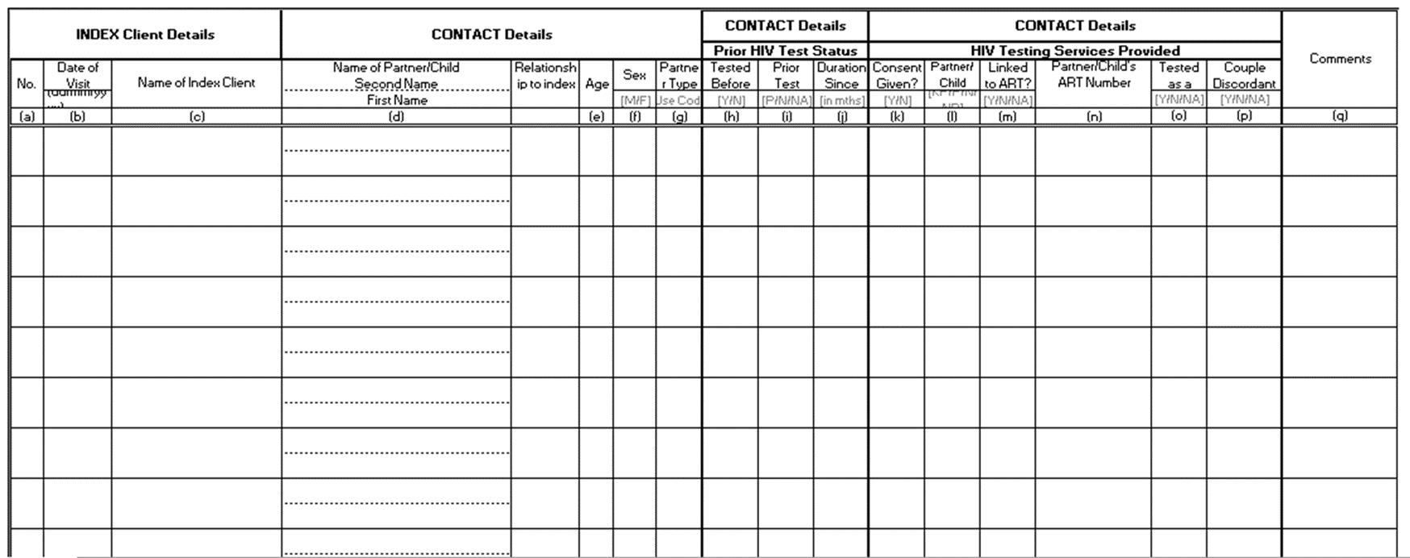
Country example: Tanzania, register with page totals allows reporting on testing cascade
  Example of index client register
  Page Totals for:
  # partners/children identified
  # partners/children tested
  # partners/children diagnosed
  # partners/children linked to HIV treatment

Slide 16
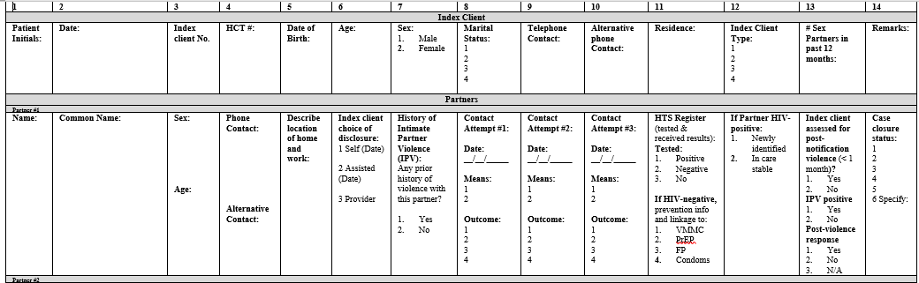
Country example: Uganda, register allows tracking of IPV risk assessment

Slide 17
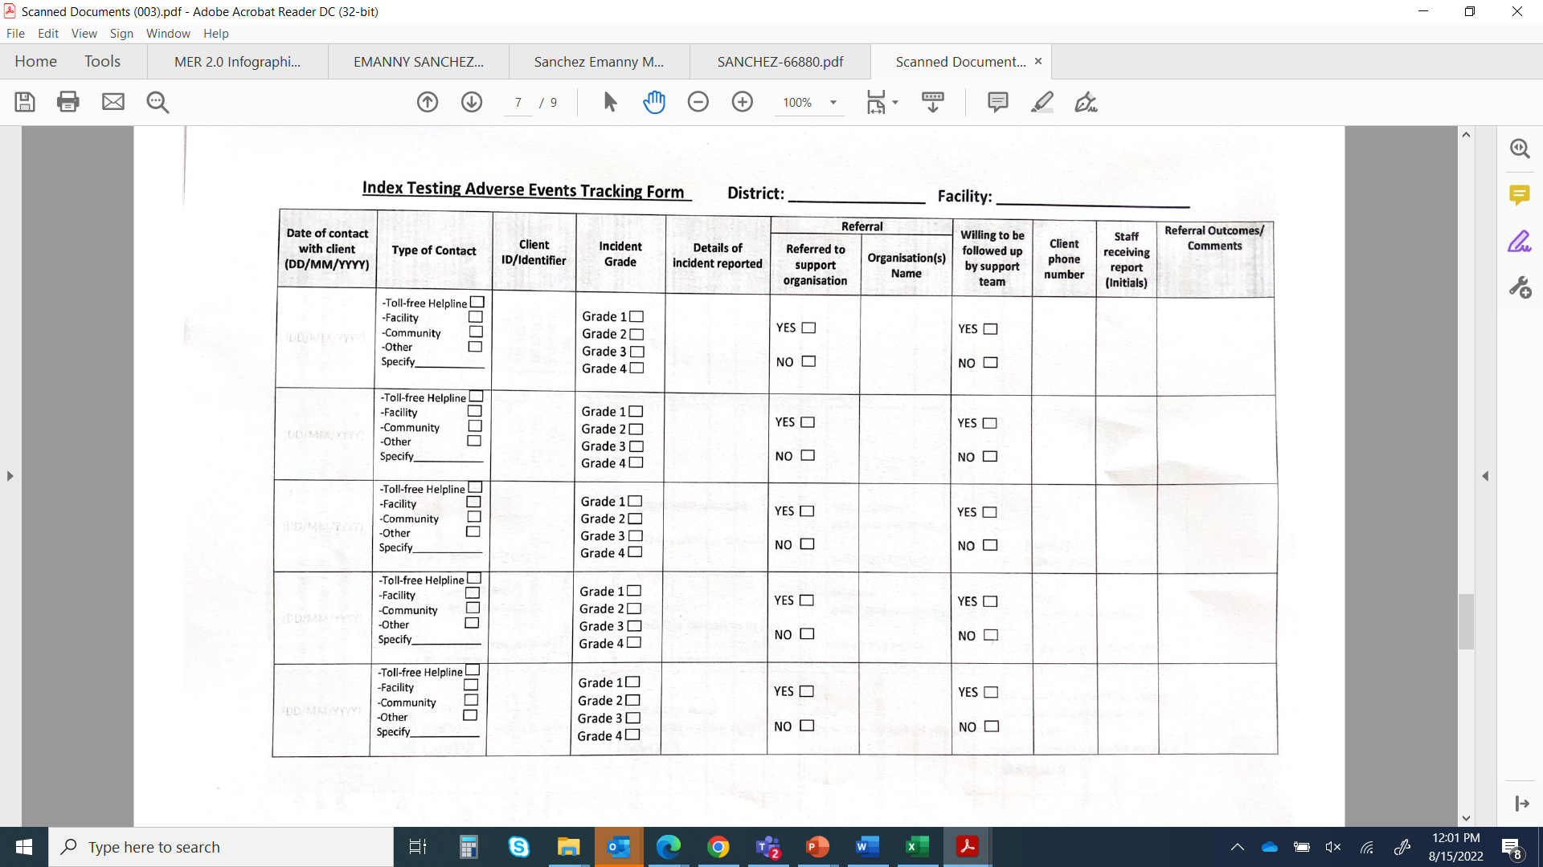
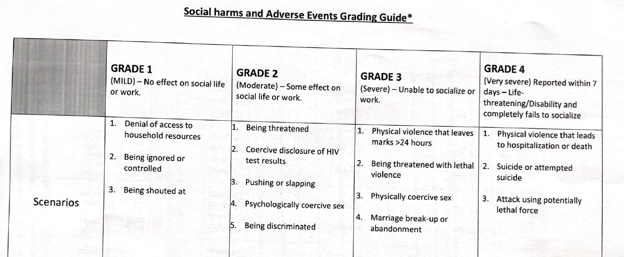
Country example: Botswana, NBT services form – Adverse Event (AE) monitoring
* Adapted from PSI HIV Self Testing Africa Project (STAR) Active Social Harm Monitoring at the Community Level Tools

Slide 18
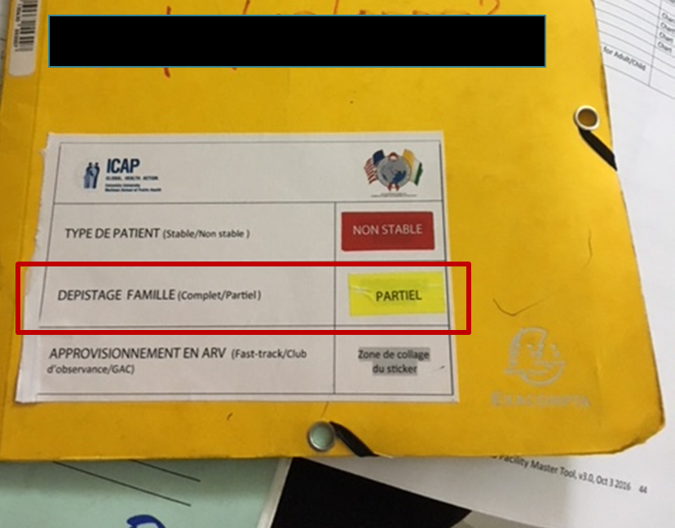
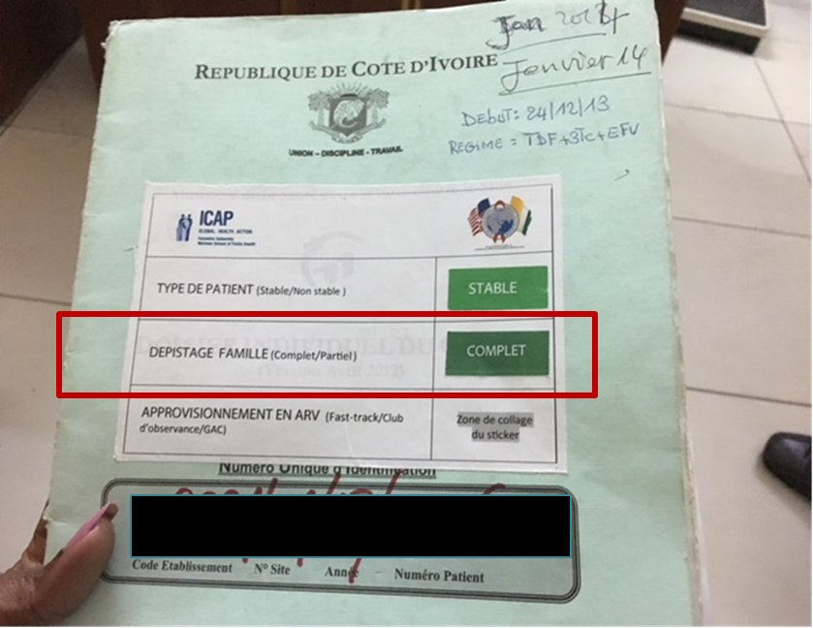

Country Example: Cote d’Ivoire,
Sticker system used to identify index clients with incomplete family trees

Slide 19
Network-based testing services monitoring tools

Slide 20

Country example: Nigeria, partner notification services (PNS) bottleneck analysis for improving performance
# Index Patients (N= 2,464 )
Sub-optimal Coverage
( < 100% )
Offered PNS n= 2,218 (90% )
Acceptance
Accepted PNS n= 750 (33.8%)
Elicitation
(0.85 contacts: 1 index)
# of partners/contacts named
(n= 640)
Notification
# of partners/contacts reached
n= 264 (41.3%)
# unknown status (n= 208; 79.8%)
# known status (n= 56; 21.2%)
# received test n= 152 (73%)
# diagnosed with HIV n= 66 (43.4%)
Good Linkage!
# Initiated on treatment n= 62 (93.9%)

Slide 21
Country example: Kenya, analysis of partner notification services cascade by age & sex
Improved Acceptance of Testing by Sexual Partners*
54%
Intensive mentoring
of providers
19%
87%
All agency IM data
 | Female- 15-24 yrs | Female- 25+ | Male- 15-24 yrs | Male- 25+
Testing uptake | 60% | 57% | 61% | 48%
% Positivity | 15% | 23% | 9% | 19%
*DOD Kisumu West

Slide 22
Country example: Vietnam, documenting outcome of partner notification services (PNS)
Vietnam collected and analyzed additional NBT data to guide programmatic adjustments and shifts.

Slide 23
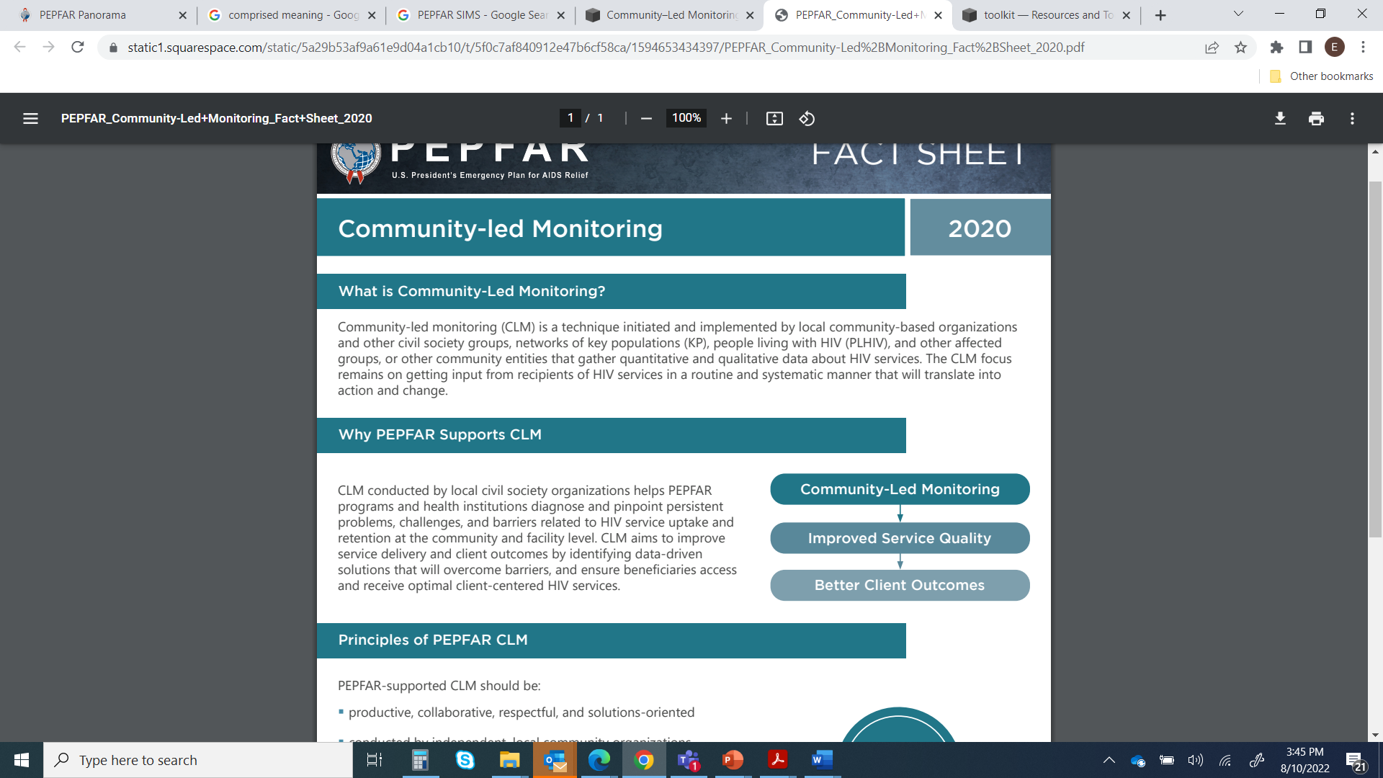
Community-led monitoring leads to better services!
CLM helps programs and health institutions to:
Diagnose and pinpoint persistent problems
Challenges
Barriers related to service uptake and retention
AIM: To improve service delivery and client outcomes and ensure beneficiaries access and receive optimal client-centered care.

Slide 24
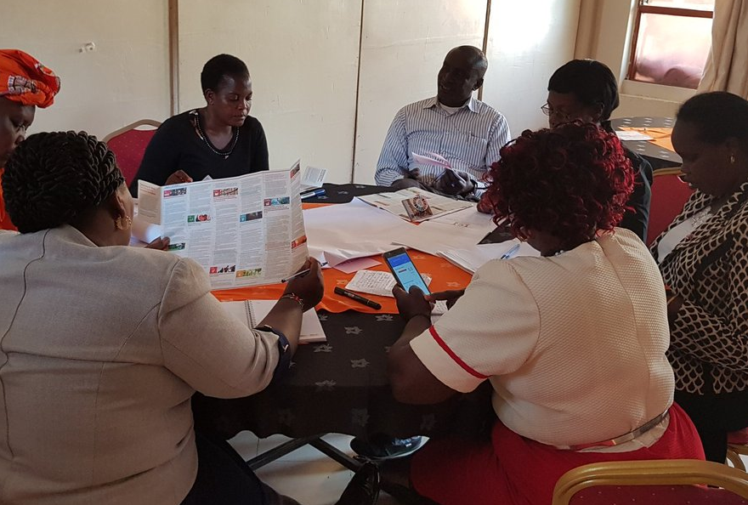
Community Led-Monitoring is Another Important Component for Monitoring the Quality of Network-Based Testing Services
CLM for monitoring the quality of network-based testing services
Monitoring and improving the quality of network-based testing services is the responsibility of organizations & programmes
However, where resources and community interest allow, teams should work with civil society organizations, and networks of recipients of care to monitor network-based testing services to ensure they meet the needs of beneficiaries

Slide 25
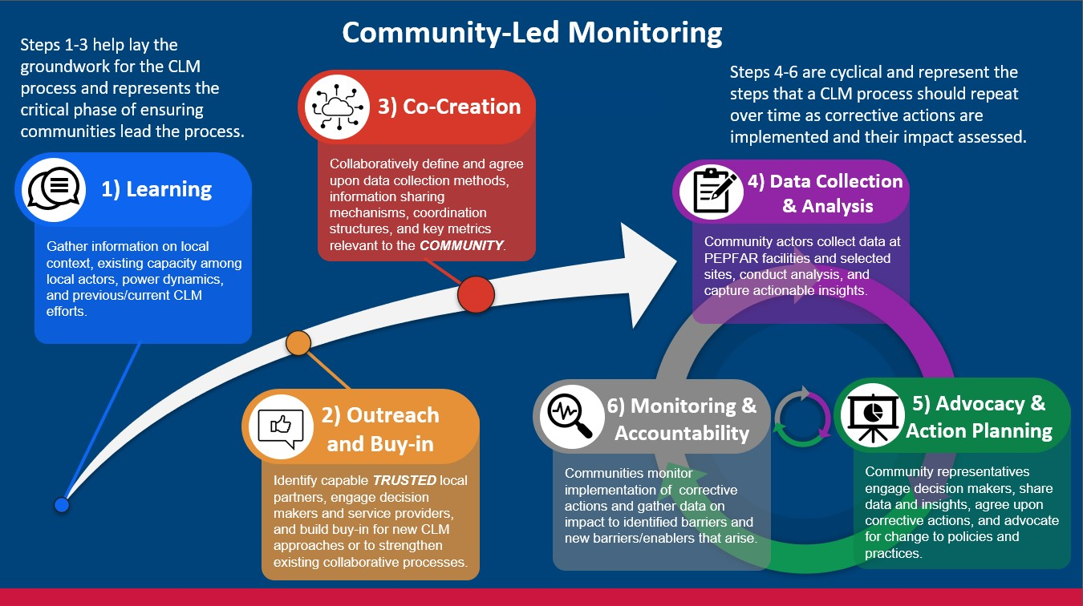
CLM is a sustainable process for program quality improvement

Slide 26
Tools for quality monitoring, accountability and action
No single data source provides the complete picture on quality and accountability of network-based testing services. Different tools provide different lenses on quality, including:
  Supportive supervision and mentoring tools for NBT services
  GBV/IPV monitoring and follow-up action tools
  Adverse event monitoring and reporting tools
  Granular site management tools
  Community-monitoring (using mystery shoppers, beneficiary interviews etc.)

Slide 27
Adverse events monitoring

Slide 28

Poll Question: True or False?
All facilities and organizations offering network-based testing services should have an adverse event and monitoring system in place.
TRUE

Slide 29

What is an adverse event?
Adverse Event = an incident that results in harm to the client or others because:
    they participated in network-based testing services OR
    they were offered network-based testing services and declined to accept them
Harm includes: any intended or unintended physical, economic, emotional or psychosocial injury or hurt from:
    one person to another,
    a person to themselves,
    or an institution (like a clinic or health facility) to a person

Slide 30
Adverse events may result if programs do not comply with the minimum standards
An adverse event may be more likely to result when index testing programs are non-compliant with the minimum standards for safe and ethical index testing services
Minimum Standards
Adherence to the 5 Cs
Conduct an intimate partner risk assessment prior to conducting partner services
Implement an adverse event monitoring and reporting system
Providers trained and supervised on network-based testing procedures
Conduct quality assurance and quality improvement processes
High quality network-based testing program that is safe for index clients and their contacts
Compliant with standards
Network-based testing clients and their contacts are at risk of experiencing an adverse event
Non-compliant with standards

Slide 31
Examples of adverse events that may result from non-compliance with one or more of the minimum standards
Example of an Adverse Event | Consent | Confidentiality | Counseling | Connection | IPV Risk Assessment
Threats or occurrences of harm (physical, sexual, emotional) |  | ✔ |  |  | ✔
Withholding of other services because index testing was declined | ✔ |  | ✔ | ✔
Unauthorized/coerced disclosure of index client’s or contact’s information (including with criminal justice system) | ✔ | ✔
Contacting child protective services without first informing child of mandated reporter status | ✔ | ✔
Abandonment or forced removal from the home |  | ✔ | ✔ | ✔ | ✔
Contacting partners or family members of the index client directly without first obtaining consent | ✔ | ✔
Stigmatizing or discriminatory treatment from a provider |  |  | ✔

Slide 32

Remember: network-based testing services should always be voluntary
One of the most common adverse events reported by clients is feeling pressured or coerced into accepting network-based testing services
This pressure can damage the relationship between the healthcare provider and the client and may cause the client to disengage from ART services
Flag sites with unusually high network-based testing acceptance rates (>90%) for a supportive supervision visit to ensure that network-based testing is being offered as a voluntary service
Consider community-led monitoring as another method for ensuring network-based testing services remain voluntary
Take any corrective actions needed

Slide 33


Which staff are responsible for monitoring adverse events associated with network-based testing services?
All staff who are involved in providing network-based testing services are responsible for monitoring and responding to any adverse events associated with network-based testing services

Slide 34

What are the components of an adverse event monitoring system?
Guiding principles for adverse event monitoring
There is no such thing as zero risk. Even if implementation of network-based testing services follows all minimum standards and procedures, there will always be the potential for adverse events.
AE monitoring systems should be led at the country level.
Whenever possible, adverse event monitoring and reporting for network-based testing services should be embedded into existing systems.

Slide 35
What is included in an adverse event monitoring system?
Adverse Event Monitoring System
Site Level Monitoring
Client Feedback Mechanisms
Community Led Monitoring

Slide 36


How do we conduct site level monitoring?
Facilities/sites should routinely ask index clients if they experienced any adverse events following participation in network-based testing services
  Suggested question, “In the time since you participated in network-based testing services, did you experience any harm from your partner, health care provider, or anyone else at this facility [or site] due to your participation in these services? This includes physical, emotional, sexual, or economic harm?”
This follow up can be done during the client’s next appointment OR through follow-up call or visit 4-6 weeks after network-based testing services have been offered.

Slide 37
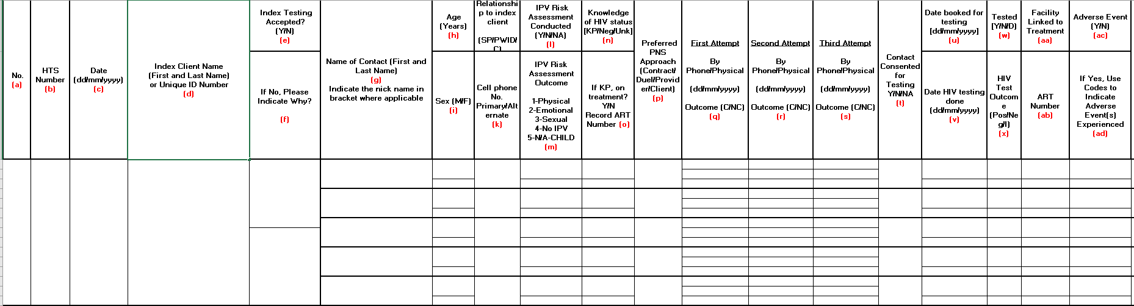
Example from Uganda: monitoring AEs in the NBT register
NBT register has an IPV Risk assessment section for each named contact
Information is used to track number of contacts with IPV risk concerns and number and type of adverse events associated with NBT services

Slide 38
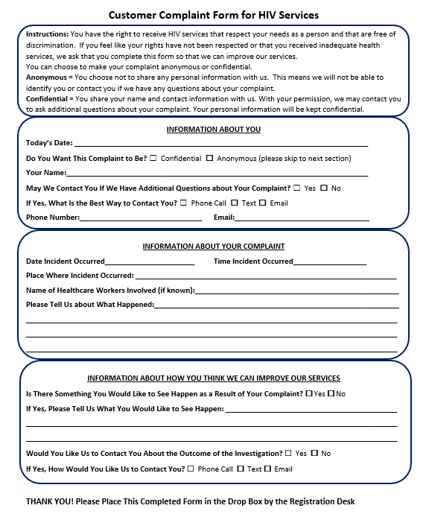
Establish mechanisms for client feedback
Clients should be provided multiple pathways for issuing concerns or complaints regarding network-based testing, including:
  Suggestion boxes within health facilities
  Hotlines
  Online submissions through websites/apps
  Client surveys
  Verbal reports for illiterate clients
Providers should also be able to use the anonymous options provided to clients.

Slide 39

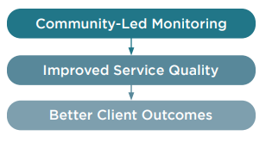
Community-led monitoring
Community-Led Monitoring (CLM): Whenever possible, programmes should work with CSOs and community networks to monitor network-based testing services to ensure they meet the needs of clients and to identify any adverse events that may be occurring (e.g., coercion, lack of consent, etc.)
Community Advisory Boards (CAB): made up of community leaders and clients, can act as a liaison between the community and facility. These CABs can make an adverse event complaint on the client’s behalf if the client does not feel comfortable making the complaint alone or prefers to make an anonymous complaint
Source: https://www.unaids.org/sites/default/files/media_asset/establishing-community-led-monitoring-hiv-services_en.pdf

Slide 40






Clients who experience adverse events should be linked to appropriate services
Medical Support
Psychosocial Support and Counseling
Legal Support
Intimate Partner Violence Services
Social Support

Slide 41
Poll Question: True or False?
Poll Question: A comprehensive adverse event monitoring system includes which components?
Select the best answer:
Client feedback
Community-led monitoring
Site level monitoring
A and C
All of the above

Slide 42
How should adverse events be documented and reported?
All adverse events should be documented (including those reported anonymously).
Follow-up steps and actions, including a remediation plan, should be developed to prevent similar adverse events from occurring in the future.
If an adverse event is determined to be a result of a provider’s failure to abide by the minimum standards for network-based testing, he or she should immediately stop offering services until remedial actions can occur.
The occurrence of adverse events, including the type and frequency, should be reported at least quarterly to the relevant stakeholders, which may include Ministry of Health, and country Agency teams, etc.
Use adverse event monitoring systems for quality improvement purposes:
    For example, high rates of IPV disclosure could indicate the need for more social workers/mental health professionals or other GBV-response services.

Slide 43
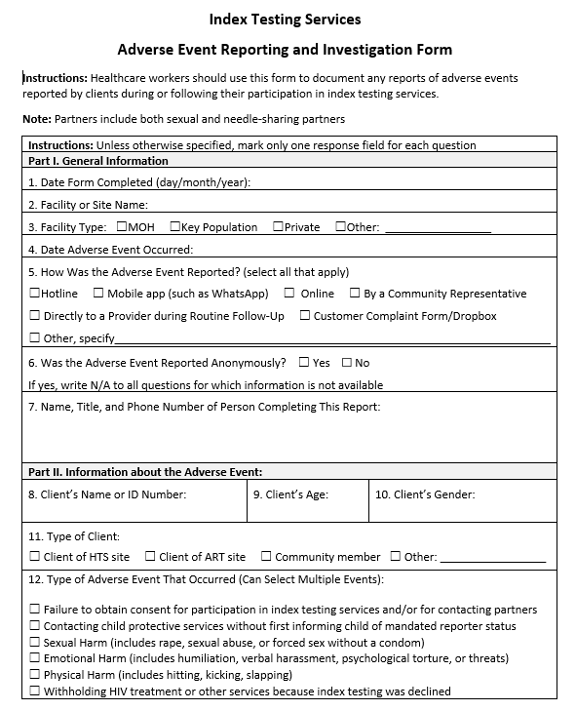
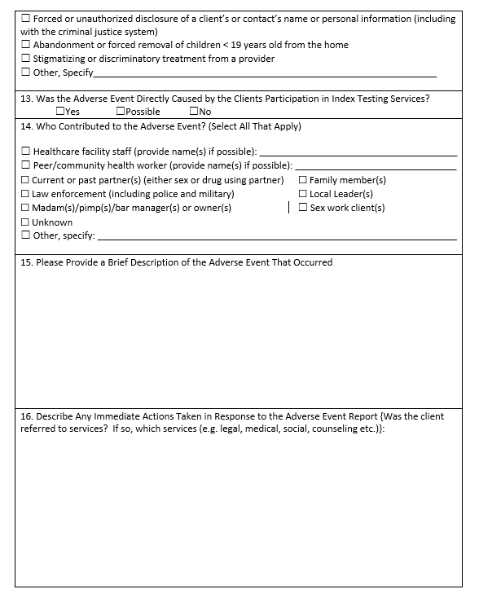
Example of an NBT services AE reporting form

Slide 44

Example of an NBT services AE reporting form
What Are Your Thoughts?
What questions would you delete?
What questions would you change? How would you change these questions?
What questions would you add to the form?

Slide 45

Activity: think, pair, share
What systems for adverse event monitoring does your country or program already have?
How can these systems be adapted to include network-based testing services?
How can we ensure that clients have opportunities to report adverse events anonymously or through community representatives?

