Slide 1
Network-based testing toolkit training modules
Module 8: Network-based testing and prevention

Slide 2
Why is this important?
Network-based testing gives us an opportunity to engage persons at high risk for HIV, hepatitis B, hepatitis C, and/or other STIs
Partners/contacts of people living with HIV or HBV
Key populations at elevated risk
People who have had exposures and may have future exposures
Using a “status neutral” approach we can ensure that all network-based testing contacts are given appropriate referrals

Slide 3
Learning objectives
By the end of the module, participants will be able to:
Identify different prevention modalities that may be appropriate for offering to individuals contacted through network-based testing
Reinforce the importance of condoms and lubricants for preventing HIV, other STIs, and pregnancy
Describe harm reduction and its importance in prevention for HIV, hepatitis B and hepatitis C
Describe what pre-exposure prophylaxis (PrEP) for HIV is and the difference between HIV PrEP, PEP, and ART treatment.
Understand what clients are eligible for PrEP and population-specific guidance
Describe eligibility and requirements for hepatitis B vaccination

Slide 4
Prevention options for network-based testing
HIV
Hepatitis B & C
Other STIs
Condoms & lubricants
Substance abuse & mental health care
Treatment as prevention
Harm reduction, including NSP and OAMT for PWID
All subject to local guidelines and eligibility
PrEP
PEP
VMMC
Hepatitis B vaccination
Expedited partner treatment

Slide 5
Condoms and lubricants

Slide 6
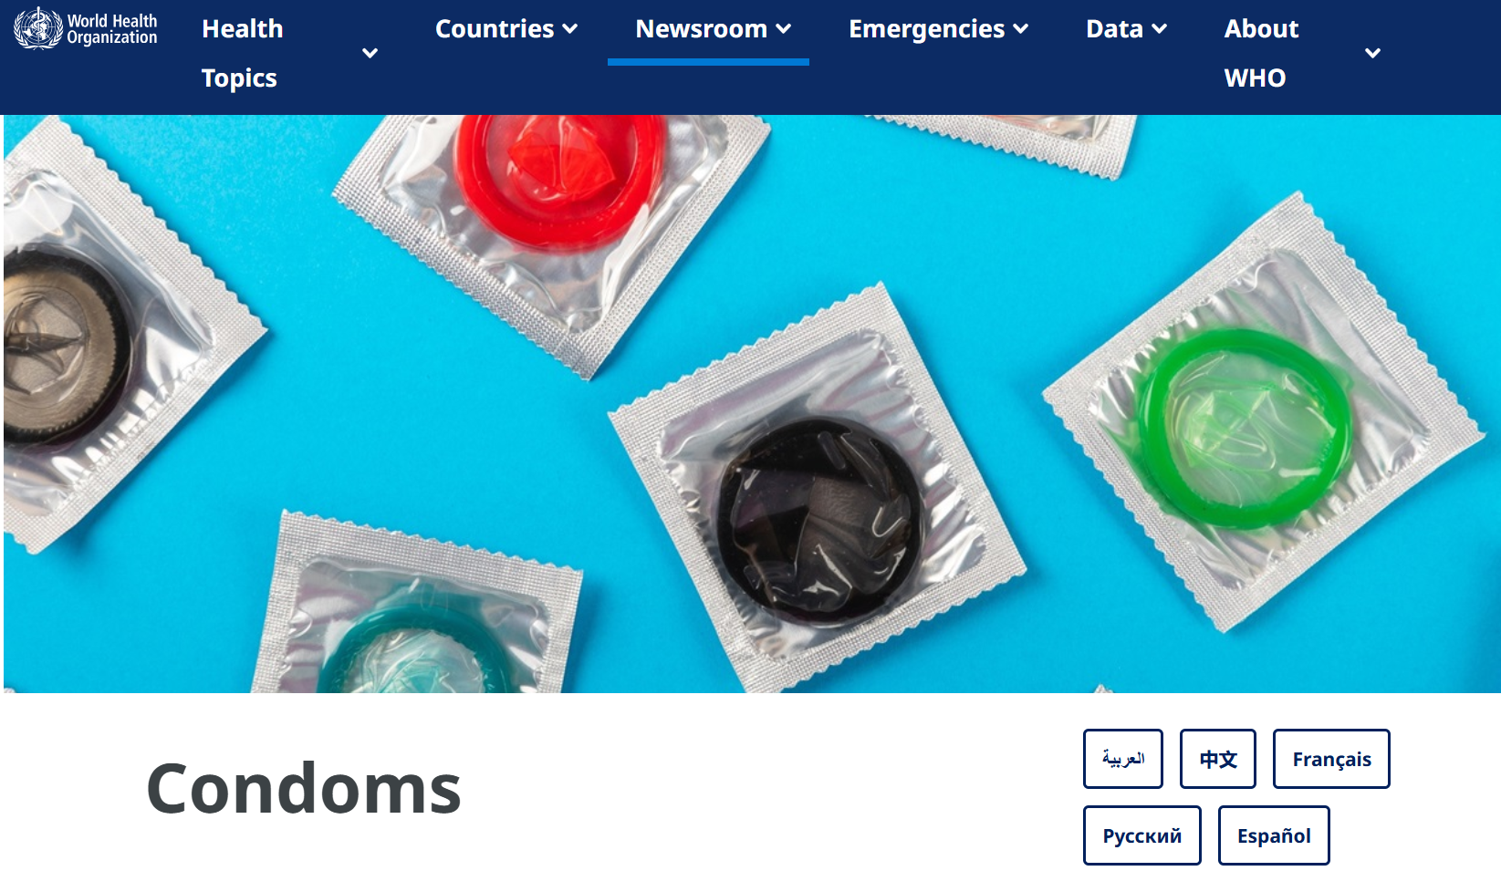
The importance of condoms
Condoms remain the only option that prevents HIV, other STIs, and pregnancy
When used effectively and consistently, male condoms are 98% effective and female condoms are 95% effective at preventing pregnancy
Condoms are listed as a WHO Essential Medicine
https://www.who.int/news-room/fact-sheets/detail/condoms
Lubricants increase both effectiveness and pleasure. Water- or silicone- based lubricants are recommended for use with condoms

Slide 7
Condoms and lubricants within NBT services
Condoms should be offered to anyone reached through network-based testing, aside from biological children and household contacts
Consider condom distribution through social network testing services, partner services, and self-test distribution
https://www.who.int/news-room/fact-sheets/detail/condoms

Slide 8
Harm reduction

Slide 9
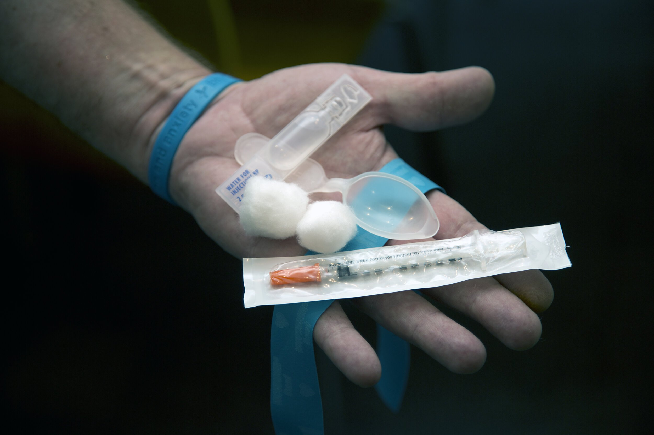
Harm reduction
Harm reduction encompasses policies and strategies aimed at minimizing the negative health, social, and legal impacts associated with drug use, drug policies, and drug laws.
Harm reduction includes:
  Needle and syringe distribution
  Opioid agonist maintenance therapy (OAMT)
  Overdose prevention, including naloxone
  Prevention, testing & treatment for HIV, other STIs, and hepatitis B & C
  Condoms & lubricants

Slide 10
Harm reduction and NBT services
Linkages and referrals to harm reduction services should be offered to those reached through NBT services among people who use drugs (PWUD) or people who inject drugs (PWID)
Testing packages within these populations may also include testing for HIV, hepatitis C and hepatitis B, depending on local epidemiology

Slide 11
Pre-exposure prophylaxis (PrEP) and post-exposure prophylaxis (PEP) for HIV

Slide 12
Pre-exposure prophylaxis (PrEP)
PrEP is the use of ARV drugs by HIV-uninfected persons to prevent the acquisition of HIV before exposure to HIV.
Pre
Exposure
Activity that can lead to HIV infection
Prophylaxis
Prevention
Before

Slide 13
Post-exposure prophylaxis (PEP)
PEP is the use of ARV drugs by HIV-uninfected persons to prevent the acquisition of HIV after they have had a recent (within 72 hours) exposure to HIV.
Post
Exposure
Exposure that can lead to HIV infection
Prophylaxis
Prevention
After

Slide 14
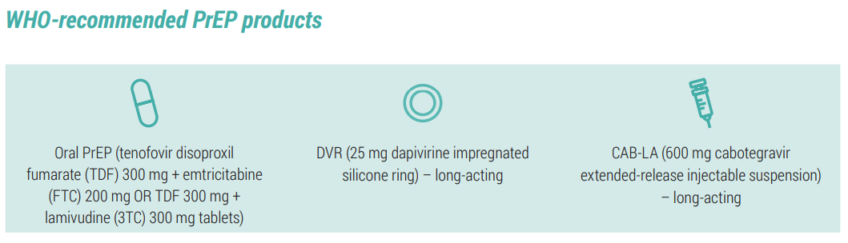
Pre-exposure prophylaxis options
https://iris.who.int/bitstream/handle/10665/378164/9789240097230-eng.pdf?sequence=1

Slide 15
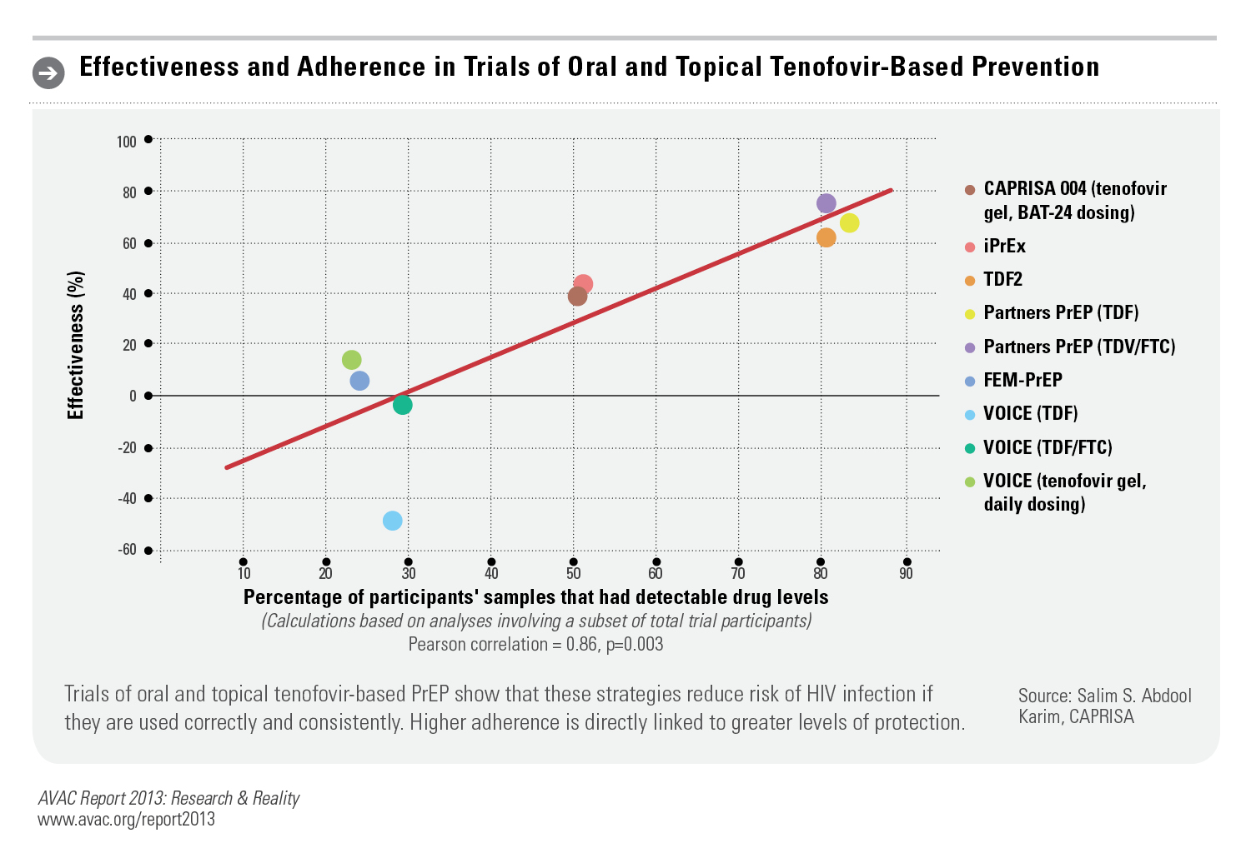
PrEP effectiveness is strongly related to adherence

Slide 16
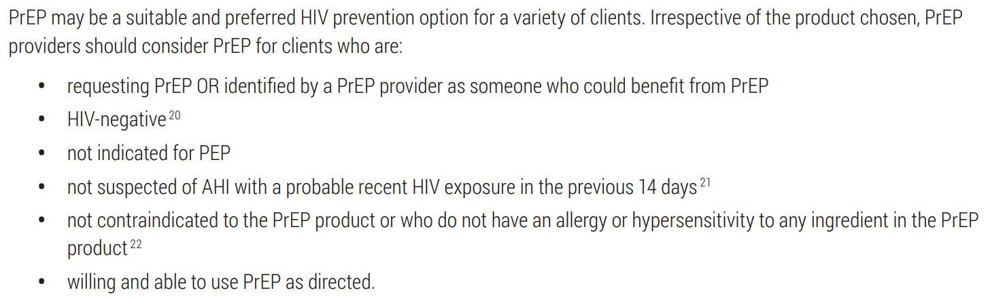
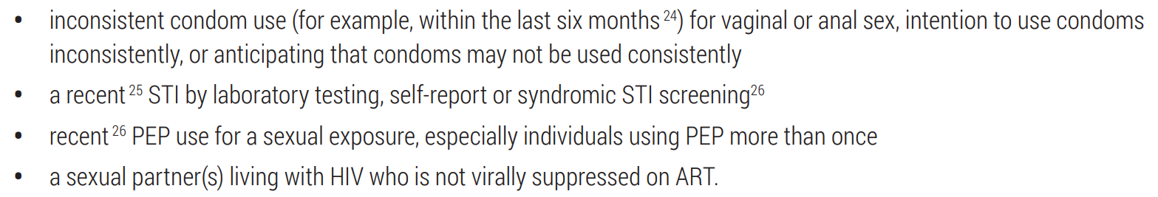
Who should be offered PrEP?
PrEP may benefit people with:

Slide 17

Features of the recommendation
Enabling for all individuals at risk for HIV acquisition
  Not population specific
  For people at substantial HIV risk, which can be determined on an individual basis. People requesting PrEP should be considered at substantial risk.
An additional prevention choice within combination prevention
  Condoms and lubricants
  Harm reduction, including needle syringe programs and opioid agonist
  maintenance therapy (OAMT)
  HIV testing and linkage to ART
Provide PrEP with comprehensive support
  Adherence counselling
  Legal and social support
  Mental health and emotional support
  Contraception and reproductive health services

Slide 18
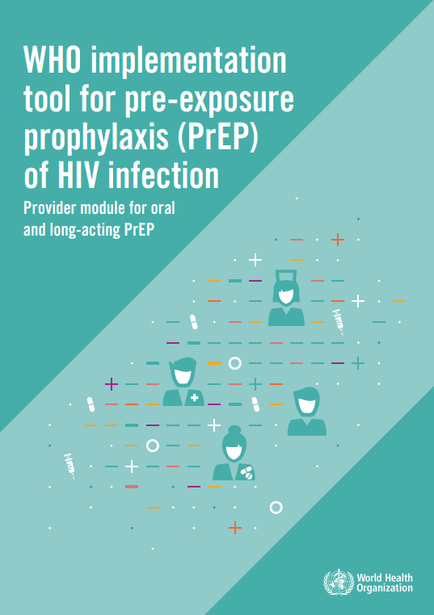
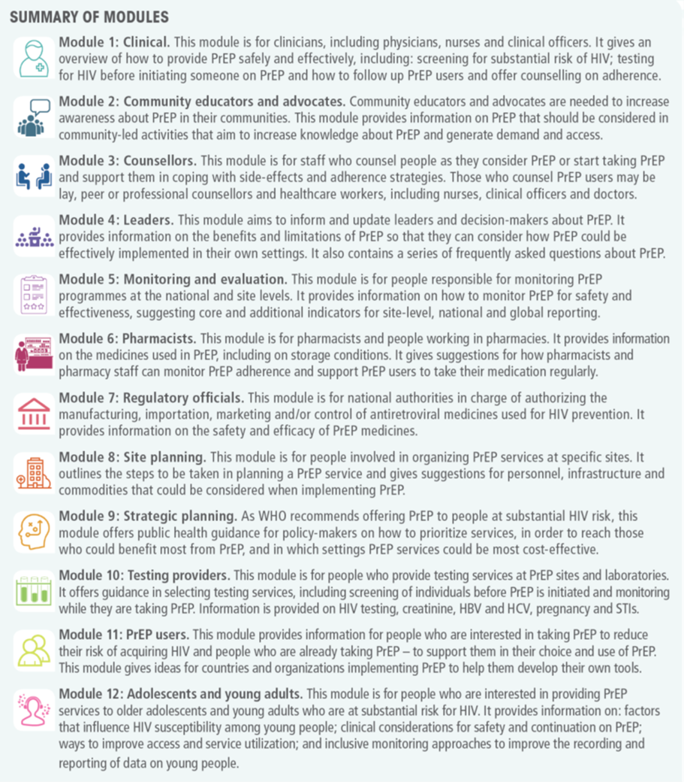
WHO guidance on PrEP implementation
https://www.who.int/tools/prep-implementation-tool#modules

Slide 19
Comparing PrEP and PEP
What is the Same?
PrEP & PEP Used by persons who are HIV-negative Uses ARVs to prevent HIV acquisition May be available in a variety of settings (clinics, pharmacies, drop-in-centres) Very effective when taken correctly and consistently
What's Different?
PrEP | PEP
Started BEFORE potential exposure to HIV | Taken AFTER potential exposure to HIV
Taken for as long as HIV risk exists (different schedules exist) | Taken for 28 days following exposure, then stopped

Slide 20
Differences between HIV treatment and PrEP
HIV treatment requires adherence to life-long therapy with consistent, fully-suppressive dosing.
PrEP is needed during periods of high HIV risk.
Both ART and PrEP require optimal adherence.
  Individuals using PrEP require ongoing risk assessment and PrEP can be discontinued if they:
    are no longer at substantial risk for HIV infection.
    decide to use other effective prevention methods.
    acquire HIV infection.
Motivation for adherence is different: ART is taken by persons living with HIV to remain healthy and prevent onward transmission, while PrEP is used by persons without HIV to prevent acquisition of infection.

Slide 21

Oral daily use PrEP
HIV prevention strategy where antiretroviral drugs are used prior to potential exposure to reduce the risk of infection
Currently approved medication regimens are once-daily combinations of 2 antiretroviral drugs:
tenofovir disoproxyl fumarate (TDF) + emtricitabine (FTC)
  Fixed-dose, available widely
tenofovir disoproxyl fumarate (TDF) + Lamuvidine (3TC)
  Two separate pills

Slide 22
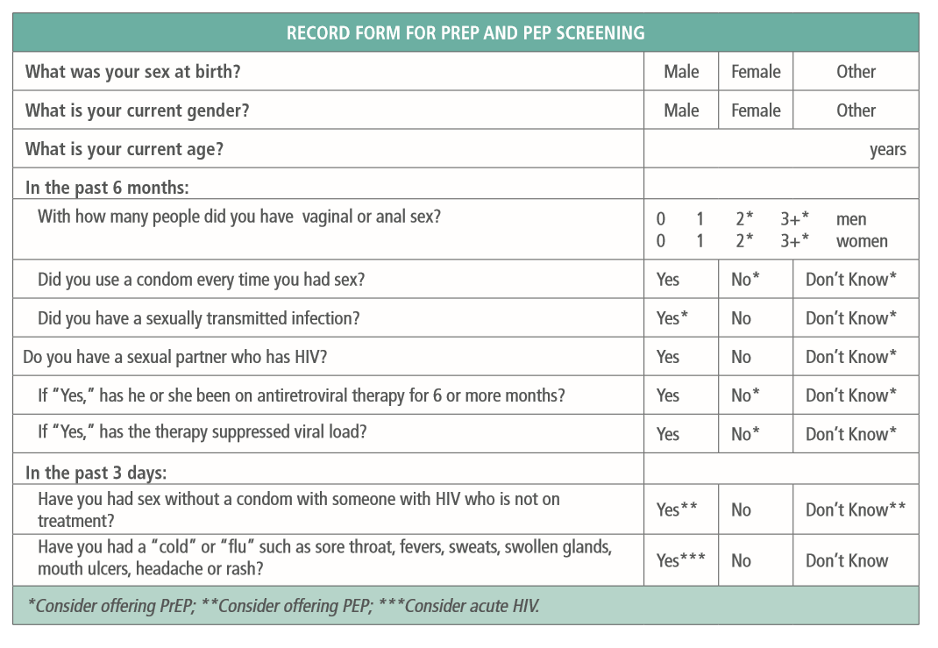

Other PrEP modalities
New, more convenient, methods of taking PrEP are becoming available
  The dapivirine ring
    Designed for women to discreetly use
    No daily pills to take, no pill bottles to be found
    Inserted into the vagina and replaced monthly (with a 3 month version under development)
    WHO approved
  Long acting injectable PrEP
    Injectable prevention options (CAB-LA and LEN)
    No pills to take, no pill bottles to be found
    Approved by US FDA, and WHO (CAB-LA)

Slide 23
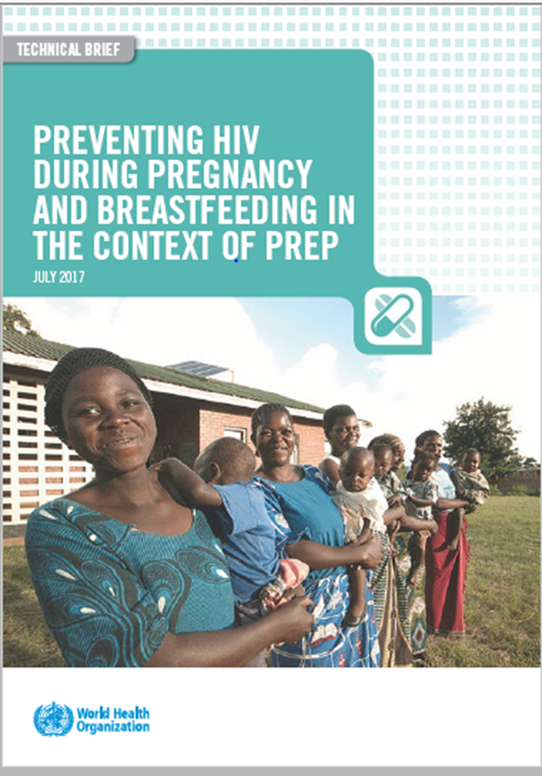
PrEP in pregnancy and breastfeeding
Pregnancy and the postpartum period are associated with a higher risk of acquiring HIV
HIV acquired during pregnancy or breastfeeding can increase the risk of HIV acquisition for the fetus or infant, respectively
Exposure to oral PrEP in the first trimester is not associated with adverse pregnancy or infant outcomes
Contraceptive services and links to antenatal care should be available when providing PrEP services to women
The risks and benefits of continuing to use oral PrEP in pregnancy and during breastfeeding should be discussed with each client

Slide 24
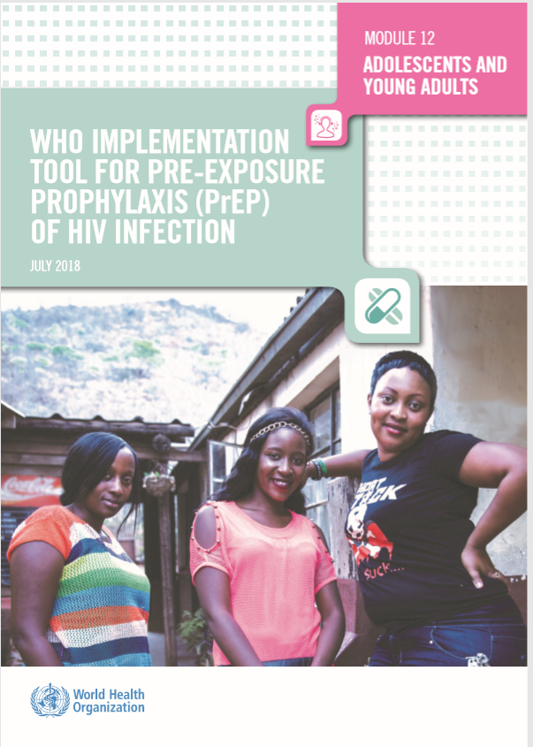
PrEP among adolescents: key messages
Many youth struggle to take a pill daily and may be able to benefit from other PrEP options such as dapavirine or injectable long acting PrEP
Adolescents and young adults (<24 years old) may benefit from additional monitoring and adherence support
More frequent clinic visits or other approaches, to address their changing routines and multiple needs should be considered
Counselling should be grounded in supportive, adolescent-centred language without judgement
Ensure that STI screening and counseling about contraception options are available for adolescents on PrEP.

Slide 25
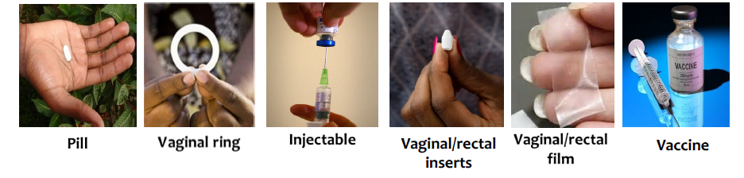
PrEP is not one size fits all
Tenofovir containing pills are not for everyone
There are many new prevention products that could offer additional options
No single option will work for every persons
Choice is important to meet diverse needs

Slide 26

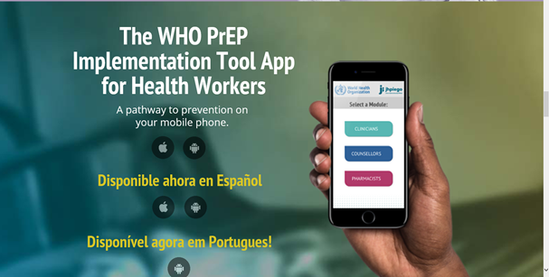
Resources
WHO: http://www.who.int/hiv/topics/prep/en/
WHO: http://www.who.int/hiv/pub/prep/prep-implementation-tool/en/
WHO: https://apps.who.int/iris/bitstream/handle/10665/325955/WHO-CDS-HIV-19.8-eng.pdf?ua=1
WHO: https://www.who.int/publications/i/item/9789240053694
ICAP: http://icap.columbia.edu/resources/PrEP-kit
PrEPWatch: https://www.prepwatch.org/
PrEPFacts: https://men.prepfacts.org/the-basics/
Clinical options: https://clinicaloptions.com/hiv
JHPIEGO: https://www.hivoralprep.org/

Slide 27
Voluntary medical male circumcision (VMMC)

Slide 28
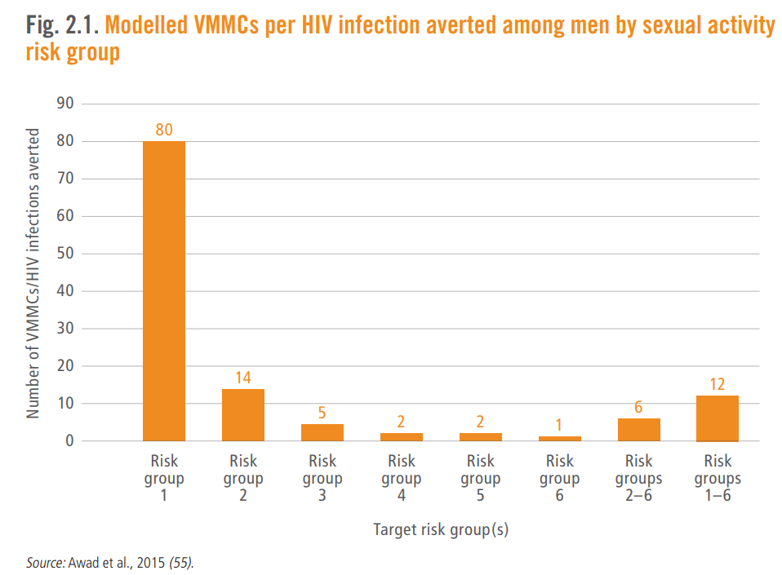
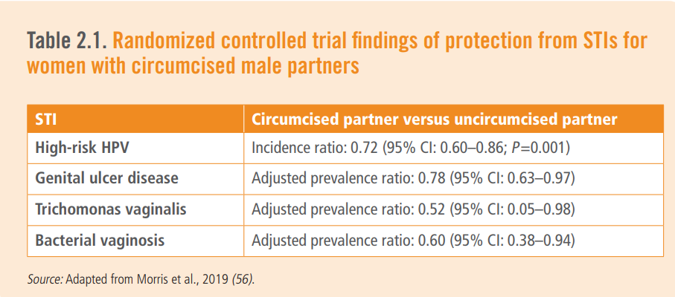
WHO Recommendation
6-12 voluntary medical male circumcisions modeled to avert 1 HIV infection
VMMC also protects against many other STIs
https://www.who.int/publications/i/item/978-92-4-000854-0

Slide 29
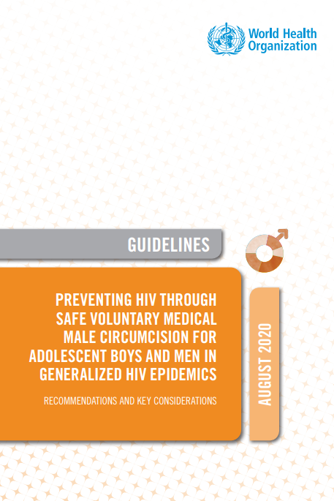
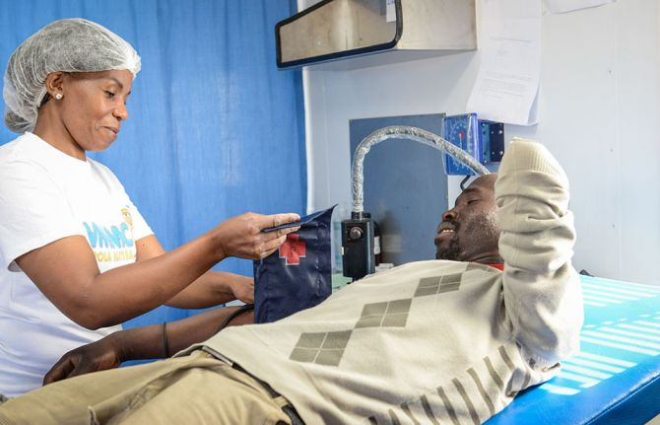
WHO Recommendation
WHO recommends offering voluntary medical male circumcision (VMMC) within combination prevention for adolescents aged 15 years and older and adult men in settings of high HIV prevalence
https://www.who.int/publications/i/item/978-92-4-000854-0

Slide 30
Hepatitis B vaccination

Slide 31
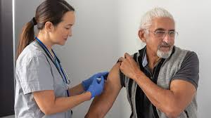
Hepatitis B vaccination
WHO recommends adult Hepatitis B vaccination for the following groups after negative HBsAg test:
Sexual partners of HBV index clients, including spouses
First-degree relatives (children, siblings, parents) of HBV index clients
Any other person living in the household of an HBV index client
Male partners of pregnant women
https://iris.who.int/bitstream/handle/10665/255841/WER9227.pdf?sequence=1

Slide 32
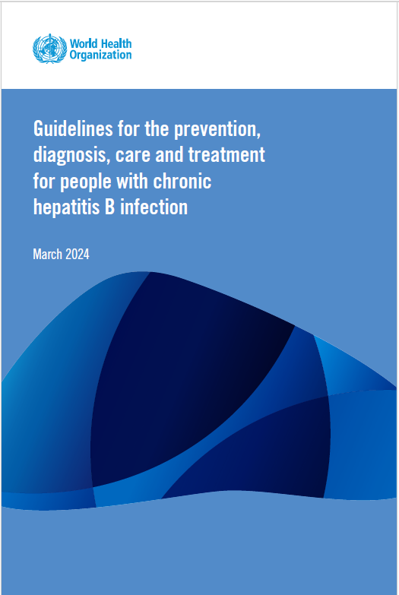
Who is eligible for hepatitis B vaccination?
Adults at significant risk (including partners and household contacts of HBV index clients)
AND
Negative for active HBV infection (HBsAg negative)
AND
No documented or definitive previous vaccination or immunity
https://www.who.int/publications/i/item/9789240090903

