Slide 1
Network-Based Testing Toolkit
Training Modules
Module 7: Network-based testing for key, vulnerable, and priority populations

Slide 2




Learning objectives
By the end of this module, participants will be able to:
  Define key, vulnerable, and priority populations, and
  Describe considerations and best practices for offering network-based testing services to members of key, vulnerable, and priority populations and their contacts.
Source: Getty Images
Source: UNAIDS
Source: Frank Leonhardt/picture-alliance

Slide 3
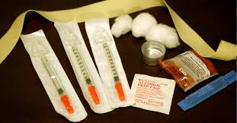


Who are key populations?
Key Populations Include:
  Men who have sex with men (MSM)
  People who sell sex (SW)
  People who inject drugs (PWID)
  Trans and gender diverse people (TG)
  People in prison or other closed settings
Priority and Vulnerable Populations Include:
  Adolescents, children, and infants
  Women & pregnant women
  People who use drugs (other than injecting)
  Other at-risk groups, depending on setting
Photo credits: (clockwise from top) istock, Bikas Das/AP, Getty Images, Jacob Lund/Shutterstock.com, Todd Huffman/Flickr

Slide 4
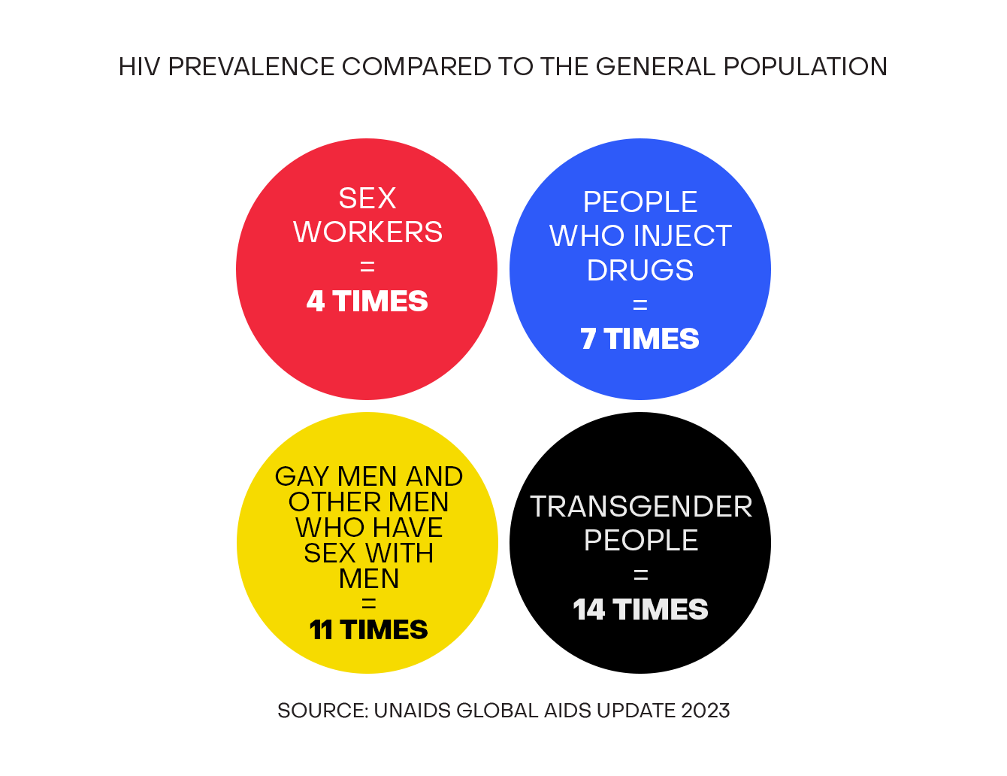
Characteristics of key, vulnerable, and priority populations (KVP)
Disproportionately affected by HIV and other sexually transmitted infections
Engage in behaviors that:
      Increase risk for HIV/STI acquisition and transmission
      Sharing of injection equipment
      Other drug use, such as "chemsex"
      Unprotected, condomless vaginal and/or anal sex
      Multiple sex partners
Are often marginalized, criminalized, and experience limited access to health, education, employment, and others
Experience stigma, discrimination, and violence based on gender identity, sexual orientation, and behaviors
Source: Global Fund. Key Populations Fact Sheet

Slide 5


Where should network-based testing for KVP be offered?
NBT services can be offered at many entry points:
  As part of provider- or community-based HTS
  All public health facility service delivery points
  All KP-specific clinical service delivery points
  ANC clinics
  Adolescent or youth-friendly services
  Outreach services
  Private sector, including pharmacies
Testing counselors in both public health facilities and KP-specific clinics should offer network-based testing services
Sites must first meet the requirements for safe and ethical network-based testing

Slide 6

KP consideration 1: Preparing KP clients for NBT services
Confidentiality
Emphasize that partner elicitation is voluntary
Emphasize protection of KP identity/information by facility staff
Screen
KP identification helps clinicians to provide better care to KP
Knowing KP “status” helps service providers know what types of partners to elicit (e.g., needle-sharing contacts)
Educate
Use KP-competent posters, notices/alerts on virtual platforms, or other materials that advertise the options for partner services and social network testing
Communication
Consider developing a list of common slang/colloquial terms
  Engage with KPs to learn appropriate terms
  Don’t assume you know all the slang terms
  Update local terms for types of partners and behaviors as needed

Slide 7

KVP consideration 2: Legal and social risks
Service providers must be aware of the legal environment where they operate and how KVP may be adversely impacted from disclosure of their KVP “status”
Screen for intimate partner violence (IPV)
  Ensure linkage to services (e.g., legal, psychological, social support, etc.), as needed
  See module 5 for more information on how to conduct the IPV risk assessment
Each site should have a process for beneficiaries to anonymously report any adverse events or other risks experienced as a result of their participation in network-based testing services
  Anonymous and accessible feedback box or other platforms
Be aware of legal reporting mandates and other important considerations when working with adolescents

Slide 8
KVP consideration 3: Partner elicitation
Use inclusive language when eliciting information about partners
  “Now I would like to ask you about all of the people you’ve had sex with over the past 3 years, regardless of your relationship with them”
Ensure that MSM and TG clients are asked about all sexual partners and any children <19 years of age
All KVP index clients should be asked about injection and drug use partners
PWID clients should be asked about sexual partners
Transactional sex
Male-male sexual activities
Injection drug use

Slide 9
KP consideration 4: Eliciting the children of KPs
Network-based testing counselors should elicit information on all biological children (< 19 years) of KVP individuals
  For awareness: anecdotal evidence indicates that children of FSW are sometimes left in the care of a family member who may live in a different town. Special approaches may be needed to provide testing services to these children
Ensure that all biological children of index KVPs are linked with service providers for vulnerable children, if appropriate and available
A strong referral and treatment service linkage system should be in place when actively eliciting biological children of KVPs. Services can be co-located within a trusted KVP-competent community space or within an established network of health facilities that have undergone KP sensitization trainings
While SW are more likely to have children, please ensure that MSM, TG women, and PWID are asked about biological children

Slide 10
KVP consideration 5: Confidentiality must be preserved and anonymity maintained
  Service providers must emphasize to KVP that their personal identity and other information will be kept strictly confidential and protected
  When shared confidentiality occurs between service providers, only information necessary to trace and test the contact should be shared. No information about the index client should be shared to avoid potential breeches in confidentiality
  Use unique IDs and/or separate registers for listing index contacts as another way to ensure confidentiality of index clients, their contacts, and the nature of their relationship
  Healthcare workers should explore self-testing and other peer-based approaches such as social network testing when discussing network-based testing options with KVPs
    Some KVPs may not want to or be able to disclose all partners so providing extra ST kits can extend services

Slide 11
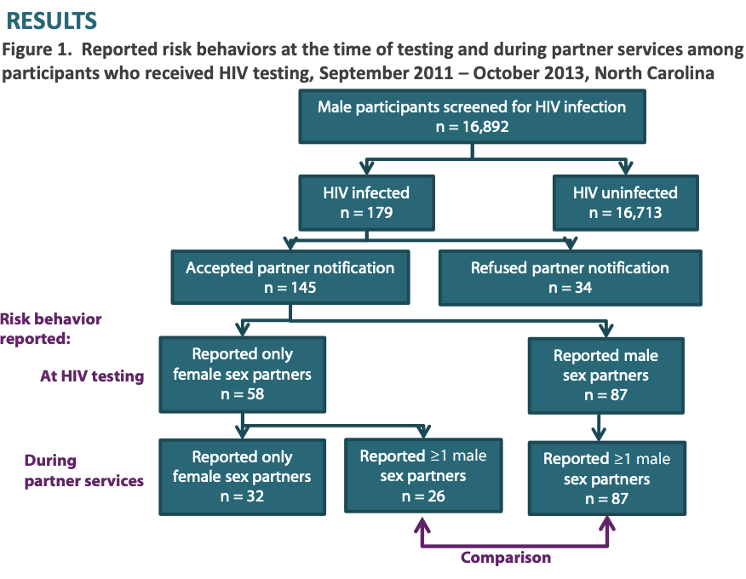
Lessons learned: MSM partner testing in the US
MSM might not disclose risk to testing providers
Large proportion of newly diagnosed males reporting female partners later disclosed male sex partners
Highlights the complexity of partner elicitation especially with KVP

Slide 12
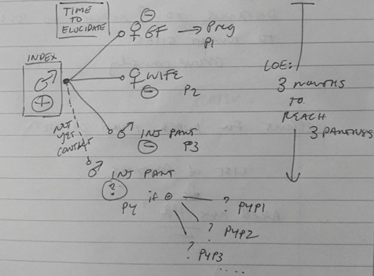
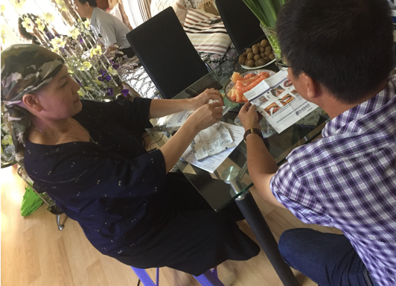
Lessons learned: Network-based testing for KVPs in Vietnam
Provide HIV self-test (HIVST) kits for secondary distribution
In particular, MSM may want to distribute kits to male partners who they may not want to name
Index clients like HIVST because it gives them an excuse to introduce the idea of testing without having to disclose
Source: CDC/Vietnam

Slide 13

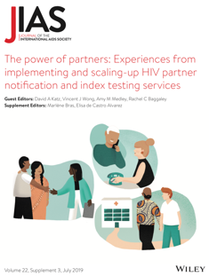
Recommendations from the KVP community
Offer network-based testing services only after informed consent is given
Do not offer partner services where socially marginalized groups are criminalized, if the risks outweigh the benefits
Engage communities in the design, implementation and evaluation of network-based testing, especially marginalized and/or criminalized populations
Community- and peer-led organization should be funded to deliver technically competent, high-quality network-based testing services, with an emphasis on the potential benefits, including linkage to prevention and treatment
Partner Notification: A community Viewpoint

Slide 14
Recommendations from the KVP community (2)
Train and sensitize healthcare providers to deliver rights-based network-based testing, with consideration for the specific needs and concerns of each key, vulnerable, and priority population
Accurately and comprehensively assess the risk for violence before offering voluntary network-based testing services
Ensure and offer counselling services, including counselling to prevent or mitigate violence
Disseminate fact-based information about voluntary network-based testing programs in partnership with communities and in tandem with community-led “know-your-rights” campaigns
JIAS Special Issue: Volume 22, S3

Slide 15
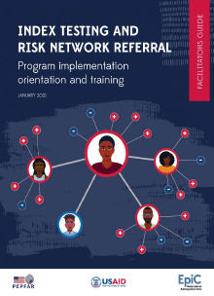
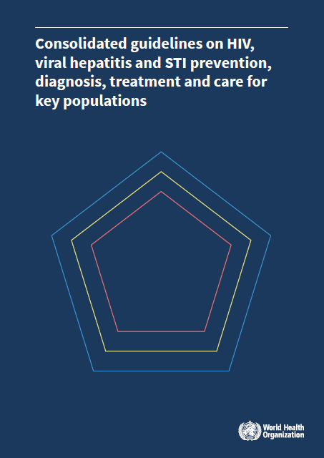

Additional KVP-specific NBT resources
FHI360 Guide to KP-specific NBT
WHO guidance on testing for key populations
WHO guidance on adolescents

Slide 16
Adolescents and network-based testing services

Slide 17
Learning objectives
By the end of this module, participants will be able to:
  Define adolescents and describe their unique needs;
  Discuss steps that providers can take to offer non-judgmental, adolescent-friendly NBT services;
  Describe additional considerations for the 10 steps of NBT services aimed at protecting the safety and security of adolescents, including recognizing when and for whom NBT services are appropriate;
  List prevention, treatment and support services that adolescents should be linked to as part of NBT services; and
  Describe special considerations for offering NBT services to adolescents who are pregnant and/or a member of a key population.

Slide 18
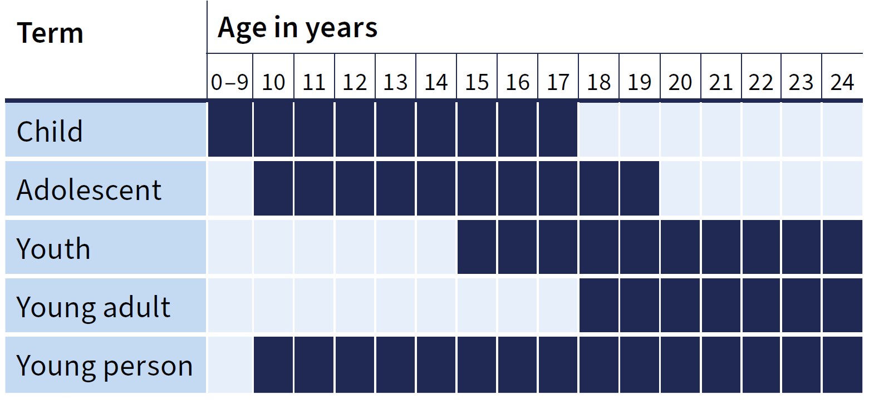
Adolescents, youth, and young people

Slide 19

Activity: When you were an adolescent
Think back to when you were an adolescent and write down your answers to these questions:
    Who were the most important people in your life?
    What were your biggest concerns?
    What risks did you take?
    What do you remember most about accessing health services?
    What health care services did you prioritize?
    Did you feel like the provider listened to your concerns?

Slide 20
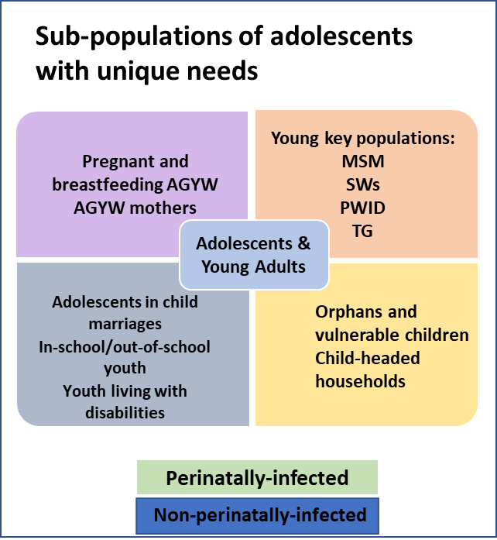

Adolescents are the same age but do not have the same needs or circumstances
One size does not fit all!

Slide 21


Example of how adolescent needs and concerns can differ within the same gender
Marie Is 15 Years Old and Pregnant
Risk: Lack of biological maturity places her at risk for complications during pregnancy Unsafe abortion May need to drop out of school HIV and STIs | Needs: Access to health services Nutritional support for her and the baby Emotional support | Strengths: Connected to antenatal services Opportunity to link to specific services
Joy Is 18 Years Old and in School
Risk: HIV and STIs Unplanned pregnancy Peer pressure and exposure to drugs/ alcohol | Needs: Access to sexual and reproductive health services Job opportunities | Strengths: Enrolled in school Age of autonomy in most contexts Goal oriented
Services listed here are an example and not exhaustive. For more complete information on adolescent needs: https://www.who.int/publications/i/item/9789240081765

Slide 22


Example of how adolescent needs and concerns can differ within the same gender
John is 15 Years Old, Heterosexual and Attends School
Risk: Peer pressure to become sexually active HIV and STIs Bullying Depression and suicide Harmful substance use | Needs: Access to condoms Access to health services Comprehensive sexual education | Strengths: - School provides setting for providing prevention and gender norms messaging
Jerry is 18 Years Old, Identifies as Gay, and Is Out of School
Risk: Sexual violence Depression and suicide Harmful tobacco, alcohol, and substance use HIV and STIs | Needs: Access to health services (PrEP) Access to condoms and lubricants Access to mental health services | Strengths: Self-identification of sexuality may make it easier for outreach and service linkage
Services listed here are an example and not exhaustive. For more complete information on adolescent needs: https://www.who.int/publications/i/item/9789240081765

Slide 23
How we can make network-based testing services more adolescent friendly: 8 global standards

Slide 24
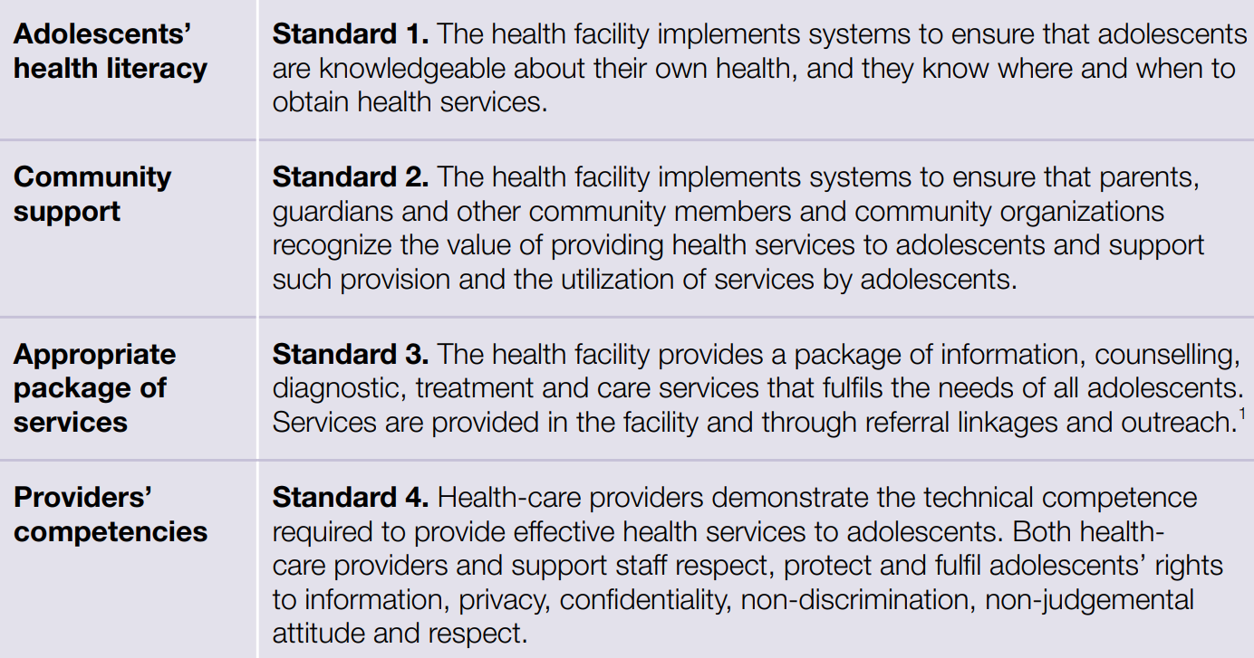

8 global standards for quality healthcare services for adolescents
https://www.who.int/publications/i/item/9789241549332

Slide 25
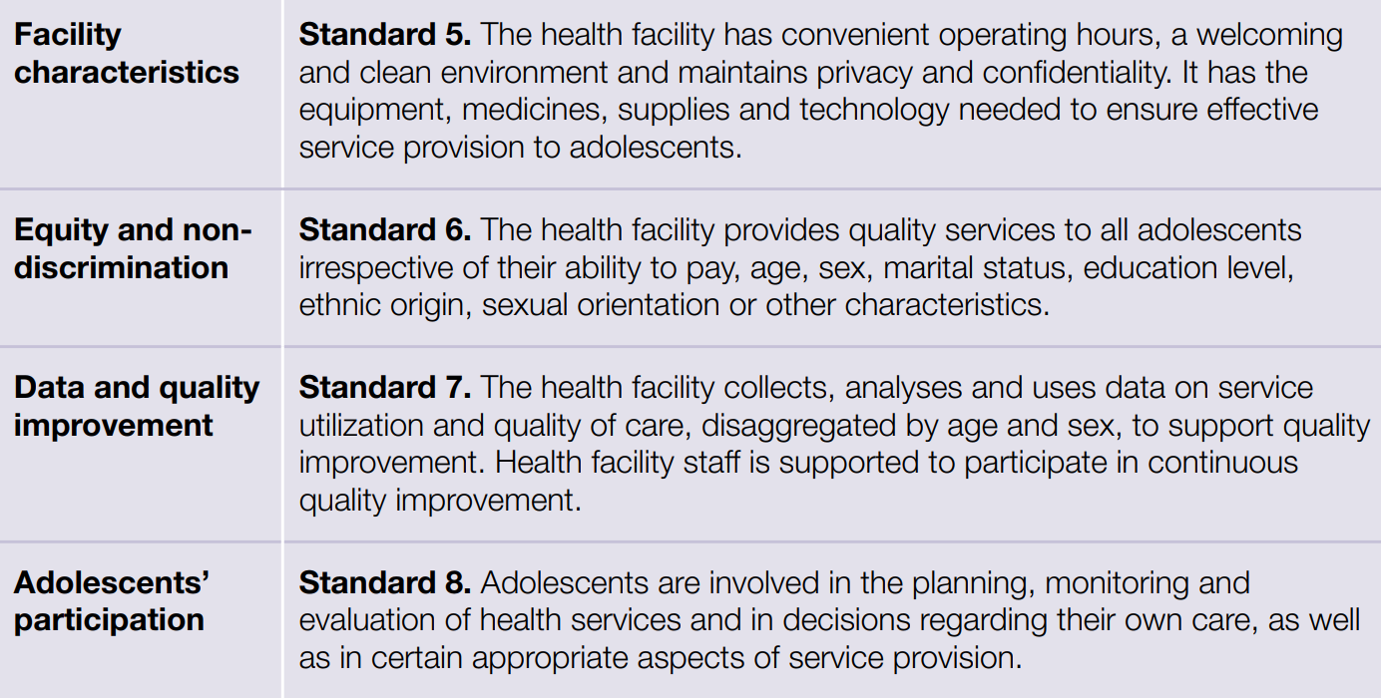
8 global standards for quality healthcare services for adolescents
https://www.who.int/publications/i/item/9789241549332

Slide 26

Stigmatizing attitudes from providers can discourage adolescents from participating in network-based testing services
To stigmatize someone: Seeing a person, including oneself, as inferior (less than or below others) because of something about him or her.
Discrimination: Treating someone unfairly or worse than others because he or she is different (for example, because a person has a sexually transmitted infection).
Stigma and discrimination can:
  have short‐ and long‐term effects on clients’ and caregivers’ psychosocial well being
  deter access to prevention, care, and treatment services
As providers, we must be aware of our implicit biases and not allow them to affect how we treat our clients.
Source: ICAP Adolescent HIV Care and Treatment: A Training Curriculum for Health Workers

Slide 27

Pause and think: Is this an example of meaningful youth engagement?
I invite a young person to attend community meetings to share how our services have benefited them. This is to encourage other young people to come receive services.
No: The young person has a limited role that has been determined by the provider
Meaningful engagement: Provider and youth work together to decide how youth will be engaged in the design, implementation, monitoring, and evaluation of safe and ethical network-based testing services

Slide 28
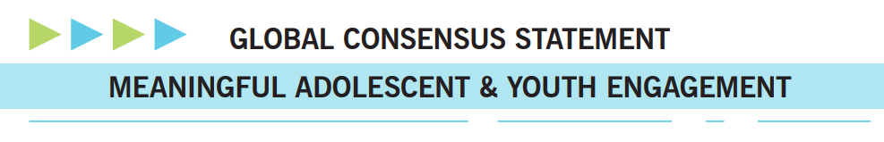
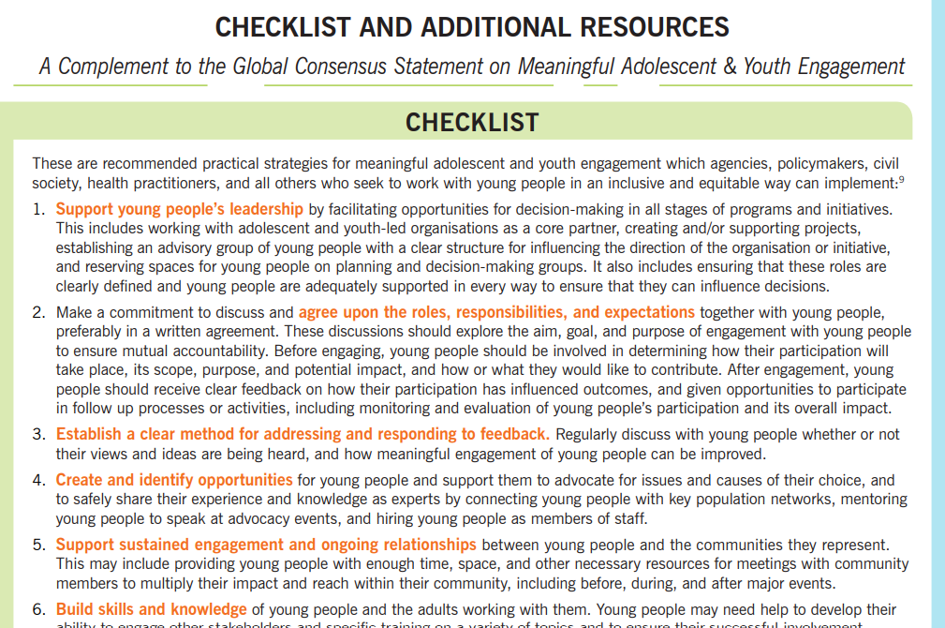
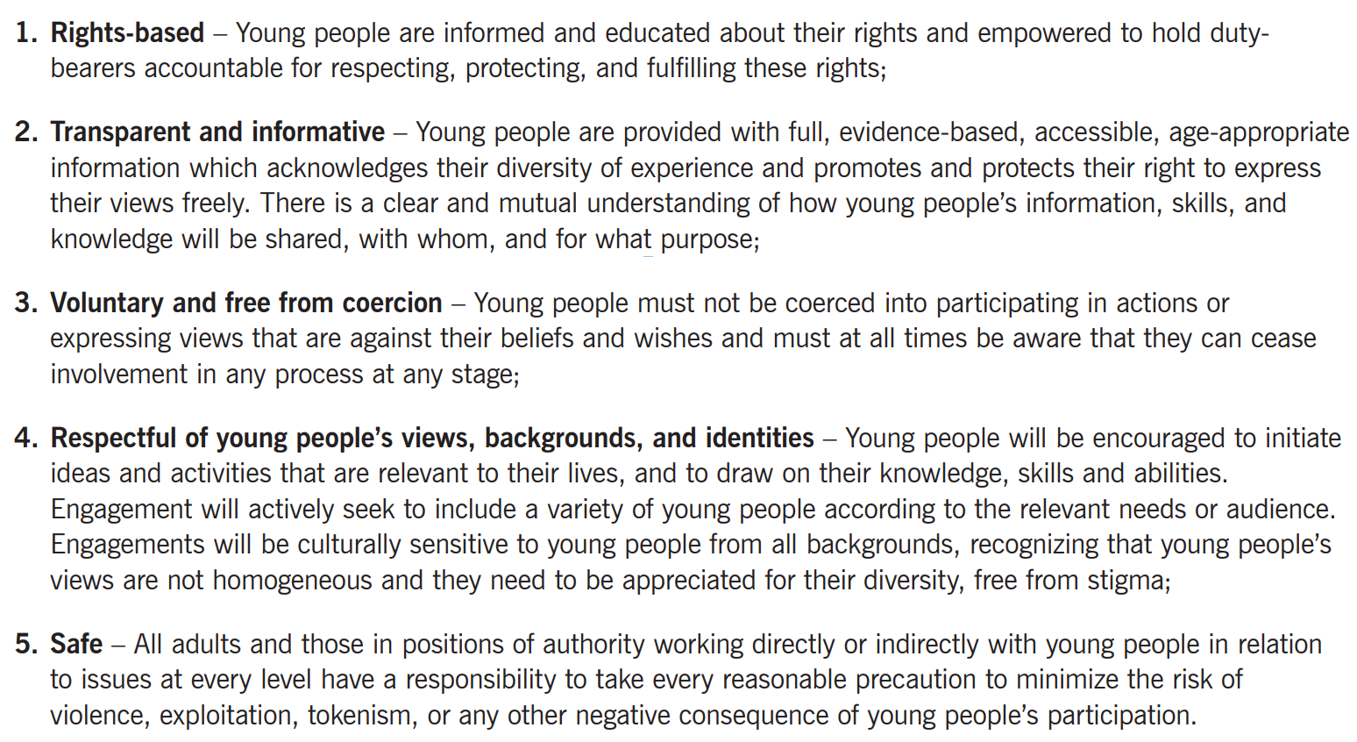
Meaningful youth & adolescent engagement
Checklist and additional resources:
https://pmnch.who.int/resources/publications/m/item/global-consensus-statement-on-meaningful-adolescent-and-youth-engagement#:~:text=This%20Statement%20seeks%20to%20galvanize%20local%20and%20global,all%20policies%2C%20programs%2C%20and%20processes%20that%20affect%20them.

Slide 29
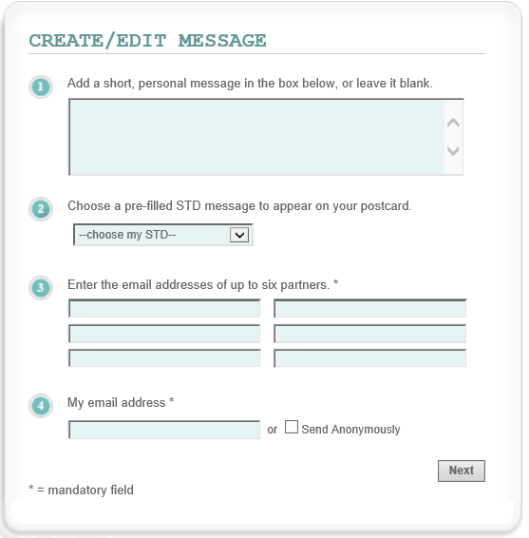
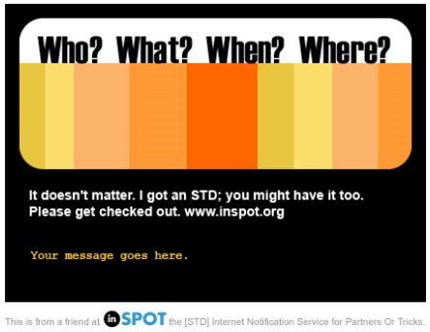
Using technology to strengthen network-based testing with adolescents
Innovative approaches for delivering and tracking distribution of self-test kits: online ordering with delivery systems, QR codes for support interpreting test results and linking to care
Phone apps that include a Health Tracker, a “Resources” tab with educational materials on concepts, and an “Ask an Expert” or “Ask a Peer” where they can get real-time support
Provision of prevention education, including the importance of testing, and mental health support through WhatsApp
Anonymous electronic notification systems to help adolescents notify their partners to seek testing
1. Index client enters information confidentially or anonymously
2. Partner receives an e-card notifying them of the need to test for HIV
Source: https://www.stdcheck.com/anonymous-notification.php
Online apps must ensure confidentiality and data protections, with protocols for patient safety, privacy, and accountability

Slide 30

Case study: Engaging youth in monitoring and improving network-based testing services
CASE STUDY
During a quarterly review of network-based testing data, your health facility finds that female adolescents (15-19 years) are the most likely to refuse network-based testing services. You also find that male adolescents (15-24 years) are among the least likely groups to come in for testing.
How could you engage youth to help address these gaps?
SOME IDEAS FOR ENGAGING YOUTH
Mentors and youth facilitators host small listening sessions and conversations with young people to understand their concerns and barriers
Your facility works with a support partner to assess your adolescent and youth health services, with young people trained and compensated as co-assessors
Young people are engaged to participate in the creation of youth-specific demand creation material (including making videos and other social media)
Young people are asked to design and monitor network-based testing services that better meet their needs
Source: Marmion, Rob, Shutterfly

Slide 31
4 additional considerations for services for adolescents

Slide 32

Consideration #1: Network-based testing with adolescents must be free of coercion
How might unequal provider-adolescent power dynamics affect an adolescent’s ability to accept or decline network-based testing services?
Adolescents are at risk for experiencing power imbalances with providers/counselors, as these individuals may represent positions of authority in their lives (both as providers and as elders/role models in their community)
Because of this imbalance, adolescents may feel pressured or obliged to accept network-based testing when offered by providers/counselors
It is imperative that non-coercive, non-judgmental, and confidential network-based testing services are offered to adolescents at risk
AND
that they understand they are free to accept or decline these services without penalty
Sources: Parmley LE et al. Journal of the International AIDS Society 2020, 23:e25595
http://onlinelibrary.wiley.com/doi/10.1002/jia2.25595/full | https://doi.org/10.1002/jia2.25595

Slide 33
Consideration #2: Inform the adolescent of any mandatory reporting requirements before conducting network-based testing services
Age of majority: In many countries, adolescents are legally considered children, because they are below the age of majority where the law recognizes their ability to make independent decisions (in most countries, the age of majority is 18 years).
Age of sexual consent: Define when a young person is legally allowed to consent to sex. The age of sexual consent differs widely between countries and may be younger than the age of majority.
Child sexual abuse and violence: any type of sexual activity that an adult engages in with a child who is under the legal age of consent (includes penetration, inappropriate touching, fondling, kissing, and non-contact abuse such as showing children their genitals or sexually explicit material).
  The concept of consensual sex is IRRELEVANT when discussing sexual activity between an adult and a child who is under the age of sexual consent, because these children are not able to consent to sexual activity.
Mandatory reporting requirements: Certain disclosures of violence and/or sexual abuse against children and adolescents must be reported. These are called mandatory reporting requirements.

Slide 34

Limits to confidentiality: Mandatory reporting requirements
Mandatory reporting requirements are defined both by what is disclosed AND to whom it is disclosed.
    If violence or abuse is disclosed to a non-covered provider than the mandatory reporting is not required.
    HIV and other testing providers need to know both what types of disclosures trigger mandatory reporting (e.g., sexual abuse? physical abuse?) and who is covered by this requirement (e.g., HIV testing counselors? community health workers? Peer educators?).
It is an organization’s job to know these policies and to give clear guidance to providers on how to comply with these requirements.
EXERCISE
    Do you know what the mandatory reporting requirements are in your country?
    What disclosures or triggers must be reported?
    Who must report? Peers? Counselors?
    Are the policies or laws available in your clinical setting?
    Can healthcare workers easily access the laws?

Slide 35

Inform the adolescent of mandatory reporting requirements
You must inform adolescents of any mandatory reporting requirements as part of the informed consent process in a way that is consistent with their age and developmental stage
Adolescents must understand what types of information will be reported, who will do the reporting, and who it will be reported to

Slide 36
Sample language on mandatory reporting requirements to adapt and add to consent forms for NBT services with adolescents
Sample Script 1
“Although most of what we talk about is between you and me, there may be some situations you might tell me about that we would have to talk about with other people. For example, if there's a problem I can’t help you with, we may need to talk to a social worker to get you the services you need. Or if I find out that you or someone else are in danger, I would have to tell [insert appropriate agency here] about it. If you tell me you have made plans to seriously hurt yourself, I would have to inform your parents or another trusted adult. If you tell me you have made a plan to seriously hurt someone else, I would have to report that. I would not be able to keep these problems just between you and me because I want to be sure that you are safe and protected.
Do you understand that it’s okay to talk about anything with me, but there are other things we must talk about with other people?"
Adapted from International Rescue Committee (2017). Caring for Child Survivors of Sexual Abuse Guidelines
Sample Script 2
“Your wellbeing and safety are important. I will be asking you questions about your sex partners and if you tell me that someone is sexually abusing you or hurting you in a sexual way, it is my duty by law to report that to [insert agency]. I will also have to report if you tell me that you plan to hurt yourself or someone else, or that you are in immediate danger. If you are in immediate danger, then I will have to tell a trained social worker [or insert other required person/organization] so we can get you help.”
[FOR ADOLESCENTS BELOW THE AGE OF SEXUAL CONSENT] “I am also required by law to report to [insert agency] if you tell me that you are having sex with someone who is 18 years or older.” Adapted from the Violence Against Children and Youth Surveys (multiple countries)

Slide 37

Ensure safeguarding standards are in place to protect adolescents
    Train providers on how to:
          Recognize the signs of potential sexual violence and other forms of abuse, neglect or exploitation
          Discuss violence and exploitation with adolescents and how to respond with adolescent-tailored first-line support when transgressions are suspected
  Have appropriate SOPs and polices in place on how to:
    Discuss violence, neglect and exploitation with adolescents and how to respond when violence, neglect or exploitation is suspected
    Conform to mandatory reporting requirements, including guidance on how to discuss these requirements with clients
  Ensure a referral system is in place for child protection authorities, post violence care services, and adolescent/youth-friendly services

Slide 38
Safety checks for adolescent clients
Providers can introduce a safety check by saying:
“We do a safety check with adolescent clients where we ask everyone the same questions. These questions and your answers help us better understand your experiences. You do not have to answer any questions you are not comfortable answering. Choosing not to answer will not affect the services you receive.”
YouthPower Learning, 2019

Slide 39




Potential questions for conducting a safety check
Home environment:
Do you have any concerns about the people living in your home finding out that you are living with a sexually transmitted or other type of infection?
Is there someone in your home who you trust?
Experience of Violence
Is anyone in your home threatening to hurt you in any way?
Is anyone in your home currently hitting, kicking, slapping, or punching you in a way that physically hurts you?
Are you afraid that someone in your home could hurt you or physically harm you in any way?
Is someone in your home forcing you to do something sexually that makes you uncomfortable?
Fear of Mistreatment
Do you fear that revealing your infection would cause someone to treat you differently? How so?

Slide 40
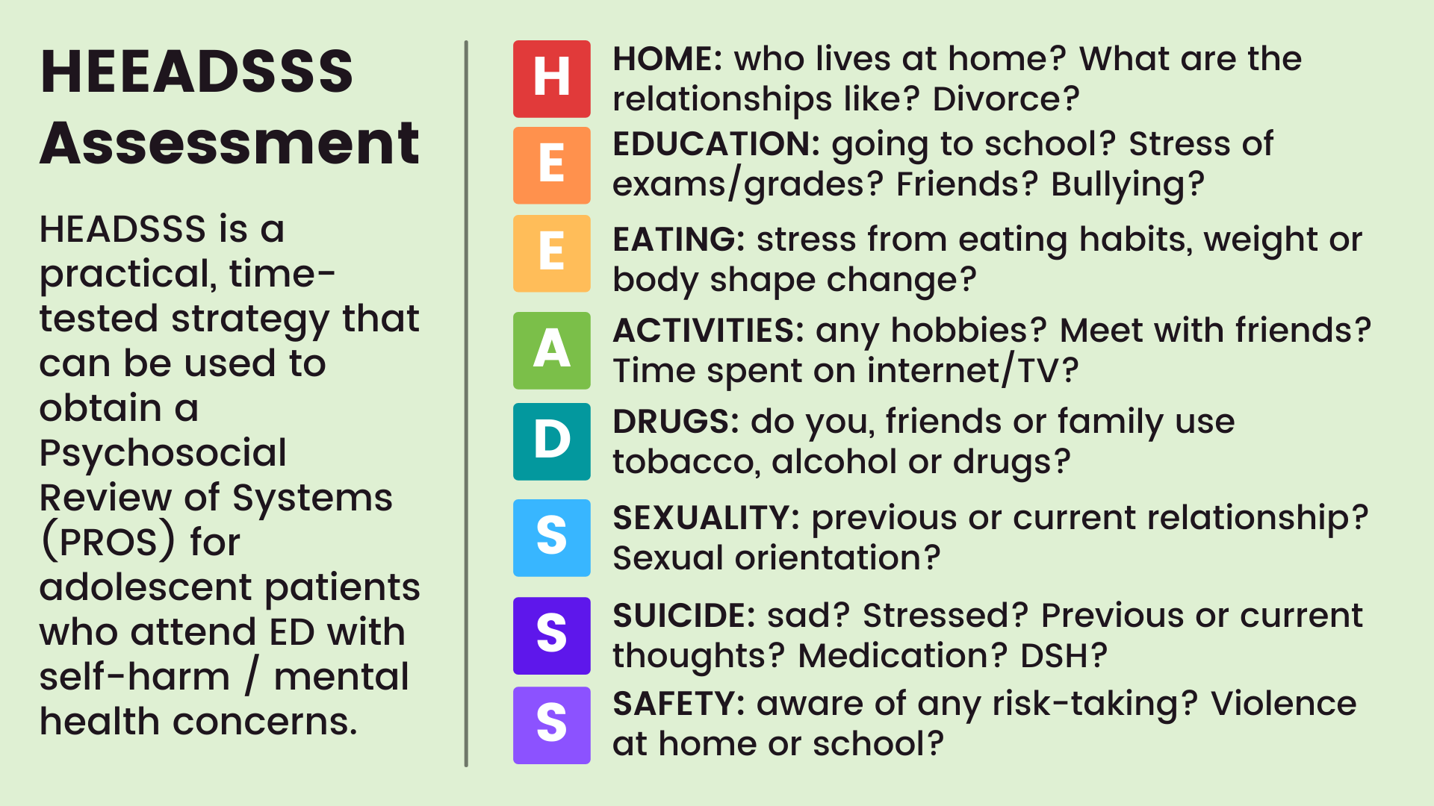
Potential questions for conducting a safety check

Slide 41

Provide survivor-centered care to adolescents disclosing a fear of or an experience with violence
If the adolescent client expresses concerns about their safety in their home or discloses physical, emotional, and/or sexual violence or harm:
Provide survivor-centered, first-line support to the client;
Refer the client to relevant violence response services;
Address any fears the client may have about index testing services;
Help the client plan for how they can remain safe if they chose to participate in NBT services;
Adolescents in unsafe environments should not participate in NBT services.
Follow your country’s laws and policies and your site’s mandatory reporting process, as necessary.
YouthPower Learning, 2019

Slide 42

Consideration #3: Be aware of the different types of contacts that adolescents may need to notify and assist them to determine the best notification strategy for each type of contact
Possible Contacts Include:
Regular partners
Casual partners
Injection partners
Transactional partners
Biological children
Biological parents, siblings*
*Note for older adolescents, do not ask them to list parents and siblings. Biological mothers who are index clients should be asked to list children between the ages of 15-18 years.
What are all the different types of contacts that adolescents may want to notify during index testing either through disclosure or provider notification?

Slide 43

The contacts are the same but the approach to elicitation is different
While the types of contacts for adults and adolescents are the same, the approach to elicitation is different for adolescent clients because of the:
      Power imbalance between the provider and adolescent
      Client’s maturity level (compared to an adult)
      Different types of relationships that adolescents have, which are different from adult relationships
Adolescents will require additional support during the elicitation process, including guidance and assistance from the provider (and possibly a social worker). This may require additional time– it should not be rushed
Providers will also need strong communication skills to create a rapport with their adolescent clients and assist them to determine the best notification strategy for each type of contact
Anonymous provider-assisted partner services and social network testing strategies may be most acceptable and most effective for adolescents

Slide 44
Adolescents may prefer different notification approaches for different types of contacts
Client-led (passive) partner services may not be effective for adolescents
Anonymous provider-assisted partner services and social network testing approaches may be both preferred by and more effective for adolescents
Provider-assisted partner services do NOT require adolescent to disclose his/her/their HIV status to their sex and drug using partner(s) directly. Instead, the partner can be notified anonymously.
          You need to reassure the adolescent that their name will not be revealed and explain to them exactly what you will say to the partner during the notification process.
You may also want to consider offering the adolescent self-test kits to take home to their contacts as another option for getting their contacts tested if allowed by national guidelines.
Finally, as we discussed earlier, anonymous notification through websites and other electronic platforms may appeal to adolescents who are tech savvy.

Slide 45
Bottom line: Assist adolescent clients to find the notification strategy that works best for them
Provide a range of network-based testing options
Assist the client to find the best option for each type of contact
Account for the client’s safety when discussing notification strategies
Partner services (provider-assisted preferred)
Social network testing
HIVST kit distribution
Electronic notification
They may choose different notification strategies for different types of contacts
They may choose to notify some partners and not others
Anonymous approaches may be best for certain partner(s).
Notification should not proceed if the client’s safety is in doubt.
Remember that NBT services are a process. They should be routinely offered over time and not just on the first visit.

Slide 46
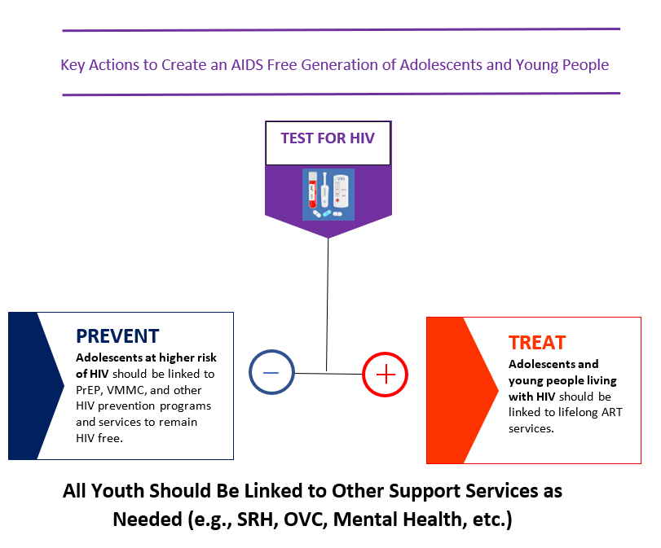
Consideration #4: Link the contacts of adolescents to appropriate services based on their test results
Adolescents should be linked to services based on their test results – including treatment and prevention
Special attention needs to be paid to ensure linkage to services for particularly vulnerable adolescents such as:
        Those living on the streets,
        Adolescents in child-headed households,
        Adolescents from key populations,
        Girls engaged in sex with older men and in multiple or concurrent sexual partnerships,
        Adolescents affected by sexual exploitation
Youth-Designed, Peer-led, Adolescent-Friendly

Slide 47

Sexual and reproductive health (SRH) services
Adolescents are more vulnerable to sexually transmitted infections, HIV, and unplanned pregnancy than any other age group.
Adolescents require unconstrained access to comprehensive sexual and reproductive health information and services
Comprehensive SRH services include:
      Comprehensive sexuality education provision
      Contraception counselling and provision
      Antenatal, intrapartum, and postnatal care
      Safe abortion care
      Sexually transmitted infections prevention and care
      HIV prevention and care
      Violence against women and girls: prevention, support and care
      Harmful traditional practices prevention
https://www.who.int/publications/i/item/9789241514606

Slide 48
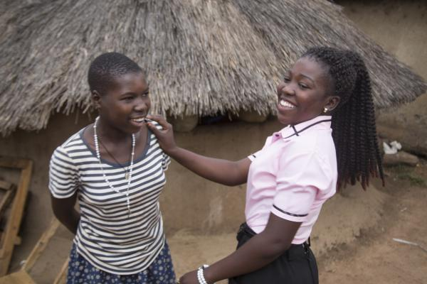
How can youth peer supporters help adolescents at risk?
Encourage, support, and facilitate testing for HIV, STIs, and hepatitis B / C
Distribute self-test kits (HIV, syphilis, hepatitis C) in accordance with national guidelines and policies​
Empower and support the adolescent to develop and implement a disclosure plan​
Provide education on PrEP/PEP, condoms, hepatitis B vaccination and other evidence-based prevention services​
Photo Credit: UNICEF

Slide 49
Discussion: Tailoring prevention options for young people
Scenario:
Yoshi, who is 19 years old, is living with HIV, has a steady girlfriend and plans to marry her when he is able to afford living on his own. He does not know his girlfriend’s HIV status. He thinks she knows that he is living with HIV because she has seen him take his ARVs and he has said that he has a long-term illness. He wants to have sex, but he hasn’t talked about it with his girlfriend. ​
Discussion:
What are Yoshi’s prevention and HIV treatment needs?
What are the prevention and HIV testing needs of his girlfriend?
What are the barriers Yoshi might experience at a health center?
What messages and resources would you prioritize offering Yoshi?
Case study adapted from FHI360 Positive Connections

