Slide 1
Network-based testing toolkit training modules
Module 6: Intimate partner violence risk assessment and response as part of network-based testing

Slide 2
Trigger warning
Many of us may have experienced violence, are currently experiencing violence, or know someone who has been impacted by violence
This presentation will discuss violence and some of the content could be retraumatizing or trigger difficult emotions
Please take care of yourself and feel free to step away at any time. We will make sure that everyone has access to the slides

Slide 3
Learning objectives
By the end of this module, participants will be able to:
    Describe gender-based violence (GBV) and intimate partner violence (IPV)
    Summarize why the IPV risk assessment is a critical component of network-based testing services
    Explain the process for IPV risk assessment in network-based testing services
    Describe how to offer first-line support through LIVES to clients who have experienced or are currently experiencing IPV
    Understand the role of providers when conducting the IPV risk assessment
    Practice using LIVES with an observer and meet quality IPV risk assessment and response standards

Slide 4
Overview of GBV and IPV

Slide 5
Gender-based violence (GBV)
GBV is any form of violence against an individual based on biological sex, gender identity or expression, or perceived adherence to socially-defined expectations of what it means to be a man or woman, boy or girl
GBV includes sexual assault, intimate partner violence, child sexual abuse, physical and psychological abuse, threats, coercion, arbitrary deprivation of liberty, and economic deprivation.
GBV is rooted in gender-related power differences, including social, economic and political inequalities; it is characterized by the use and abuse of physical, emotional, or financial power and control

Slide 6
Who is affected by GBV?
Women and girls are most at-risk for GBV, yet other vulnerable populations are also disproportionately affected by GBV
Vulnerable populations:
    Children/youth
    Key populations – sex workers, people who inject drugs, men who have sex with men, transgender persons, prisoners
    People in conflict and crisis areas/refugees, internally displaced persons
    People with disabilities
    Indigenous, ethnic and religious minority communities
    Low-wage/informal sector workers
    Older persons, widows

Slide 7
1 in 3 women
Globally 1 in 3 women have experience physical and/or sexual violence. Most of this violence is perpetrated by an intimate partner.
It is estimated that of all women who were the victims of homicide globally in 2012, almost half were killed by intimate partners or family members, compared to less than six percent of men killed in the same year (United Nations Office on Drugs and Crime, 2014).

Slide 8
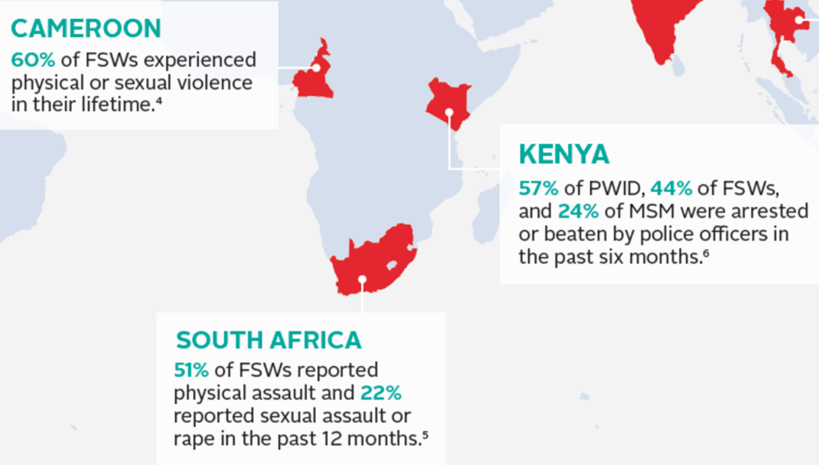
Key populations most exposed to violence, including GBV
*Key populations include men who have sex with men (MSM), female sex workers (FSW), prisoners, people who inject drugs (PWID), transgender women
Image source: https://www.fhi360.org/sites/default/files/media/documents/infographic-hiv-gpv.PDF

Slide 9
Knowledge check
Which of the following would you consider an example of GBV?
    While at a bar drinking, Michael gets into a dispute with another man. After loud shouting, the man hits Michael in the face.
    Patience’s husband, Sipho, gets extremely jealous and constantly accuses her of cheating. He doesn’t allow her to talk on the phone, even to friends.
    Moses is in a relationship with another man and is worried about his family finding out. Moses’ boyfriend often threatens to tell Moses’ mother and father about their relationship when Moses doesn’t do what his boyfriend tells him to.
    Amara and her friends need money. As they walk along the street late at night, they decide to follow a random person and rob them with a knife.

Slide 10
Knowledge check
Which of the following would you consider an example of GBV?
Patience’s husband, Sipho, gets extremely jealous and constantly accuses her of cheating. He doesn’t allow her to talk on the phone, even to friends.
Moses is in a relationship with another man and is worried about his family finding out. Moses’ boyfriend often threatens to tell Moses’ mother and father about their relationship when Moses doesn’t do what his boyfriend tells him to.
Both of these scenarios are a type of GBV called intimate partner violence

Slide 11

Intimate partner violence (IPV)
IPV is one form of GBV
IPV is ongoing or past violence and abuse by an intimate partner or ex-partner, defined as a husband or wife, boyfriend or girlfriend, or lover
It can include physical, sexual, or emotional violence, economic abuse and controlling behaviors
Most data and research on IPV has been done with heterosexual women but this training also applies to male and sexual minority survivors
Source: WHO Clinical Handbook 2014
Photo Source: CDC NISVS

Slide 12
Health care can be an entry point for violence survivors
Survivors tend to access health services more than non-survivors
Many individuals will have contact with health services several times during their lives
Providers are trained, trusted individuals to talk to
GBV is inter-related to and impacts many dimensions of an individual’s health

Slide 13
Network-based testing and the IPV risk assessment

Slide 14
What are the 10 steps of network-based testing?
1 | Introduce concept of network-based testing at any visit, and determine readiness and timing | 6 | Determine which infections each contact should be offered testing for, based on risk and epidemiology (HIV, other STIs, hepatitis)
2 | Offer network-based testing as a voluntary service to all clients with HIV, hepatitis B or C, or an STI, and obtain consent | 7 | Contact and offer integrated testing to partners and contacts using preferred approach, including self-test distribution
3 | Obtain a list of sex and injecting partners, social network contacts, biological children < 19 years old, and other household members (for HBV) | 8 | Record outcomes of network-based testing services
4 | Conduct an intimate partner violence (IPV) risk assessment for sexual partners | 9 | Link partners, contacts, children and household members to appropriate treatment and/or prevention services
5 | Determine the preferred method (partner services, social network testing, or family/household testing) for each contact | 10 | Follow-up with client to assess for any adverse events associated with network-based testing services

Slide 15
How do you ensure safe and ethical network-based testing services?
All network-based testing services for HIV, HBV, HCV and other STIs involve some risk
The priority is to minimize harm by implementing five key minimum standards:
    One of these is the IPV risk assessment and service provision
Safe and Ethical Network-Based Testing Services
Adhere to the 5 Cs of Testing
Intimate Partner Violence Risk Assessment and Service Provision
Training and Supervision for HCW
Adverse Event Monitoring and Reporting
Quality Assurance and Quality Improvement

Slide 16
Why ask about IPV during network-based testing?
Screening for IPV risk and offering an immediate first line response to any disclosure of violence is a standard operating procedure for network-based testing services
The primary goal of the IPV risk assessment is to ensure no harm comes to the index client, their partner(s), or family members as a result of network-based testing services
The IPV risk assessment also allows us to identify and link people experiencing violence to GBV response services. This can help improve health outcomes among these clients

Slide 17

Asking about IPV can help clients understand the health impacts
  “I was dying without realizing it. When the physician told me that my health problems were related to what was happening in my house, I started to understand what was going on with me. It was as if a veil was lifted from my eyes and I started to think that I didn’t deserve this.”
  Survivor – Dominican Republic
Source: IPPF: Improving the Health Sector Response to Gender Based Violence: A Resource Manual for Health Care Professionals in Developing Countries, 2010

Slide 18





1) Providers Trained on How to Ask about Violence and to Provide First-Line Support (LIVES)
Minimum requirements for the IPV risk assessment
2) Protocol or
Standard
Operating
Procedure
3) Private
Setting
If any of these minimums is missing, do not offer network-based testing
services
4) Confidentiality
Ensured
5) System for Referral

Slide 19
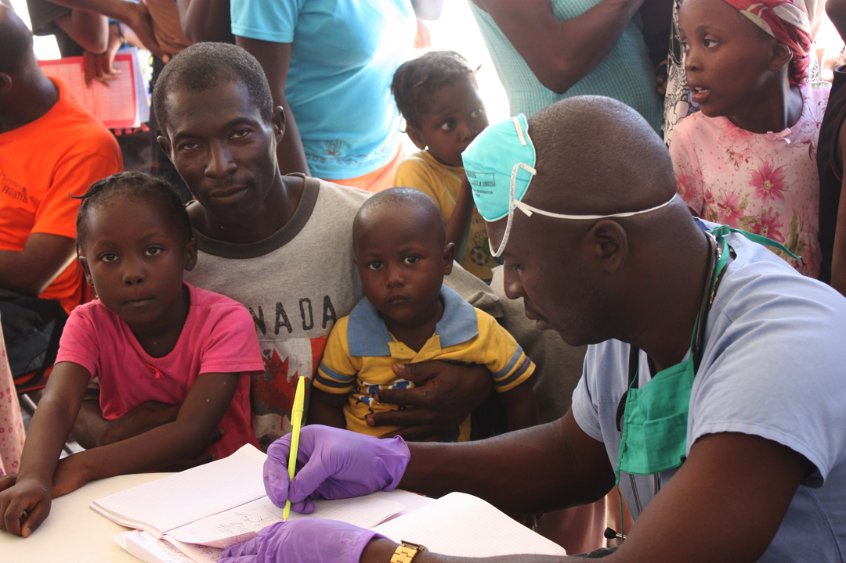
Minimum requirements for the IPV risk assessment
Has your wife ever forced you to do something sexually that you did not want to do?
This Photo by Unknown Author is licensed under CC BY-SA

Slide 20
Process for conducting the IPV risk assessment
during network-based testing

Slide 21
Client tests positive
Violence is NOT disclosed or suspected
Follow-up with client about any adverse events after partner testing
1.
Continue with partner notification
Network-based testing services are offered and accepted
Provider conducts the IPV Risk Assessment, asking a standard set of questions about IPV
2.
Offer First-line Support (LIVES):
Listen
Inquire
Validate
Enhance Safety
Support
Violence is disclosed or suspected
Refer the client to GBV response services, as appropriate
Key steps for IPV risk assessment
3.
Provider recommends they do not notify partner(s).
If client specifically requests partner notification, will the client be safe?
YES
No
Continue with partner notification. Consider methods that do no require disclosure. Staff safety is also important.
Do not move forward with partner notification.

Slide 22
Step 1: Ask about IPV
Ask client about their experience or fear of violence from any current or past partner
  The subject of IPV should be raised sensitively. For example, using an introductory script:
  “Many people experience problems with their spouse or partner, or someone else they live with. Sometimes these problems can lead to violence. Sharing information about a positive test can be very emotional and can lead to partners feeling upset. This can put your safety at risk. Because safety is very important to us, we ask all clients considering network-based testing the following questions.”

Slide 23
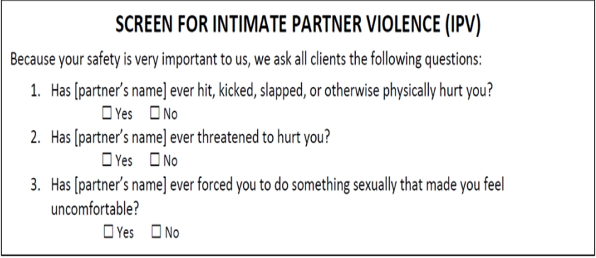
Suggested IPV questions
The provider asks about violence using a standard set of IPV screening questions.
Countries should feel empowered to develop and validate their own IPV screening questions based on their data and context.

Slide 24
Strategies to preserve privacy
Conduct the IPV risk assessment only when the client is alone and where the conversation cannot be overheard
    No one older than age 2 years should overhear your conversation. If the client’s children are present, ask a colleague to look after them while you talk
    You may need to think of an excuse to be able to see the person alone
          If another person is hesitant to leave, send the extra person to do an errand or fill out a form
Source: WHO 2018 VAW Curriculum

Slide 25
Strategies to preserve confidentiality
Assure the client that you will not repeat what is discussed with anyone outside of the immediate healthcare team
Providers must be aware of national mandatory reporting guidelines. If you are required to report specific situations, you must explain to the client what you must report and to whom prior to conducting the IPV Risk Assessment. Furthermore, the provider needs to re-check with the client to determine if they feel comfortable proceeding.
Ensure that any client files containing IPV information are stored securely and limit the number of people who have physical access to the files
Source: WHO 2018 VAW Curriculum

Slide 26
Discussion
Q: What if the client doesn’t want to tell me about IPV or is resisting disclosure?
A: That is okay! Never force a client to talk about IPV or details of their experience if they do not want to. It is the client’s right to decide if they disclose, how they disclose, when they disclose, and who they disclose to. Your job is to listen if they feel ready.
…”
“…

Slide 27
Step 2: Offer first-line support
First-line support is a practical, survivor-centered, empathetic counseling approach
    Responds to clients' needs (emotional, physical, safety and support) while respecting privacy
Must be offered right after a client discloses violence
First-line support has helped people who have been through various upsetting or stressful events
With the right training, anyone can do it
Source: WHO Clinical Handbook 2014

Slide 28
Key Components of First-Line Support
The WHO defines “first-line support” using the acronym “LIVES”:
L | ISTEN | Listen closely with empathy, no judgement
I | NQUIRE | Assess and respond to the client’s needs and concerns – emotional, physical, social, and practical
V | ALIDATE | Show the client you believe and understand them
E | NHANCE SAFETY | Discuss how to protect the client from further harm
S | UPPORT THROUGH REFERRALS | Help connect the client to appropriate services, including social support. For KP’s like sex workers or men who have sex with men, this should only include KP-friendly services

Slide 29

Providers Using LIVES
LIVES helps ensure respectful, sensitive communication with clients
The client is the expert on their situation. Explore the client’s options and respect his or her wishes
Speak to the client respectfully with kindness and empathy- not blame
Empower the client to feel able to ask for support
Know the resource a client is being referred to – quality matters
Source: WHO Clinical Handbook 2014

Slide 30

LIVES: Listen (cont.)
Let the client say what they want. Encourage the client to keep talking if they want by asking open-ended questions. Ask “How can we help?”
Allow for silence. Give time to think.
Stay focused on the client’s experience.
Acknowledge the client’s needs and respect their wishes. Don’t push them to talk if they say they are finished.
Source: WHO Clinical Handbook 2014

Slide 31
How do you like to be listened to?
Things listeners SHOULD do | Things listeners SHOULD NOT do
Be patient and calm Let client know that they’re listening (nod head, make eye contact, etc.) Acknowledge how client is feeling Let clients tell the story at their own pace Encourage client to share Give client time to think Stay focused on client Respect client’s wishes | Pressure client Look at their watch or seem distracted Judge client Rush client Assume they know best Interrupt Finish clients’ thoughts for them Tell clients their own troubles or someone else’s Think and act as if they can solve client’s problems
Source: LINKAGES Health Care Worker Training: Preventing and Responding to Violence against Key Populations

Slide 32
Avoid blaming, shaming and judging
Do not ask questions like:
    Why were you alone?
    Why were you walking in that neighborhood?
    Why were you wearing such revealing clothes?
    What did you do to make him angry?
    If you were really afraid, why didn’t you run or scream?

Slide 33
LIVES: Inquire about needs and concerns
The purpose is to learn what is most important for the client by helping them to identify and express their needs and concerns
Phrase your questions as invitations to speak by asking open-ended questions
Verify your understanding by restating what the client says
Reflect back to the client the feelings they express
    Explore as needed and ask for clarification if you don’t understand
Summarize what they expressed
Source: WHO Clinical Handbook 2014

Slide 34


LIVES: Validate
The purpose is to let the client know that their feelings are normal, that it is safe to express them, and that they have a right to live without violence
Show the client that you understand and believe them
Source: WHO Clinical Handbook 2014

Slide 35
LIVES: Validate (cont.)
Example validation statements:
    It’s not your fault. You are not to blame.
    You did the most important thing you could do in that moment: you survived.
    Thank you for sharing that with me. I’m sorry that happened to you.
    No one deserves to be hurt by their partner.
    You are not alone. Unfortunately, many others face this problem.
    Your life and your health are of value.
    Everybody deserves to feel safe at home.
    You are brave to talk me about it.
Source: WHO Clinical Handbook 2014

Slide 36
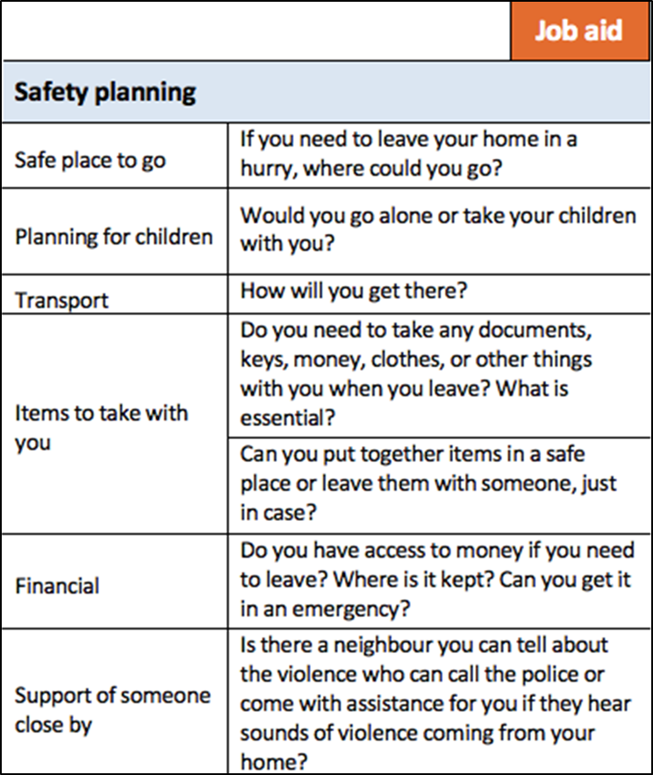
LIVES: Enhance safety
Many clients who have been subjected to violence have legitimate fears about their safety
Safety planning is an active client-led process in which you help them identify their own strengths and resources
    Clients are the expert on their situation and may have ideas or know best on how to keep themselves safe
Source: WHO Clinical Handbook 2014

Slide 37
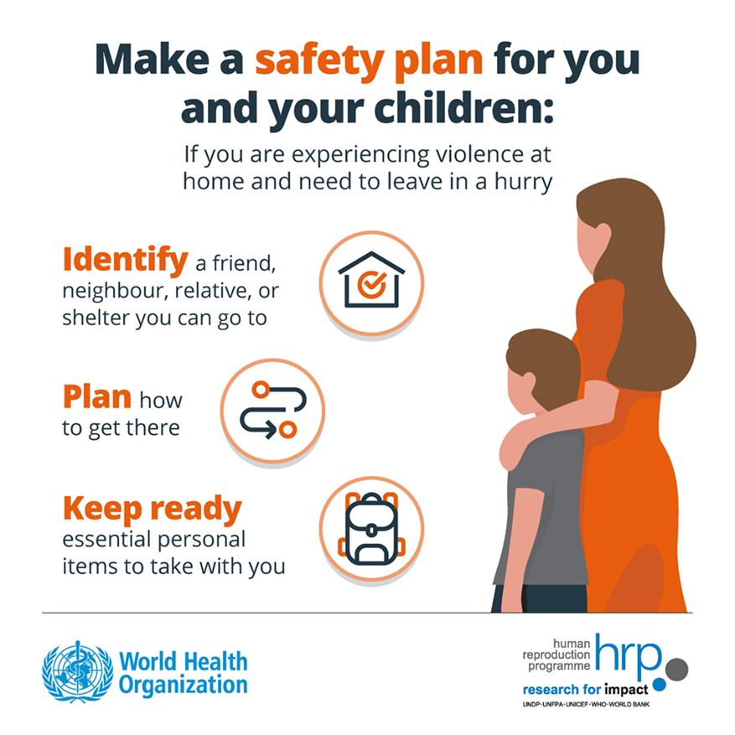
Understand immediate safety risks
Some clients may be at an elevated risk of being seriously harmed or killed by their partner
Red flags:
    Client says they think their partner is going to kill them
    Involvement and access to weapons
    Physical violence that has increased in severity or frequency
    Strangulation or violence in pregnancy

Slide 38
Sample Tool to understand immediate safety risks
“Based on your responses to my questions about violence, I am concerned about your immediate safety. If it’s ok with you, I would like to ask you a few more questions to find out if it is safe for you to go home after this visit.”
  Has the physical violence happened more often, or gotten worse, in the past 6 months?
  2. Has your partner used a weapon or threatened you with a weapon or
  another potentially harmful object?
  3. Has your partner ever tried to strangle you?
  4. Do you believe your partner could kill you?
  For women in a heterosexual partnership: Has your partner ever beaten you when you were pregnant?
If the client responds yes to any of these questions, work with the client to develop a safety plan and do not continue to discuss options for getting the partner tested.
Source: WHO Clinical Handbook 2014

Slide 39
LIVES: Support (through referrals)
The goal is to support clients to connect with other resources for their health, safety, and social support
    Help them identify these and provide suggestions
People who experience violence face multiple barriers to reaching out for help
    What you have to say is important in encouraging the client to seek support
    You can help break down some of these barriers (e.g., active listening)
Source: WHO Clinical Handbook 2014

Slide 40

Support: “Warm” or “Active” referral
Reduces barriers to accessing services
Actively helps clients access the referral
Offers to make a call on their behalf
Offers to make a call with the client
Offers private office space for them to make the call
Photo: Kate Holt, MCSP Liberia
Source: WHO Clinical Handbook 2014

Slide 41

Support: Types of resources outside the health system
Hotline/helpline
Shelter/housing
Crisis center
Financial aid
Legal aid
Support groups
Counseling
Mental health care
Child protection services
Source: WHO Clinical Handbook 2014

Slide 42

Step 3: Determine if network-based testing should move forward
A client’s safety is the most important factor in determining if they should participate in partner services.
This Photo by Unknown Author is licensed under CC BY-SA
This Photo by Unknown Author is licensed under CC BY-SA

Slide 43
How to approach network-based testing with clients experiencing IPV
All decisions about partner services, family & household testing, or social network testing should ultimately be up to the client
However, providers can recommend to the client that network-based testing services NOT proceed in cases where there is a risk of violence
If clients specifically requests partner notification after disclosure of violence, the provider and client should discuss if the client as well as the HCW who will be reaching out to the contact will be safe
They should proceed only if safety can be reasonably assured

Slide 44

LIVES can be fully integrated within network-based testing
Offering LIVES does not end at the IPV risk assessment. It can be integrated throughout network-based testing services.
For example, you can:
    Plan for safety while assisting the client in choosing the network-based testing method that is right for them. If a client wants to bring in their partner themselves, you can help them plan to do it safely and you can come up with backup strategies if the conversation does not go as planned.
    Allow the client to express their needs and concerns related to notifying partners, family members, and other contacts. Create a notification plan based on listening, not directing.
    Validate fear of IPV (and other fears) as legitimate concerns – believe them.

Slide 45
The role of providers in
IPV risk assessment

Slide 46

Role of providers in responding to IPV during network-based testing
Providers are responsible for:
  Understanding IPV and prioritizing the client’s safety
  Creating a safe environment
  Understanding how gender power differences impact access to resources and interactions with the health system
  Reinforce value of your client through your words, body language, and actions
  Respect dignity by involving the client in decision-making
  Know the available local resources for all potential populations ahead of time in case a referral is needed
Source: WHO Clinical Guidelines, 2014

Slide 47

Role of providers in responding to IPV during network-based testing
Providers should NOT:
  Attempt to “solve” violence for the survivor
  Determine the legal aspects of the violence or assault
  Determine whether a client is telling the truth about IPV
  Mediate relationship problems between a couple
  Force a survivor to leave an abusive relationship
  Attempt to know all the answers
Adapted from WHO Clinical Guidelines, 2014

Slide 48
Other considerations

Slide 49
IPV Documentation
How you document IPV will depend on the forms and registers commonly used in your facility or country
After the IPV Risk Assessment, record all notes and observations in the patient file
    Writing down as much as possible once the client has shared their story can prevent the client from having to repeat their story to someone new – which can be exhausting and traumatic
Outcomes of the IPV risk assessment should be included in all client files to allow long term follow up
    Note whether a referral has been offered, and to which service
Document all key information the client says
Source: WHO Clinical Handbook 2014

Slide 50
Summary
The IPV risk assessment is a critical and required component of network-based testing services
The process for IPV risk assessment should be followed closely and included in any SOPs or protocols at the site
First-line support to clients disclosing IPV should be done using LIVES
LIVES stands for: Listen, Inquire about needs, Validate, Enhance safety, Support through referrals
If a client discloses violence, the provider may recommend to not continue with network-based testing or partner notification
Asking about violence can be difficult and self-care is important

Slide 51
Knowledge check
During a testing session one of your clients told you her story of sexual abuse. After listening to her story, you offered to tell her about some services available to survivors like her that might be helpful (counseling, legal etc.). She said she did not want to hear about any services as she would never consider disclosing to her partner or anyone else. You let her know that you were available to provide information if she ever changed her mind and also inform her that there are always printed materials in the women’s bathroom at the facility.
AGREE or DISAGREE WITH THIS APPROACH?

Slide 52
Knowledge check
This is the right approach. It is a survivor’s choice to whom or if she wants to disclose her experience and when and how she seeks services

Slide 53
Knowledge check
A young client shares that her husband is sometimes physically and emotionally violent with her. As an example, she tells you a story where she did not prepare dinner appropriately and so he hit her. You sympathize with her but, as a wife yourself, you are concerned with her safety and want her to avoid this situation in the future. You decide to share advice that she should learn how to prepare food in a way her husband likes to avoid being at risk.
AGREE or DISAGREE WITH THIS APPROACH?

Slide 54
Knowledge check
Disagree with this approach. Never provide advice to a survivor about what she / he should have done or could do in the future to avoid violence. Never blame the survivor for the violence she / he has experienced. Instead listen, validate, and ask how you can help.

Slide 55
Knowledge check
A client discloses intimate partner violence and asks for your help. Normally you would provide information on resources and help her make a safety plan, but you happen to know the perpetrator of the violence and think you could help resolve things. You offer to speak with her and her husband to resolve their conflict.
AGREE or DISAGREE WITH THIS APPROACH?

Slide 56
Knowledge check
Never mediate and never speak with the partner in the cases of IPV. Validate the woman’s feelings and inform her of available services if she consents offer to connect her to those services.

