Slide 1
Network-based testing toolkit training modules
Module 5: Ethics and quality assurance for strengthening network-based testing services

Slide 2

Learning objectives
By the end of this training, participants will be able to:​
Define the five minimum standards to conduct network-based testing services
Describe the 5 Cs of testing and how they apply to NBT services
Define the terms quality, quality assurance, and quality improvement
Describe how to use quality assurance and quality improvement strategies to strengthen the quality of network-based testing services
Discuss the role that supportive supervision plays in improving the quality of network-based testing services

Slide 3
Key definitions for this module
Quality: refers to the provision of effective and efficient network-based testing services delivered according to the latest clinical guidelines and standards, in a respectful, client-centered manner
Quality Assurance (QA): assesses whether network-based testing services are provided in compliance with recognized quality standards
Quality Improvement (QI): a process for identifying problems or barriers in network-based testing services and taking actions to address these problems in order improve the quality of services provided. QI includes follow-up monitoring to ensure that actions taken lead to an improvement in services and outcomes
Supportive Supervision: a process of guiding, mentoring, training, and encouraging staff to continuously improve their performance so they can offer high quality network-based testing services
Consent
Confidentiality
Continuum of Care
Correct Test Results
Counseling
WHO 5C’s for Testing Services

Slide 4
Implementing safe and ethical network-based testing services
There is no such thing as zero risk; all testing programs involve some risk
The level of risk may be higher for network-based testing services due to accidental disclosure of confidential information about the client and/or his/her contact(s), violations of informed consent, and other adverse events
Programs should take steps to implement safe and ethical network-based testing services by adhering to and monitoring compliance with the 5 minimum standards for NBT services

Slide 5
What are the minimum standards for safe and ethical index testing?
Any programme offering network-based testing should ensure the minimum standards for implementing safe and ethical network-based testing:
  1. Adherence to 5C’s (consent, confidentiality, counseling, correct test results, and connection to prevention/treatment services)
  2. IPV risk assessment and provision of “first line” response, including safety check and referrals to clinical and non-clinical services (if not provided on site)
  3. A site level adverse event monitoring and reporting system
  4. Providers trained and supervised on network-based testing procedures including 5Cs, IPV screening, adverse event monitoring, and ethics (respect for the rights of clients, informed consent and ‘do no harm’)
  5. Ensure quality testing through quality assurance and quality improvement processes

Slide 6
Minimum Standard 1: Adherence to the 5 Cs

Slide 7
Network-based testing must follow the 5Cs
1. Obtain Consent
2. Remain Confidential
3. Include appropriate Counseling
4. Provide Correct Test Results to Contacts
5. Connect Contacts Tested to Appropriate Services

Slide 8
1. Consent: Network-based testing services should always be voluntary
Network-based testing is a completely voluntary service offered to help people identify, notify, and link to testing and care the people at risk in their social networks and families.
Network-based testing should be client-centered and focused on the needs and safety of the index client and their partner(s), contacts, and children.
All testing clients, including index clients, should be provided with all available prevention, care and treatment services, regardless of whether or not they provide details about their partners, family members, or other contacts.
  Services may NEVER be withheld or withdrawn under any circumstances.
  Clients may NEVER be pressured into sharing the names of their partner(s), family, or contacts.
  Clients should be informed of their right to decline participation in network-based testing services throughout the process, not just during the elicitation interview.
Clients may opt-out of network-based testing services FOR ANY OR NO REASON. Clients may engage in NBT services for some partners or contacts, but not for others. Clients do not need to provide a reason for not participating in network-based testing services.

Slide 9

Obtaining informed consent is a minimum standard for network-based testing services
Informed consent must be obtained prior to eliciting the names of contacts and before partner notification
Consent can be written or verbal, depending upon national guidelines
Counseling script has been developed for countries to adapt

Slide 10

2. Network-based testing services must remain confidential
Confidentiality = protection of personal information.
Both the confidentiality of the index client and all named partners, contacts, and children should be maintained at all times.
The name of the index client should never be shared with the partner and the partner’s infection status should never be shared with the index client (unless consent is obtained from both parties).
Programs MUST have confidentiality protections in place prior to the start of network-based testing services (including safe storage of data).
Full information about the potential risk for unintended disclosure of the client’s identity MUST be discussed with the client as part of obtaining informed consent for network-based testing services.

Slide 11
Network-based testing services must protect the confidentiality of index clients and their contacts
Whenever possible, keep the names of sex and injecting partners separate from the names of index clients to prevent accidental breaches in confidentiality.
  One method for doing this is to assign all index clients a unique ID number. This number can be written in the “comments” section of the HTS register.
  This ID number can be used in place of the client’s name in the network-based testing register.

Slide 12

3. Index clients and their contacts should receive appropriate counseling
They are not alone. We are here to help and support them with testing, care, treatment, and supportive services to help them live a long, healthy life
Network-based testing services can support them to get their partners, children, and other contacts tested and linked to appropriate services
Provide them with options for getting their partners, children, and other contacts tested that meet their needs (not ours)
Use patient-centered messages that account for their current experience and needs (e.g., IPV risks, partner lives far away, etc.)

Slide 13
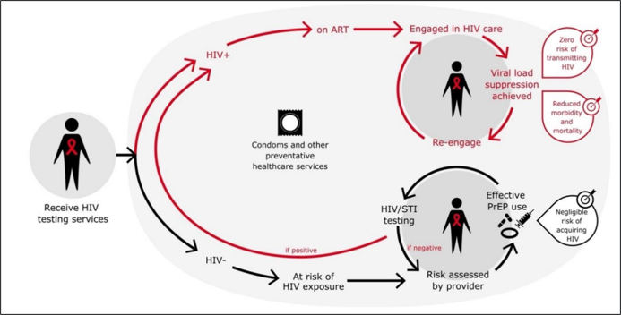
4. Connect: Link clients and contacts to appropriate services based on their individual needs and circumstances

Slide 14
Minimum Standard 2: IPV assessment and provision

Slide 15

Conduct intimate partner violence (IPV) risk assessment
Screening for IPV risk and provision of immediate response to any disclosure of violence is a minimum requirement for conducting network-based testing services
The goal of the IPV risk assessment is to ensure no harm comes to the index client or their contacts because of network-based testing services
The IPV risk assessment also allows us to identify and link individuals experiencing violence to GBV response services. This can help improve adherence and retention among these clients

Slide 16
Network-based testing should NOT be offered if the site is unable to inquire about IPV and respond appropriately
Minimum requirements for the IPV Risk Assessment include:
  A private setting, where confidentiality is ensured
  Network-based testing providers have been trained how to assess IPV and how to respond
  A protocol or standard operating procedure is in place which outlines the roles and responsibilities of site staff if an index client discloses violence
  A standard set of questions to assess for IPV
  Network-based testing providers trained to provide first-line support through LIVES (Listening, Inquiring, Validating, and Enhancing Safety and Support through referrals)
  A referral system is in place for clients experiencing violence
Network-based testing services should not be offered if these minimum requirements are not met
Please see Module 6 for more in-depth information on how to assess for and respond to IPV as part of network-based testing services

Slide 17
Minimum Standard 3: Adverse event monitoring and reporting

Slide 18

Implement an adverse event monitoring and reporting system to monitor the safety of network-based testing services
Adverse Event = an incident that results in harm to the client or others because:
  they participated in network-based testing services OR
  they were offered network-based testing services and declined to accept them
Having an adverse event monitoring and reporting system in place is a required standard for conducting network-based testing services
This system should include site level monitoring, client feedback (e.g., drop boxes, online submissions, hotlines, etc.), and community monitoring
Please see Module 9 for more information about what elements should compromise an adverse event and monitoring system

Slide 19
Minimum Standard 4: Training and supervision for NBT service providers

Slide 20

Training & supervision for NBT services
ALL workers involved with NBT need adequate training and supervision
  Trained testing providers, lay providers, peers, and others engaged in NBT service provision
  Training must cover ethics and minimum standards
Training can include peer-to-peer learning
Training is not a 1-time event, and should be offered on a regular basis
Supervisors are essential for maintaining quality of services
  Supervisors also provide support for HCW for difficult cases or situations

Slide 21
Minimum Standard 5: Quality assurance and improvement

Slide 22
Tools for quality improvement, accountability and action
No single data source provides the complete picture on quality and accountability of network-based testing services.
A variety of tools exist to support quality assurance for network-based testing services, including:
    Adverse events monitoring and reporting tools
    IPV Monitoring and follow-up action tool
    Community monitoring
    Supportive supervision and mentoring tools.

Slide 23

Monitoring and improving the quality of network-based testing services is the responsibility of organizations & programmes
However, where resources and community interest allow, teams should work with civil society organizations, and networks of recipients of care to monitor network-based testing services to ensure they meet the needs of beneficiaries
Community Led-Monitoring Can Be Another Important Component for Monitoring the Quality of Index Testing Services

Slide 24
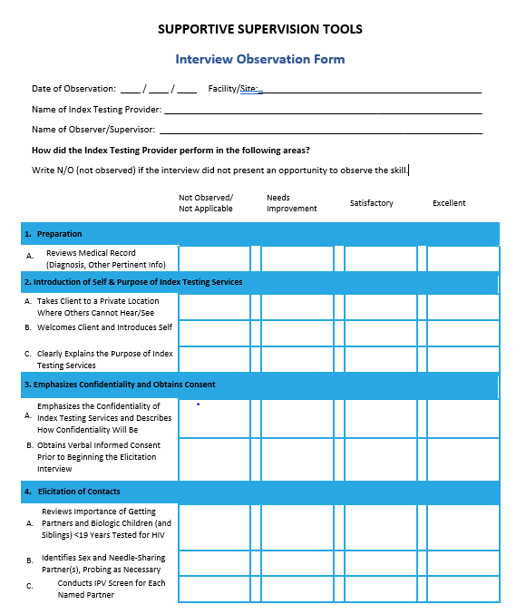
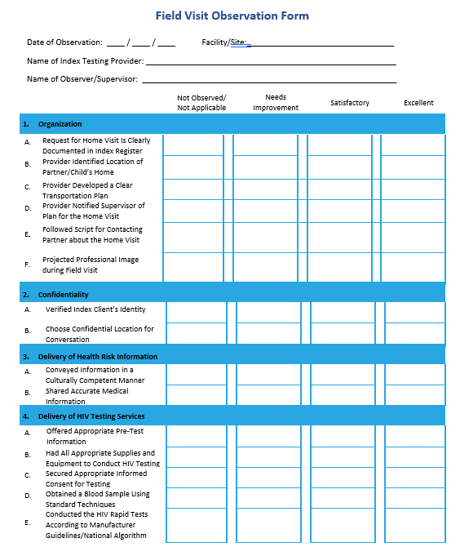
Monitoring quality through supportive supervision
Supervisors should directly observe the elicitation interview and provider notification visits regularly to ensure that counselors are conducting these services in a safe and ethical manner
Providers should be given immediate feedback, with suggestions for improvement
Providers failing to offer quality services should be re-trained and/or reassigned other duties

Slide 25
Best practices for providing supportive supervision
  Having trainees “shadow” an experienced counsellor for 2-4 weeks for on-site learning opportunities
  Using experienced counsellors to mentor counselors who are struggling
  Routinely observing network-based testing providers and providing feedback on their performance, including completeness of their records
  Offering daily, weekly or monthly opportunities for counsellors to share difficult cases and learn from each other (case conferences either in-person or virtually)
  Rotating counsellors experiencing burn-out back to regular counselling duties

Slide 26
How can we use quality improvement to strengthen network-based testing services?

Slide 27
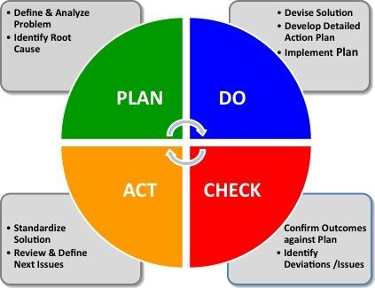
Using the PDCA cycle for quality improvement
Quality improvement aims to improve patient care through designing, testing, and implementing changes using real time measurement for improvement.
The Plan-Do-Check-Act cycle is a four-step model for carrying out change. Just as a circle has no end, the PDCA cycle should be repeated again and again for continuous improvement.
        Plan: Define the problem using your QA activities and data review.
        Do: Devise a solution and implement it.
        Check: Analyze the results to see if your solution worked, and identify what you’ve learned.
        Act/Adjust: If the change did not work, go through the cycle again with a different plan. If you were successful, incorporate what you learned into wider changes.
  Use what you learned to plan new improvements, beginning the cycle again.

Slide 28

How do you start quality improvement activities?
Recruit your quality improvement team (e.g., healthcare workers, patients, community members)
Identify a problem collaboratively with your team using data and your QA activities
Take time to discuss what may be causing the problem
Develop an intervention strategy using the SMART framework (Specific (S), Measurable (M), Achievable (A), Realistic, and Timely (T)
Implement your intervention and monitor the results using data
Ask for feedback from healthcare workers and patients on whether the intervention is helping improve services
Make adjustments to the intervention, as necessary. These adjustments can range from minor tweaking to abandoning the intervention if it is not working and/or is too burdensome
Repeat steps 2-8

Slide 29
Case study for developing a QI study
Staff at the Health and Wellness Clinic want to improve the network-based testing services they offer to clients within their STIs programs. They review their program data from the last quarter and find that most clients are accepting network-based testing services and the counselors are eliciting several contacts per index client. However, many of these contacts, particularly infrequent or non-relationship sexual partners, are not being tested for STIs. They want to use the PDCA cycle to improve the number of contacts tested. In your groups, answer the questions below to help the staff at this clinic develop a QI strategy.
  Define the problem they should focus on.
  What factors may be causing this problem?
  What is one possible solution that could address this problem? (Make sure to write it as a SMART strategy so it can be measured).
  How could they monitor their QI strategy to see if it is working to address the problem?

Slide 30
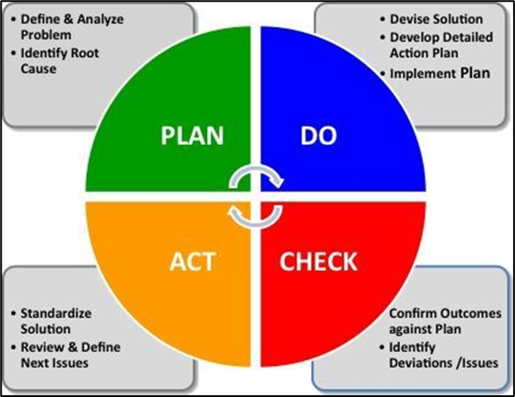
Summary of how to use quality assurance and improvement strategies to strengthen index testing services
Quality Assurance to Monitor Compliance with Minimum Standards
Quality Assurance Tools
Quality Improvement Cycle to Strengthen Index Testing Services
At the site level:
Ensure adherence to the 5 Cs
  Obtain consent for NBT services
  Maintain confidentiality
  Provide appropriate counseling to index clients and their contacts
  Provide correct test results
  Connect index clients and their contacts to appropriate services
Conduct IPV risk assessment and provide of “first line” response (as needed)
Implement an adverse event monitoring and reporting system
Ensure adequate training and supervision of HCWs conducting NBT services
Maintain quality through quality assurance and quality improvement processes
    Adverse Events Monitoring and Reporting Tools
    IPV Monitoring and Follow-Up Tools
    Community Monitoring
    Supportive Supervision and Mentoring Tools

