Slide 1
Network-based testing toolkit training modules
Module 4: Operational considerations and tips for implementing network-based testing

Slide 2
Learning objectives
By the end of this training, participants will be able to:
Describe the who, when, and where of network-based testing services
Discuss the human resources necessary to offer network-based testing services
Discuss the importance of ensuring effective linkage to prevention and care services as part of NBT services
Describe how to ensure that NBT continues for all positive contacts
Describe strategies for protecting the safety of network-based testing providers
Demonstrate an understanding of updated counseling messages to use during network-based testing counseling sessions
Describe 5 tips for improving elicitation and brief motivational interviewing techniques

Slide 3
Consideration 1.
Who, what, when, where, how, and how much of network-based testing services

Slide 4
WHO Who performs NBT services? Public or community health workers Peer educators or lay providers Testing providers Who benefits from NBT services? Which clients Which partners, contacts, & family members | WHAT What services are offered? Demand generation Active notification HIV, hepatitis B, hepatitis C, and/or STI testing Linkage to or provision of prevention or treatment Vaccination Social support or other services | WHEN When is a client offered NBT services? At diagnosis During routine follow-ups How often should NBT services be performed? Yield of recurrent NBT services Partner service fatigue
WHERE Do outcomes differ by location? Facility-based Community-based Virtual Private sector, pharmacies Homes | HOW What approaches work best for which populations? Phone calls In-person tracing Virtual interventions Other modalities | HOW MUCH What are the costs of NBT services? Overall costs Incremental & opportunity costs Cost-effectiveness Do costs differ between NBT service delivery modalities, populations, or pathogens?
Network-Based Testing Services Implementation Questions

Slide 5
Who should be offered network-based testing services?
Adults and adolescents with HIV should be offered partner services, testing of children, and social network testing
Adults and adolescents with another STI should be offered partner services. In some cases, social network testing or secondary distribution of self-tests can be considered (syphilis).
Adults and adolescents with hepatitis B should be offered partner services, family and household testing
Adults and adolescents with hepatitis C should be offered self-test kits for secondary distribution. Partner services can also be considered.
Adults and adolescents at risk of HIV or another STI should be offered social network testing even if they are negative

Slide 6
Types of network-based testing
 | HIV | HBV | HCV | STIs
Partner Services | WHO recommended(1) | WHO recommended(2) | Some evidence | WHO recommended(3)
Social network testing services | WHO recommended |  |  | Some evidence
Family & household testing services | WHO recommended (biological children)(1) | WHO recommended (family & household)(2)
Secondary distribution of self-testing kits | WHO recommended(1) |  | Some evidence | WHO recommended (syphilis)(3)*
1. Consolidated Guidelines on Differentiated HIV Testing Services, 2024: https://www.who.int/publications/i/item/9789240096394
2. Guidelines on HBV and HCV Testing, 2017: https://www.who.int/publications/i/item/9789241549981
3. Updated recommendations for the treatment of Neisseria gonorrhoeae, Chlamydia trachomatis, and Treponema pallidum (‎syphilis)‎ and new recommendations on syphilis testing and partner services, 2024: https://www.who.int/publications/i/item/9789240090767
*Not widely available

Slide 7
Who should conduct network-based testing services?
Partner services & family/household testing services:
  Trained healthcare providers/testers should conduct partner, family, and household testing services
  Peer educators or navigators may assist with services in locating and contacting partners, family, and household members
  Social network testing
  Peer educators or navigators can act as test promoters or can identify test promotors
  Community health workers or others can also identify or act as test promoters

Slide 8
What services should be offered in integrated network-based testing?
Consider the capacity of the systems supporting network-based testing in your setting, including follow-up testing for hepatitis B, hepatitis C, and certain STIs.
Consider the epidemiology of different infections affecting the populations you are engaging.
Linkage to treatment must be offered with any testing services
In addition to notification and testing services, consider offering the following, based on availability and local guidance:
    Prevention services (condoms, lubricants, VMMC, HIV PrEP and PEP, hepatitis B vaccination)
    Linkage to other health services (family planning, mental health and substance dependence, noncommunicable disease services)
    Linkage to social support services

Slide 9
When should these services be offered?
Introduce basic network-based testing services concepts and benefits at pre-test information or post-test counseling session
Partner elicitation and testing is NOT a one-time event but should be offered continually:
    Soon after diagnosis
    On a regular basis if on ongoing treatment (HIV, HBV, HCV)
    If a client living with HIV develops a detectable HIV viral load
    If the client has an incomplete ‘family tree’ (e.g., the status of their spouse and/or biological children <19 years is unknown)

Slide 10
Where should NBT services be offered?
Where should NBT services be offered?:
  At all facility-based HIV, hepatitis, and STI testing service delivery points (e.g., co-located VCT, SRH, ANC, TB, etc.)
  At all facility-based HIV, hepatitis, and STI treatment sites (e.g., KP programmes, SRH, PMTCT, ART, etc.)
  As part of all community-based HIV, hepatitis, and STI testing or treatment programs (e.g., mobile, workplace, KP drop-in centers/one stop shops, etc.)
Network-based testing
HIV testing sites
STI clinics & testing sites
Hepatitis B & C clinics
Key population services
TB clinics & centres
Community - based testing
Antenatal care

Slide 11
How should network-based testing services be delivered?
Options for conducting network-based testing include:
  Phone calls to partners, family, and/or household members
  In-person tracing
  Virtual applications, including leveraging existing dating apps
  Secondary distribution of self-testing kits (HIV, HCV, syphilis)
  Community-based (testing parties, etc.)
  Costs and cost efficiency in network-based testing:
  Consider using community health workers and/or peers to conduct components of network-based testing
  Integrate network-based testing with other services

Slide 12
Consideration 2.
Ensuring proper human resources to implement network-based testing services

Slide 13

What are human resource considerations for network-based testing services?
Network-based testing services require trained personnel and resources to conduct interviews, notify partners/children, offer testing, and link all newly diagnosed partners/children to treatment and high-risk negative contacts to prevention services.
Programs may need to assign dedicated network-based testing providers who have these responsibilities included in their job descriptions and who are evaluated on their performance eliciting and contacting exposed partners, children, household members, and other contacts.
Where human resources are constrained, consider secondary distribution of self-test kits to offset the burden on staff

Slide 14
Estimating the additional resources required for conducting network-based testing services
Questions to consider:
What infections will testing be offered for (HIV, hepatitis B, hepatitis C, other STIs)?
What is the number of clients expected to be approached for network-based testing each month or year?
What is the average number of partners, family members, and other contacts elicited per index client?
What is the proportion of elicited partners, children, household members, and other contacts who are of unknown status eligible for testing?
What tools and options are available for conducting network-based testing while minimizing the burden on the healthcare workforce? These may include secondary distribution of self-test kits, use of virtual tools, or task sharing by engaging lay providers to assist with NBT services.

Slide 15
Consideration 3.
Network-based testing should include linkage to prevention and treatment services

Slide 16
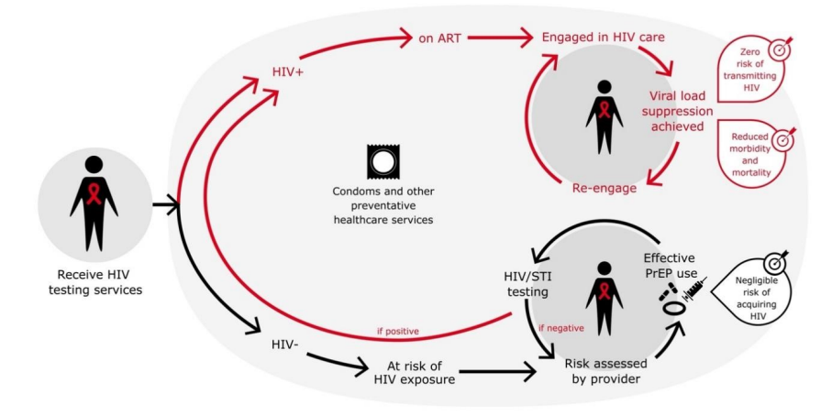
Network-based testing aims to break the chain of transmission
Network-based testing is centered on supporting the contact’s needs through timely linkage to person-centered treatment, care, and/or prevention services

Slide 17
Network-based testing should support both case finding and re-engagement in care
Network-based testing often results in contacting people who already knew their status
Network-based testing programs should have SOPs in place to re-engage contacted partner(s) who know their status and who are not currently in care
Re-Engaging Known Positive Contacts
New Diagnoses
Treatment Services

Slide 18

Monitor re-engagement in care
Programs should track how many known positive contacts, not receiving treatment services, are successfully re-engaged in treatment

Slide 19
Consideration 4.
Offer network-based testing to all positive contacts, re-starting the contact cycle

Slide 20
Offer network-based testing to all positive contacts, re-starting the contact cycle
When a partner is diagnosed, they becomes a new index client, and the process starts over from the beginning.
Index client names
three contacts
Index Client
Partner 1
Social Contact 2
Household Member 3
Two contacts test positive
Positive
Positive
Negative
Both contacts become new index clients
Linked to treatment and offered network-based testing services
Linked to prevention services (PrEP, VMMC, condoms)

Slide 21
Network-based testing helped to establish an active HIV transmission cluster in Vietnam
1 index client led to 9 PLHIV in their network (PWID + Sex Partners)
-
-
-
-
-
X-12027, PWID
-
X-12106, PWID
X-12112, PWID
-
+
-
+
-
+
X-12109, PWID
-
X-12136, PWID
10 HIV positive: 38%
16 HIV negative: 62%
+
-
It is important to note that this example does not show the direction of HIV infection, which would require phylogenetic testing.
-
-
-
+
-
-

Slide 22
Consideration 5.
Provide information on importance of testing for multiple infections

Slide 23
Positive messaging for HIV, hepatitis B, hepatitis C, and other STIs
HIV: treatable, excellent new drugs, viral suppression results in inability to transmit to partners through sex
Hepatitis B: preventable with vaccines, treatable with daily medication
Hepatitis C: curable with highly tolerable 8-12 week course of oral medication
Other STIs: many are curable, some are preventable with vaccines (HPV)

Slide 24

Provide messaging on viral suppression for HIV
Treatment has prevention benefits for partners, children and communities by reducing transmission. A person who is virally suppressed cannot transmit HIV to others through sex.
Sample message:
    "This is a time of new hope: with ART, people living with HIV can live healthy lives and protect their loved ones."

Slide 25
Consideration 6.
Maintaining the safety of network-based testing service providers

Slide 26
Strategies for maintaining the safety and security of network-based testing providers
Obtain government support and backing for testing services (e.g., circulars, guidelines)
Ensure testing providers receive the training and supportive supervision they need to safely implement these services
Provide community education on the importance and availability of partner, family, household, and/or social network testing to increase community’s awareness of these services
For safety reasons, network-based testing providers should travel in pairs for home visits (if possible, one male and one female provider) and carry proper identification
During home visits, providers should dress in normal street clothes and avoid carrying branded backpacks to help protect the confidentiality of the person being contacted

Slide 27
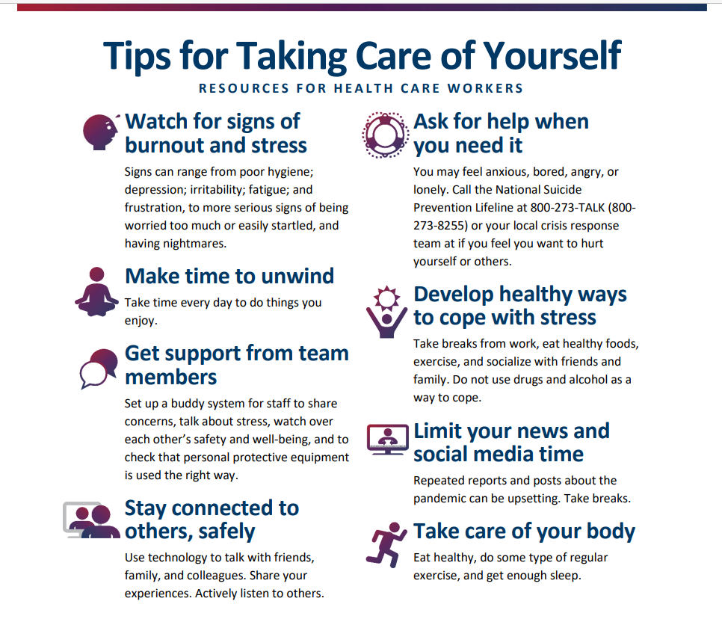
Network testing provider self-care is crucially important
Network-based testing can be an emotionally draining activity.
Taking care of yourself is an essential part of taking care of others.
Remember the healthier the tree, the better the fruit it can offer.
If you don’t take care of your mental health, you may burn out or have difficulty coping with the pressures of conducting network-based testing.

Slide 28
Discussion Question
What other suggestions do you have for maintaining the health, safety, and security of network-based testing providers?

Slide 29
Summary of the 6 operational considerations for implementing NBT Services
Consideration 1: Determine the who, what, when, and where, how, and how much of network-based testing services
Consideration 2: Ensure proper human resources to implement network-based testing
Consideration 3: Network-based testing should include linkage to prevention and testing services
Consideration 4: Offer network-based testing to all positive contacts, re-starting the contact cycle
Consideration 5: Provide information on importance of testing for multiple infections
Consideration 6: Maintain the safety of network-based testing providers

Slide 30
Tips to improve elicitation in network-based testing
Notes:
The first consideration that we will discuss is who should offer index testing services, and when and where these services should be offered.

Slide 31
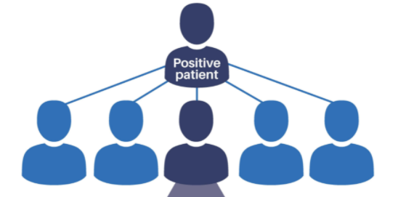
What is elicitation?
Elicitation = process of asking an index client to think of and name their sexual and injection partners, household contacts, children, and other contacts who are:
    at risk of HIV, hepatitis B or C, or STIs
    in need of testing

Slide 32






Elicitation is key to network-based testing success
Testing based on social connections
Sex Partners
Drug use Partners
Main, casual, clients of sex workers
Anyone who uses or injects together, regardless of needle sharing
Social Network Contacts
Family & Household
Any contacts perceived to be at risk
Biological children (HIV & HBV), other household contacts (HBV, TB)

Slide 33
Poll
What is one challenge that you have faced (or are concerned that you will face) when eliciting the contacts of index clients?

Slide 34

Five tips for improving elicitation
Provide person-centered care and counseling
Assure clients of the confidentiality of services
Use appropriate questions to ask about partner(s), children, and other contacts
Use appropriate humor, slang, and normalizing language to make clients laugh and feel comfortable with you
Use brief motivational interviewing to identify and address client’s concerns around network-based testing and partner notification

Slide 35
Tip 1. Provide person-centered care and counseling

Slide 36

Tip 1. Provide person-centered care and counseling
  Person-centered counseling treats index clients with respect and dignity by assuming they are an expert on their own life.
  Person-centered counseling is NOT a lecture. Instead, the counselor uses active listening skills to understand the client and their story.
  The counselor does not judge the client but instead uses empathy to understand the challenges that the client is facing.
  The counselor presents the client with options and helps the client to choose the best option for their life circumstances.
Connect
Understand
Proceed

Slide 37

Person-centered counseling requires good communication skills
Good communication depends on:
Appropriate non-verbal messages
Appropriate verbal messages
Effective listening.
Demonstrate professionalism
  Sit with your body facing the client, and maintain good eye contact
  Communicate a non-judgmental and objective stance about the client’s behavior
  Maintain professional boundaries with clients and their partners and contacts.

Slide 38
Knowledge Check
Why it is important to build rapport with the index client?
What best practices do you have for building rapport with your index clients?

Slide 39
Tip 2. Reassure clients of the confidentiality of network-based testing services

Slide 40



Tip 2. Reassure clients of the confidentiality of index testing services
If clients don’t trust that their information will remain confidential, they might not share the names of their partner(s), child(ren), and other contacts with us
It is our duty to never reveal the information that clients tell us
Both the confidentiality of the index client and all named partners, contacts, and children should be maintained at all times.
The partner’s status should not be revealed to the index client
The identity of the index client should never be revealed to the partner unless agreed to by the index
Unless Explicit Consent Is Obtained from All Parties

Slide 41
Explain how you will protect the client’s confidentiality
“We are committed to protecting your personal information. All the information you share with us will be kept in strict confidence. This means that we will not reveal your name to your partner(s) or other contacts. It also means that we will not be able to tell you whether your partner tested or his or her status, unless we get consent from both you and your partner(s). All information you provide us will be kept in locked cabinets, accessible only to health care workers and counselors providing network-based testing services.”

Slide 42
Tip 3. Use appropriate questions to ask about the client’s partner(s), children, household members, or social network contacts

Slide 43
Appropriate questions
Instead of… | Try…
Who have you had sex with in the past 3 years? | I want you to think back over the past 3 years, and try to share with me the names of as many sexual partners as you can remember.
Name your children. | How many children have you given birth to in your lifetime (women)? How many children do you have (men)?
Which of your friends needs to be tested? | Are there any other people you know who might be in need of testing?
Who do you inject drugs with? | Do you have any friends that you’ve injected with who might be in need of testing?

Slide 44
Tip 4: Use appropriate humor, slang, and normalizing language to make clients laugh and feel comfortable with you

Slide 45

Tip 4: Use appropriate humor, slang, and normalizing language to make clients laugh and feel comfortable with you
    You may want to start with a funny story normalizing the fact that many people have more than 1 sex partner.
      “Have you ever heard the story about the person who tried to sit on a one-legged chair? The chair wasn’t stable, and they fell over into the fire. We, as humans, are kind of like that chair. We may need more than 1 sex partner for us to feel stable and happy. Maybe we have our main partner for raising our children together, another partner for money, and a third partner for love. In fact, having more than 1 sex partner is very common in some communities. I’m grateful that you shared the name of your main partner with me. I just want to make sure that you don’t have any other partners that may need to be tested for syphilis. If so, I hope you will feel comfortable enough to share their names with me so we can offer them syphilis testing services.”

Slide 46
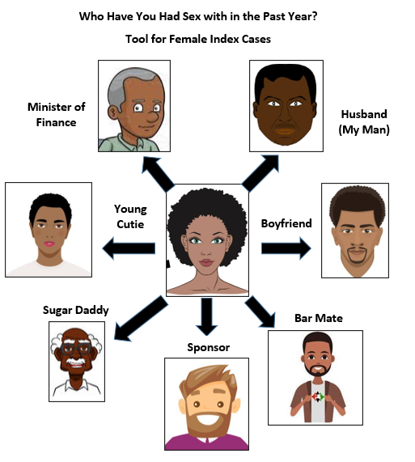
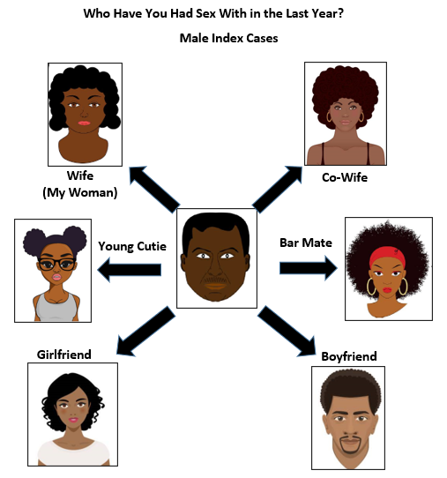
Use appropriate humor, slang, and normalizing language to make clients laugh and feel comfortable with you
You can also prepare job aids with slang terms from your community to probe for different type of partners

Slide 47

Activity: What are the slang terms used in your community?
  Take 5 minutes with the person sitting next to you to think of all the slang terms you can for the female partners of male clients
  Don’t forget about slang for same sex partners
  Now, think of slang terms for the male partners of female clients and write them on a separate set of sticky notes. Again, don’t forget about slang for same sex partners

Slide 48
Tip 5. Use brief motivational interviewing to identify and address client’s concerns around network-based testing

Slide 49

Tip 5. Use brief motivational interviewing to identify and address client’s concerns around network-based testing
What is brief motivational interviewing?
A person-centered counseling style for eliciting behavior change
Assumes client knows what their barriers are to changing their behavior
Counselors’ role is to help client identify these issues and develop a plan to address
Creates a cognitive dissonance (or discrepancy) between where one is and where one wants to be

Slide 50

OARS Strategy
Open-ended questions
“What concerns do you have about notifying partners and social contacts about testing?
Affirming statements
“Many people aren’t quite sure how to tell their partner they may have been exposed, especially partners you may not speak to anymore…”
Reflective listening
“It sounds like you are not sure how to inform partners, family members, and social contacts about the need to get tested….”
Summarize the conversation
“To review, I will call your partner, John, to notify him of his chlamydia exposure. You will also tell your other partner, Sam, of your diagnosis and his exposure. I am here if you need me, and if you change your mind about telling Sam, I can notify him as well.”

Slide 51

Additional tips for elicitation
Consider creating an anonymous “drop box” where clients can place the names and phone numbers of their contacts
Use “Expert Elicitors” to train and mentor new counselors through "shadowing"
Conduct supportive supervision & mentoring, including observing the elicitation interview
Conduct “case conferences” (also known as “chalk talks”) to provide counselors the opportunity to learn from each other
Refer to partners as ‘contacts’ or ‘individuals’ since ‘partner’ implies a more committed/regular relationship
If you’re working with PWID, ask about ‘sexual and injecting partners’ together. Injecting partners have similar risks as sexual partners, even if they have not shared needles.

Slide 52
Knowledge Check
What other elicitation strategies have you used?

Slide 53

Now, it’s your turn!
  Please read each of the following scenarios and think about how you would approach this situation.
  How would you elicit the client's partner(s) (both sex and injecting), social network contacts, and family and household members?
  What services would you offer to the index client and partners, family members, and other contacts?

Slide 54
Scenario 1
Elizabeth is a 25-year-old woman who injects drugs and was diagnosed with hepatitis C two years ago. She comes to clinic after hearing that treatment for hepatitis C is now available. She has a boyfriend and works at a local bar. She injects drugs with her boyfriend, as well as several other friends. She also has a 2-year-old son and lives with her mother.

Slide 55
Scenario 2
Marlon is a 25-year-old man who has sex with men. He recently tested positive for syphilis. He reports that his friend, Mark, encouraged him to get tested for syphilis.

Slide 56
Scenario 3
John is a 40-year-old truck driver who tested positive for hepatitis B during an outreach program in the nearest town. He informs you that he lives with his girlfriend Grace and their two children, Harry and Lisa. He spends much of his time either travelling across the country or at Mary’s club in the adjoining neighbourhood drinking and having a good time with his friends.

Slide 57
Scenario 4
Sarah recently tested HIV-positive. She tells you that she has had sex with two partners during the past year. She is willing to talk to you about notifying one partner but does not want to discuss the other at all because “he is married, and his wife is pregnant”.

Slide 58
Discussion
Which contacts did you identify who may have been exposed?
Which infections should each contact be tested for?
Which additional infections, if any, should the index be tested for?
What challenges did you encounter during the interview?
How did you try to address those challenges?
…”
“…

Slide 59
Discussion
…”
What elicitation strategy did you learn today that you plan to use in your counselling?
“…

