Slide 1
Network-based testing toolkit training modules
Module 3: Ten steps of network-based testing services

Slide 2
Learning objectives
By the end of this module, participants will be able to:
  Describe the 10 steps of network-based testing
  List tips for eliciting named contacts
  Discuss the process to obtain informed consent for network-based testing services
  Explain why and how an intimate partner violence (IPV) risk assessment is conducted for network-based testing services
  Describe the importance of monitoring adverse events associated with network-based testing

Slide 3
What are the 10 steps of network-based testing?
1 | Introduce concept of network-based testing at any visit, and determine readiness and timing | 6 | Determine which infections each contact should be offered testing for, based on risk and epidemiology (HIV, other STIs, hepatitis)
2 | Offer network-based testing as a voluntary service to all clients with HIV, hepatitis B or C, or an STI, and obtain consent | 7 | Contact and offer integrated testing to partners and contacts using preferred approach, including self-test distribution
3 | Obtain a list of sex and injecting partners, social network contacts, biological children < 19 years old, and other household members (for HBV) | 8 | Record outcomes of network-based testing services
4 | Conduct an intimate partner violence (IPV) risk assessment | 9 | Link partners, contacts, children and household members to appropriate treatment and/or prevention services
5 | Determine the preferred method (partner services, social network testing, or family/household testing) for each contact | 10 | Follow-up with client to assess for any adverse events associated with network-based testing services

Slide 4
Step 1: Introduce the concept of network-based testing at any visit, and determine readiness and timing
1 | Introduce concept of network-based testing at any visit, and determine readiness and timing
2 | Offer network-based testing as a voluntary service to all clients with HIV, hepatitis B or C, or an STI, and obtain consent
3 | Obtain a list of sex and injecting partners, social network contacts, biological children < 19 years old, and other household members (for HBV)

Slide 5
Discussion
When is the best time to introduce and discuss network-based testing with a client?
…”
“…

Slide 6



Step 1: Introduce the concept of network-based testing at any visit, and determine readiness and timing
Optimal timing for network-based testing will vary greatly, based on the individual client, the health system, and the nature of the relationships with partners and contacts.
Network-based testing may be a process that takes place between a client and a provider over weeks, months, or even years.
While introducing network-based testing early after diagnosis may help facilitate easier location of partners, other factors should also be considered:
Many clients report not feeling ready to engage in network-based testing at the time of diagnosis. It is important to allow clients time to process before starting NBT
Research shows that subsequent rounds of both social network testing and partner services can have higher yield than initial rounds conducted at diagnosis
Clients may feel ready to engage in network-based testing for certain partners or contacts, but not for others. They should be given the option to engage in whatever form of NBT they choose, but should also be encouraged to complete the process with other contacts in the future.

Slide 7
Step 1: Introduce the concept of network-based testing at any visit, and determine readiness and timing
Once the client expresses readiness, provide important information:
Partners, social contacts, and family members need to know their status so that they can engage in prevention if they test negative, or treatment if they test positive.
Participation in network-based testing is voluntary and confidential. Partners and others can be contacted and notified of their risk without revealing the identity of the client.
Network-based testing involves offering testing to sexual & injecting partners, children, and social contacts at risk. There are different ways of reaching contacts, and clients can choose whether and how to contact them.
Network-based testing is a process. Starting the process soon after diagnosis is important for finding partners, but clients can re-visit and continue to work on this throughout their care.

Slide 8
Step 1: Introduce the concept of network-based testing at any visit, and determine readiness and timing
Inform the client that:
    All information will be kept confidential. This means that:
          Partners will NOT be told the client’s name or test results.
          The client will NOT be told the test results of their partner(s) or whether or not their partner(s) actually tested.
          Testing services and results for children will not be shared with others.
    You will NOT contact partner(s)/child(ren) without their permission.
    They will continue to receive the same level of care at this health facility regardless of whether they choose to participate in network-based testing services.
*Exceptions to confidentiality include discussions of self-harm or harm to others, in which case mandatory reporting would come into play.

Slide 9
Knowledge check
What is an important thing to discuss with someone considering network-based testing?
Select the best answer:
They need to decide now whether to engage in partner services, as there will be no opportunities in the future
Network-based testing is a good idea because the client may learn who infected them.
Network-based testing is voluntary and confidential, and the timing depends on the client’s preferences and readiness.
Network-based testing requires people to disclose their status to partners, contacts, and family members.

Slide 10
Step 2: Offer network-based testing as a voluntary service to all clients with HIV, hepatitis B or C, or an STI, and obtain consent
1 | Introduce concept of network-based testing at any visit, and determine readiness and timing
2 | Offer network-based testing as a voluntary service to all clients with HIV, hepatitis B or C, or an STI, and obtain consent
3 | Obtain a list of sex and injecting partners, social network contacts, biological children < 19 years old, and other household members (for HBV)

Slide 11
Step 2: Offer network-based testing as a voluntary service to all clients with HIV, hepatitis B or C, or an STI, and obtain consent
Who needs network-based testing?
All individuals newly diagnosed with HIV, hepatitis B, hepatitis C, or an STI
Individuals previously diagnosed with HIV, hepatitis B, hepatitis C, or an STI who have partners, contacts, or children in need of testing
Pregnant and breastfeeding women
Individuals with HIV, hepatitis B, hepatitis C, or an STI with interruptions in care
Individuals at risk of HIV, hepatitis B, hepatitis C, or an STI may participate in social-network testing even if they have tested negative

Slide 12

Step 2: Offer network-based testing as a voluntary service to all clients with HIV, hepatitis B or C, or an STI, and obtain consent
Informed consent must be obtained prior to eliciting the names of contacts and before contacting partner(s).
As part of the consent process, review the risks and benefits of network-based testing, answer any questions that the client might have, and obtain their verbal consent to continue with the elicitation interview.
We have sample consent scripts that you can adapt for your setting.
If the client declines, do not continue with network-based testing services. Consider offering these services again at their next clinical visit.

Slide 13
Information to provide when obtaining verbal informed consent for NBT services
Instructions: Health care worker should use this script to obtain consent for network-based testing services
Provide definition of NBT services.
If they agree to participate, we will ask the names and contact information of their sexual partner(s), injecting partners, and child(ren), as well as inquire about social network contacts
They can choose from these options to get their partner(s), contacts, and child(ren) tested: partner services, social network testing, family & household testing
They can choose different options for different contacts. They can choose to engage some individuals and not others.
Network-based testing services are completely voluntary and confidential
Describe risks and benefits associated with NBT services
Provide an opportunity to ask questions
Obtain consent for participating in NBT services
Note: Consent can be verbal or written, depending upon your national guidelines

Slide 14

Activity: Is this consent process adequate?
Sarah: It is important that your partner(s) get tested for syphilis. If they are negative, we can provide them with information and services to keep them healthy. If they are positive, we can start them on treatment. If you agree to participate, I will ask you to give me the names and contact information of people you have had sex within the past year, including anyone you had sex with just one time, even if you used a condom. We will keep all information you tell us confidential. Do you agree to participate in NBT services?
Client: I’m not sure.
Sarah: Come on, don’t you love your partner? If so, you really need to get him tested for syphilis All the clients in this clinic have participated.
Client: Ok, I guess I’ll participate.
GROUP DISCUSSION

Slide 15
Step 3: Obtain a list of sex and injecting partners, social network contacts, biological children < 19 years old, and other household members (for HBV)
1 | Introduce concept of network-based testing at any visit, and determine readiness and timing
2 | Offer network-based testing as a voluntary service to all clients with HIV, hepatitis B or C, or an STI, and obtain consent
3 | Obtain a list of sex and injecting partners, social network contacts, biological children < 19 years old, and other household members (for HBV)

Slide 16
Step 3: Obtain list of sexual and injecting partners
Ask the index client to tell you the names and contact information of all the persons they have had sex with or injected drugs with in the last 3 years.
Start by asking if they have injected drugs in the past 3 years. If not, just focus on sexual partners.
“I want you to think about all the people have you had sex with in the last 3 years even if it was just one time.”
Ask by type of relationship:
      What is the name of the person you mainly have sex with?
      Are there any other people that you have had sex with in the past 3 years? (remember to use slang terms to probe further)
Ask by chronological order in time: “Who is the last person you had sex with?”
  Who was the person you had sex with before that?
If the client injects drugs, ask them to tell you the names and contact information for any persons they have injected with, even if they didn’t share needles.

Slide 17
Step 3: Obtain list of social network contacts
**This step is recommended for HIV, but evidence suggests it could be effective in other settings and epidemics (e.g. HCV testing among PWID). Consider context, population, and epidemiology.**
Ask the index client to consider other people in their network who might benefit from testing.
“Now let’s think about other people in your social network who you think might be in need of testing. These could be friends, acquaintances, people at work, or others in your community.”
Make a list by type of contact: friends, work contacts, other community members, etc.

Slide 18
Step 3: Obtain list of family & household contacts
**This step for HIV and HBV only (not recommended for other STIs or HCV)**
Ask the index client to consider people in their home who might benefit from testing.
“Now let’s think about the people you live with and those that are in your family.”
(For HIV & HBV) Please list all of your biological children under the age of 19. Have they been tested? What is their status?
(For HBV only) Please list any other individuals living in the household, even if they are not family or not your partners.
      All household members should be tested for HBV

Slide 19
A few elicitation tips
Refer to partners as ‘contacts’ or ‘individuals’ since ‘partner’ implies a more committed/regular relationship.
Detailed information about identification or contacts for social network contacts are not necessary. If the client knows how to reliably reach the person, they can distribute tests or vouchers to that person.
Use the integrated network-based testing tool!

Slide 20
Activity: How would you elicit this client’s partner(s)?
Instructions: How you would ask this individual about their partners, social contacts, and/or family and household members? Think about potential barriers and how you would address them.
Client #1: A 37-year-old married woman who has been newly diagnosed with gonorrhea
Client #2: A 46-year-old male pastor of his church living with HIV who is attending an enhanced adherence counseling session due to high viral load
Client #3: An 18-year-old pregnant woman who has just been diagnosed with hepatitis B
Client #4: A 27-year-old gay man who was diagnosed with syphilis as part of mobile testing services
Client #5: A 32-year-old transgender woman who injects drugs and has tested positive for HCV

Slide 21
Step 4: Conduct an intimate partner violence (IPV) risk assessment
4 | Conduct an intimate partner violence (IPV) risk assessment
5 | Determine the preferred method (partner services, social network testing, or family/household testing) for each contact

Slide 22
What is intimate partner violence (IPV)?
IPV is behavior by an intimate partner that causes physical, sexual, or psychological harm, including acts of physical agression, sexual coercion, psychological abuse and controlling behaviors. (WHO, 2013)
Although studies repeatedly demonstrate the safety of network-based testing services, concerns remain that it could result in an increased risk of IPV.

Slide 23

Why Do We Conduct an IPV Risk Assessment?
Screening for IPV risk and provision of immediate response to any disclosure of violence is a standard operating procedure for network-based testing services
The primary goal of the IPV risk assessment is to ensure no harm comes to the index client, their partner(s), or family members as a result of network-based testing services
The IPV risk assessment also allows us to identify and link people experiencing violence to IPV response services. This can help improve health outcomes among these clients

Slide 24
Step 4: Conducting the IPV risk assessment
Start with an introductory script, such as “I want to ask you a few questions to make sure that network-based testing services will be safe for you.”
Use a standard set of screening questions to identify any potential IPV risk that the client may have– see Module 6 for information about WHO-validated screening tools.
Countries should feel empowered to develop and validate their own IPV screening questions based on their data and context.
Ensure appropriate response and support systems are available for those who screen positive. This may include referral to IPV support centres.

Slide 25
Network-Based Testing Should NOT Be Offered if the Site Is Unable to Inquire about IPV and Respond Appropriately
Minimum requirements for the IPV Risk Assessment include:
    A private setting, where confidentiality is ensured
    Trained providers who know how to ask about IPV and provide first-line support: Listening, Inquiring, Validating, and Enhancing safety and Support through referrals
    A protocol or standard operating procedure which outlines the roles and responsibilities of site staff if an index client discloses violence
    A standard set of questions for asking about IPV
    A system for referrals for clients experiencing violence
If any of these minimum requirements is not met, then the site does not have the ability to conduct the IPV risk assessment and respond appropriately.
Network-based testing services should not be offered at these sites.

Slide 26
Step 5: Determine the preferred method (partner services, social network testing, or family/household testing) for each contact
4 | Conduct an intimate partner violence (IPV) risk assessment
5 | Determine the preferred method (partner services, social network testing, or family/household testing) for each contact

Slide 27

Partner services (HIV, other STIs, HBV, HCV)
    Sexual and injection partners are informed of their potential exposure, and are offered testing and other services.
    There are both active (provider-assisted) and passive (client-led) modalities, and clients can choose different modalities for different partners.
    Programs can also provide clients with HIV, syphilis, and/or HCV self-test kits to take to their partners to facilitate partner testing.

Slide 28

Family and household testing (HIV & HBV)
    Providers offer biological children in the house testing and other services (HIV and HBV)
    Providers offer other household members testing (HBV) and vaccination if negative

Slide 29

Social network testing (HIV)
    Clients discuss and encourage testing among social network contacts.
    Referrals for testing can take place through the distribution of vouchers, e-vouchers, invitation cards, or self-testing kits.
    Index clients do not need to have an infection. Test promoters and peers are encouraged to engage in social network testing.
    Can consider for other populations and epidemics (e.g. HCV testing for PWID).

Slide 30
Disclosure within network-based testing services
Disclosure to partners and family members can improve linkage to care and success in care. However, many people may not feel comfortable disclosing to partners or others.
While disclosure should be encouraged and supported, it is not necessary for network-based testing services. All network-based testing options can be conducted without disclosure.

Slide 31

Examples of clients who may prefer provider-assisted partner services
Adolescent girls with older married partners
Married individuals with extra-marital partners
Casual partners (e.g., one-night stands with individuals met at bars/while traveling)
Sex workers and their male clients
Men who have sex with men who have not disclosed their sexual behavior to others

Slide 32
Examples of counseling scripts for anonymous provider notification
Example Script 1: “Hello. My name is _____________________and I am calling from ___________Health Centre. We have recently learned that you may have been exposed to HIV and would like to offer you an HIV test. You can receive this HIV test at home or at the health facility. Which option would you prefer?”
Example Script 2: “Hello. My name is___________ and I am calling from ___________Health Centre. The Ministry of Health is conducting a health campaign for men your age. As part of this campaign, we are offering free health services including blood pressure, weight, diabetes screening, and HIV testing. We would like you to come to the facility on Monday by 9am for your free health screening. When you get here, ask for me by name and I will help you avoid the queue.”

Slide 33
Knowledge check
Which referral approach is this?
The healthcare provider contacts the partner of an MSM over the phone, notifies him of potential gonorrhea exposure, and offers him testing for gonorrhea and HIV.
Answer: Partner services

Slide 34
Knowledge check
Which referral approach is this?
A female sex worker distributes vouchers for HIV and syphilis testing to people with perceived risk within her social network.
Answer: Social network testing

Slide 35
Knowledge check
Which referral approach is this?
The healthcare worker contacts people within a home to test household members for hepatitis B and offers hepatitis B vaccine to those who are negative.
Answer: Family & household testing

Slide 36
Choice and flexibility are key
Clients may choose to engage in NBT services for some partners and contacts, but not others
Clients may choose some NBT approaches for some partners and contacts, and other approaches for others.
Clients may choose to delay NBT services, delay for some partners and contacts, or not to engage in NBT services at all
Successful NBT services give clients choice, flexibility, and options to engage in the timing and modality that works best for them & for each partner, contact, or family member

Slide 37
Step 6: Determine which infections each contact should be offered testing for, based on risk and epidemiology (HIV, other STIs, hepatitis B and C)
6 | Determine which infections each contact should be offered testing for, based on risk and epidemiology (HIV, other STIs, hepatitis)
7 | Contact and offer integrated testing to partners and contacts using preferred approach, including self-test distribution
8 | Record outcomes of network-based testing services

Slide 38
Evidence on testing for HIV, hepatitis B, hepatitis C, and other STIs
HIV | Hepatitis B | Hepatitis C | Syphilis | Other STIs
Sexual and injection partners of people with HIV or STIs | Sexual and injection partners of people with HBV | Sexual and injection partners of people with HCV | Sexual partners of people with HIV or syphilis | Sexual partners of people with HIV or STIs
Children living in the home of people with HIV. Anyone living in the home of people with TB. | Any person living in the home of people with HBV | Injection partners of people with HIV | Male partners of pregnant women
Key populations | Key populations | People who inject drugs, MSM | Key populations | Key populations
Social network contacts of people with risk of HIV | All biological first-degree family members of a person with HBV

Slide 39

Dual HIV/syphilis testing
Easy way to integrate syphilis testing with HIV testing
Consider for anyone who:
  Is a member of a key population
  Is pregnant
  Is a partner of a pregnant woman
  Is a partner of someone with syphilis
Can consider using or distributing as a self-test

Slide 40
Step 7: Contact and offer integrated testing to partners and contacts using preferred approach, including self-test distribution
6 | Determine which infections each contact should be offered testing for, based on risk and epidemiology (HIV, other STIs, hepatitis)
7 | Contact and offer integrated testing to partners and contacts using preferred approach, including self-test distribution
8 | Record outcomes of network-based testing services

Slide 41
Step 7: Contact all named partners, contacts, and children using preferred approach
If the client chooses partner services:
    Decide which approach to use for each partner (provider-assisted, delayed provider-assisted, or client-led approach). WHO recommends provider-assisted partner services, which is more effective than client-led approaches.
    For client-led approach:
      Help the client make a plan (where, when, using what words)
      Provide conversation starters:
        “I went to the clinic for a check-up the other day and the nurse was encouraging people to get tested for HIV. So, I got tested and learned that I have HIV. I wanted you to know so that you could also get an HIV test. There are medicines now for treating HIV that can help us live a long time.”
      Brainstorm some questions/reactions that their partner might have and help the client determine some possible answers/responses.
      Give them the Referral Slip which explains why it is important for the partner to get tested and includes information on where and how to test. Instruct the client to give the referral slip to their partner(s) at the end of their conversation.
      Set an appointment with the index client in one month to follow up and confirm that the partner(s) have been tested.

Slide 42
Step 7: Contact all named partners, contacts, and children using preferred approach
For provider assisted approach:
    Begin contacting partner(s) via telephone or in person using a script for partner notification via phone call or home visits
    Remember do not give any information to anyone other than the partner. Confirm the partner’s identity before starting the discussion.
    Be ready to respond to questions from the partner about how you obtained his/her information.
    Plan what you will say if you reach a third party (e.g., parent, spouse) who wants to know why you're there or why you’re calling.
    You may want to consider leaving a confidential "referral letter" that can be left in a plain, sealed envelope if the partner is not there. This letter should include the counselor's name and phone number.
    See “implementation resources” section for sample scripts and tools.

Slide 43
Step 7: Contact all named partners, contacts, and children using preferred approach
If the client chooses delayed provider-assisted approach:
    Follow the same steps as for provider-assisted approach
    Identify a date 14 days from today’s date and agree with the client that they will notify and refer their partner(s) for testing by this date.
    Remind the client that if their partner(s) do not come for a test by that date, you will call to get his or her permission to directly contact the partner(s).
    After 14 days have passed, call the index client and determine if the partner(s) have been tested.
    If not, obtain the client’s permission to contact the partner(s) and follow the steps for provider referral.
    If the client does not give you permission to contact their partner(s), offer additional counseling and support to encourage them to refer their partner for testing.

Slide 44
Step 7: Contact all named partners, contacts, and children using preferred approach
If the client chooses social network testing:
    Ask the client to think people in their social networks that may need a test
      This can include anyone– colleagues, friends, acquaintances, or others– who they would feel comfortable talking to about testing
    Determine what modality to use for disbursing testing information or tests
      This could include vouchers, coupons, e-coupons, or self-tests
    Give the client enough vouchers, coupons, e-coupons, or self-tests to distribute to individuals identified
    Provide conversation starters:
      I went to the clinic the other day and the nurse was encouraging people to get tested [for HIV, other STIs, hepatitis B or C]. They gave me [vouchers, coupons, self-tests] to give to others who might be interested in free testing. This is totally anonymous and I won’t be involved in any way. Are you interested in one?

Slide 45
Virtual interventions for network-based testing
Many people may use the internet or mobile apps to find sexual partners, or to connect with others socially.
Just like traditional names and phone numbers, email addresses, screen names, and online identifiers can be used to contact someone.
During the elicitation process, you should ask about partners the client may have met online.
    Confirming the exact spelling of screen names and email addresses is extremely important (i.e., Man4you vs. Manforu)
Online applications can be used to distribute social network testing e-vouchers, in addition to partner notification for specific partners

Slide 46
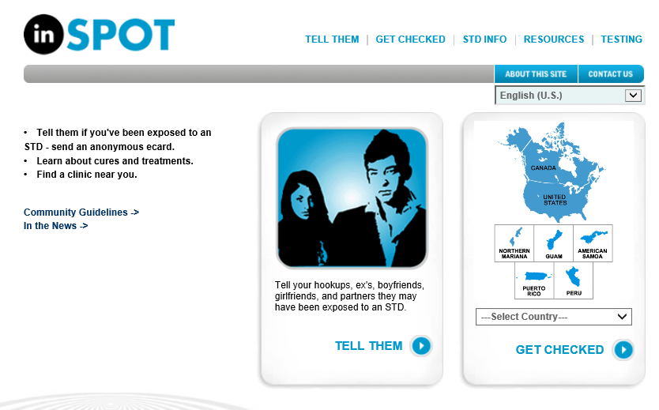
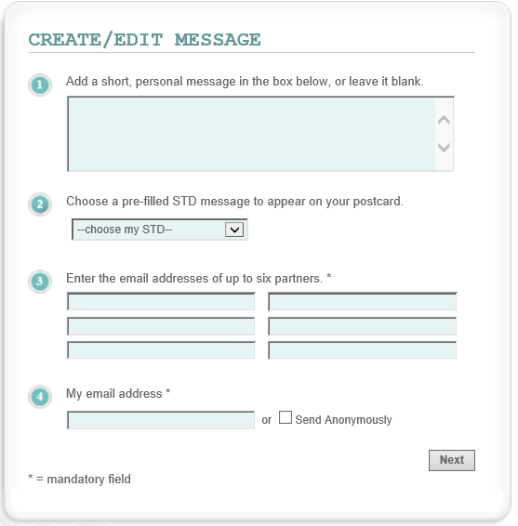


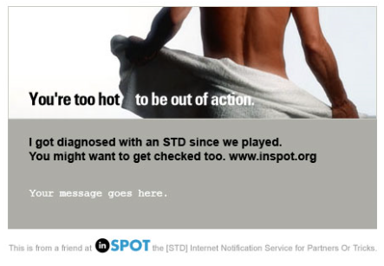
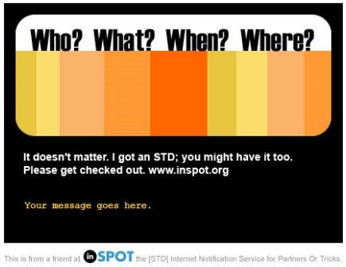
Example: Anonymous electronic notification by client
https://www.inspot.org/Default.aspx

Slide 47
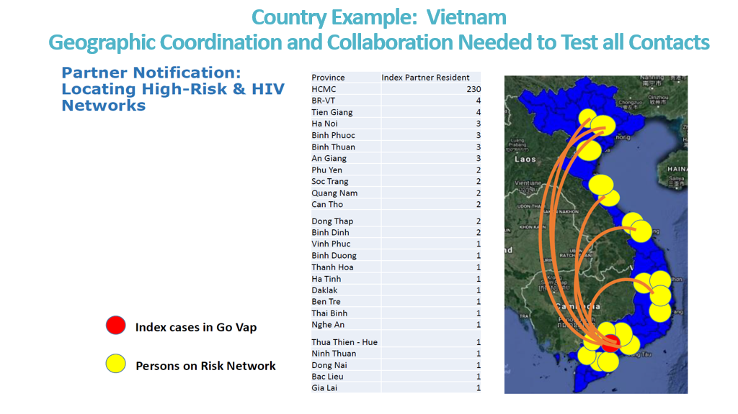
Partners can be anywhere including outside the jurisdiction​
In Vietnam, partners of index cases were located across the country.
Question: In your country setting, how have you (or could you) go about making sure that partners who reside outside the catchment area of the health facility or community site are located, reached, and offered testing services?

Slide 48
Step 8: Record outcomes of network-based testing services
6 | Determine which infections each contact should be offered testing for, based on risk and epidemiology (HIV, other STIs, hepatitis)
7 | Contact and offer integrated testing to partners and contacts using preferred approach, including self-test distribution
8 | Record outcomes of network-based testing services

Slide 49
Step 8: Record outcomes of network-based testing services​
It is important to document the outcomes of all network-based testing attempts on your organization’s record forms
Record the type of network-based testing services, date and method of contact attempts, and whether the individual was successfully contacted.
If individual was contacted, document who notified the individual, what tests were offered (e.g., did the individual accept testing and for which infections).
If the individual received testing, document his or her test results.
For each infection the individual was tested for, document next steps for both a positive result (i.e. linkage to care) or for a negative result (i.e. linkage to prevention).
Record retesting dates for those testing negative and in need of future retesting

Slide 50
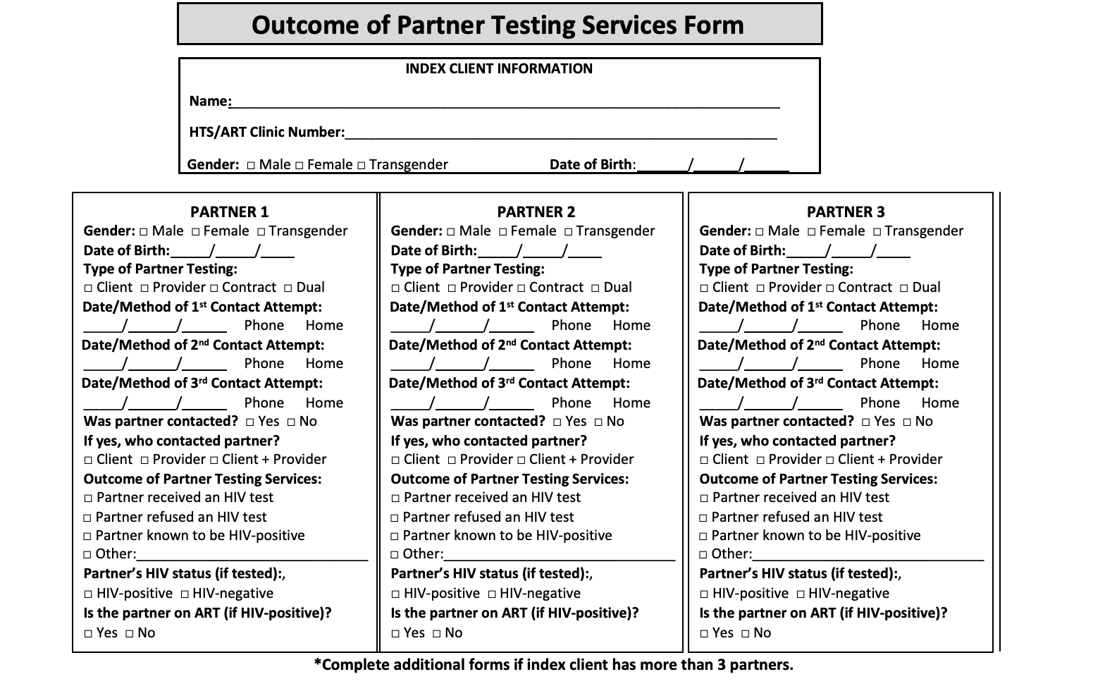

Slide 51
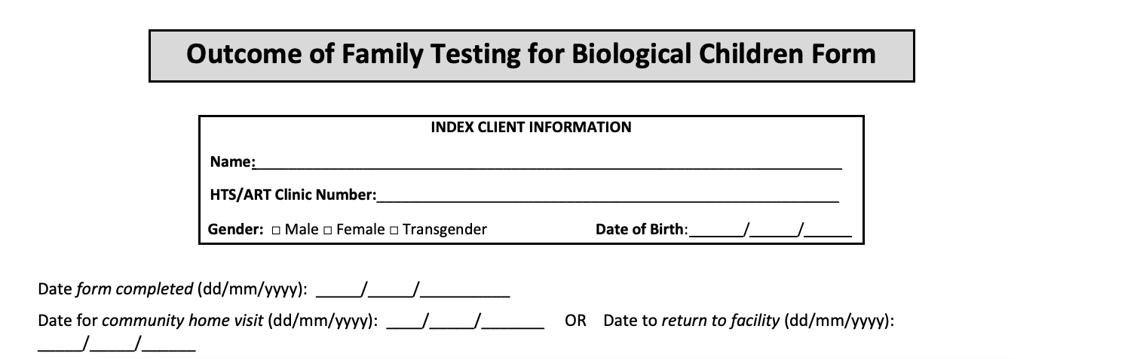
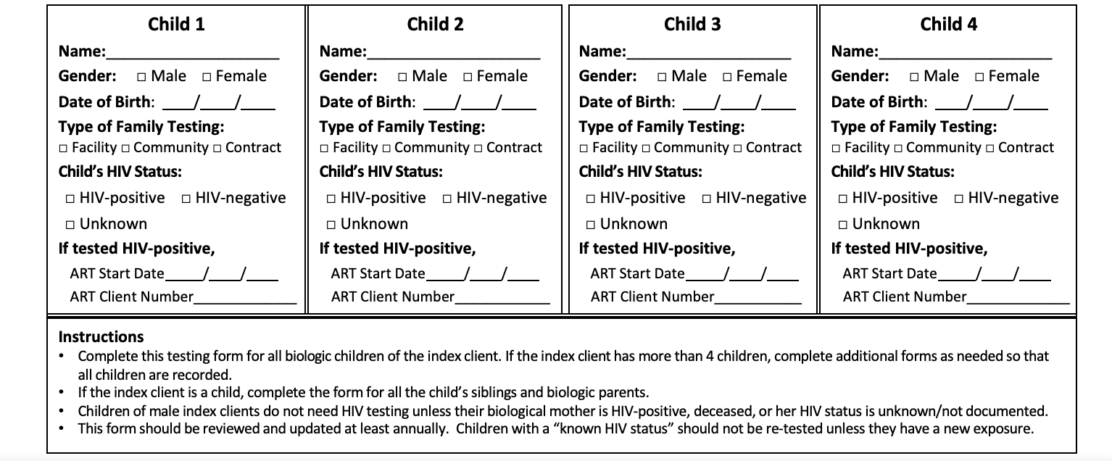

Slide 52
Step 9: Link partners, contacts, children, and household members to appropriate treatment and/or prevention services
9 | Link partners, contacts, children and household members to appropriate treatment and/or prevention services
10 | Follow-up with client to assess for any adverse events associated with network-based testing services

Slide 53
Linkage
All partners, contacts, children, and household members should be offered linkage– regardless of the result of their test
Depending on infection, those who test positive should:
    Be offered immediate treatment (HIV, curable STIs)
    Be initiated on treatment and linked to further testing (HBV, syphilis for pregnant women)
    Be linked to further testing (HBV, HCV, syphilis)
    Be offered prevention and harm reduction services (condoms, lube, harm reduction)
    Be offered NBT for their partners, contacts, and family and household members
Depending on infection and risk, those who test negative should:
    Be offered pre-exposure prophylaxis (PrEP for HIV)
    Be offered vaccination (HBV)
    Be offered other prevention and harm reduction services (condoms, harm reduction)

Slide 54
Step 10: Follow-up with client to assess for any adverse events associated with network-based testing services
9 | Link partners, contacts, children and household members to appropriate treatment and/or prevention services
10 | Follow-up with client to assess for any adverse events associated with network-based testing services

Slide 55
What is an adverse event?
Adverse Event: an incident that results in harm to the client or others as a result of their participation in network-based testing services
All testing services, including network-based testing services, should monitor for the potential harms that have experienced by clients
These harms can most easily be viewed as violations of the WHO's 5C's for HIV testing

Slide 56
What is included in an adverse event monitoring system?
Adverse Event Monitoring System
Site Level Monitoring
Client Feedback
Community Monitoring

Slide 57
Knowledge check
True or False?
Email addresses, screen names, and online identifiers (e.g., Facebook page or Grindr app) can be used to contact the partner if the client does not have the partner’s phone number
Answer: True
Notes:
.

Slide 58
Knowledge check
True or False?
We need to obtain consent prior to the elicitation interview.
Answer: True

Slide 59
Knowledge check
True or False?
Conducting an IPV risk assessment and providing an immediate response to any disclosure of violence is a minimum requirement for conducting network-based testing services.
Answer: True

Slide 60
Knowledge check
Name the three types of network-based testing services
Answer:
    Partner services
    Family & household testing services
    Social network testing

Slide 61
Knowledge check
If a child or other household member tests positive for HBV during family and household testing services, what is one method for documenting that they have been linked to HBV treatment services?
Answer:
  Write their testing number on the outcome form and/or in the network-based testing register

