Slide 1
Network-based testing toolkit training modules
Module 2: Integrated network-based testing & self-testing

Slide 2


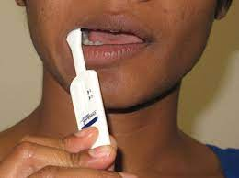

Learning objectives
By the end of this module, participants will be able to:
  Define the three main modalities of network-based testing and the four main infections to consider for testing
  Describe how to provide integrated network-based testing services that offer all three modalities for whichever infections are most important to test for in your population
  Describe how self-testing and self-care can be used to assist index clients to get their contacts tested for HIV, hepatitis C, and syphilis
  Facilitate a forum for sharing best practices for integrating network-based testing with other testing strategies

Slide 3



Types of Integration
There are multiple different ways that network-based testing services can be integrated:
  Integration across infections
  Integration across types of network-based testing
  Integration of network-based testing within health services
1
2
3
Notes:
While index testing is highly effective on its own, there may be circumstances where integrating index testing with other testing approaches can further maximize the number of contacts that receive an HIV test and are linked to appropriate prevention, treatment, and support services based on their needs and HIV status.
By the end of this module, you should be able to:
Discuss the relationship between provider-initiated testing and counseling (or PITC) and index testing services
Define social network approaches including social network strategies, enhanced peer outreach, and risk network referral and discuss how they can be used in conjunction with index testing services
Describe how HIV self-testing can be used to assist index clients to get their contacts tested for HIV, and
Facilitate a forum for sharing best practices for integrating index testing with other testing strategies

Slide 4


1. Integrating network-based testing services across different infections
When you have reached partners, social network contacts, and/or family and household contacts, it is important to consider all of the infections they may need testing for.
Consider population characteristics, risks, local epidemiology, and availability of resources.
Examples:
  People who inject drugs and their contacts may need testing for HCV and HIV
  People who sell sex may need testing for STIs and HIV

Slide 5
2. Integrating across network-based testing services
It is also important to consider how best to reach contacts in need of testing.
Offer options for network-based testing services that are appropriate for the population and the primary infection.
Examples:
  Adolescents may prefer anonymous provider-assisted partner services or social network testing
  People with HBV should be offered family & household testing
5

Slide 6
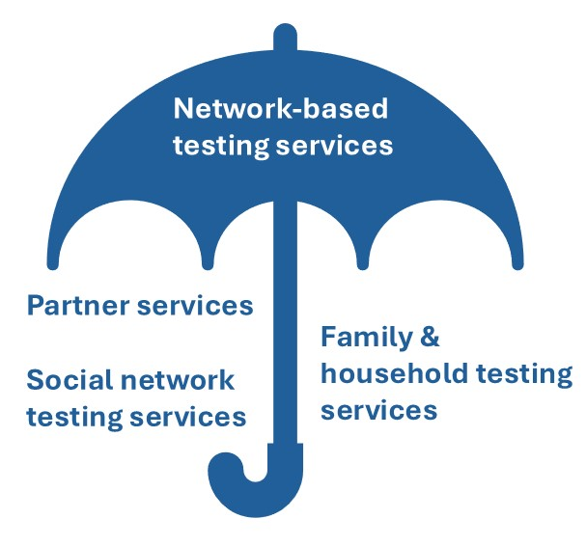
What are the three modalities of network-based testing?

Slide 7
What infections should we consider for network-based testing?
HIV
Other STIs
Hepatitis B
Hepatitis C

Slide 8
Integrated network-based testing for different infections
 | HIV | HBV | HCV | STIs
Partner Services | WHO recommended(1) | WHO recommended(2) | Some evidence | WHO recommended(3)
Social network testing services | WHO recommended |  |  | Some evidence
Family & household testing services | WHO recommended (biological children)(1) | WHO recommended (family & household)(2)
Secondary distribution of self-testing kits | WHO recommended(1) | Some evidence | Some evidence | WHO recommended (syphilis)(3)*
1. Consolidated Guidelines on Differentiated HIV Testing Services, 2024: https://www.who.int/publications/i/item/9789240096394
2. Guidelines on HBV and HCV Testing, 2017: https://www.who.int/publications/i/item/9789241549981
3. Updated recommendations for the treatment of Neisseria gonorrhoeae, Chlamydia trachomatis, and Treponema pallidum (‎syphilis)‎ and new recommendations on syphilis testing and partner services, 2024: https://www.who.int/publications/i/item/9789240090767
*Not widely available

Slide 9
3. Integrating network-based testing within all testing services
Network-based testing should be offered within all services for HIV, other STIs, and hepatitis B and C
NBT services should be offered as a routine part of prevention, testing, and treatment service provision
Full integration of service delivery for network-based testing includes provider training, integrated data systems, and integrated referral networks
Network-based testing
HIV testing sites
STI clinics & testing sites
Hepatitis B & C clinics
Key population services
TB clinics & centres
Community - based testing
Antenatal care

Slide 10

Strategies for ending the syndemics of TB, HBV, HCV, and HIV
Screen all PLHIV for TB, HCV, and HBV at least once
Ensure all patients with TB, HCV, and HBV are tested for HIV
Offer network-based testing to all PLHIV co-infected with TB since contacts of TB/HIV co-infected individuals are at high risk for both HIV and TB
Test all family members of index clients with TB for HIV, even if the index client with TB does not have HIV
Consider testing index clients with TB for HCV and HBV, depending on epidemiology
Develop data sharing agreements between HIV and TB organizations and providers to allow them to share information with each other

Slide 11
Integrating self-testing within network-based testing approaches
Notes:
Let’s now discuss how to integrate HIV self-testing with index testing services and social network approaches.

Slide 12

WHO Recommends self-testing
HCV: 2021 WHO Guidelines
HIV: 2024 WHO Guidelines
HCV self-testing should be offered as an additional approach to HCV testing servcies
(strong recommendation, moderate-certainty evidence)
HIV self-testing may be offered as an additional option for testing
at facilities
(conditional recommendation,
low-certainty evidence)
Photo credit: WHO
Syphilis: 2024 WHO Guidelines
Syphilis self-testing is suggested as an additional approach to syphilis testing services (conditional recommendation, low-certainty evidence)

Slide 13
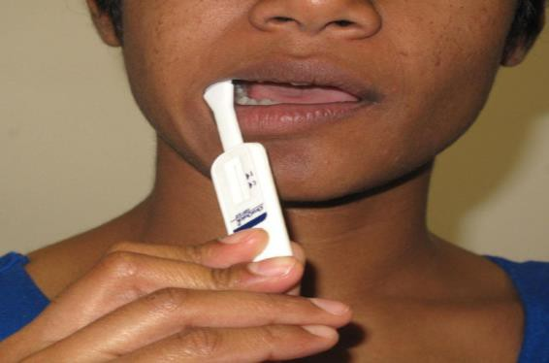
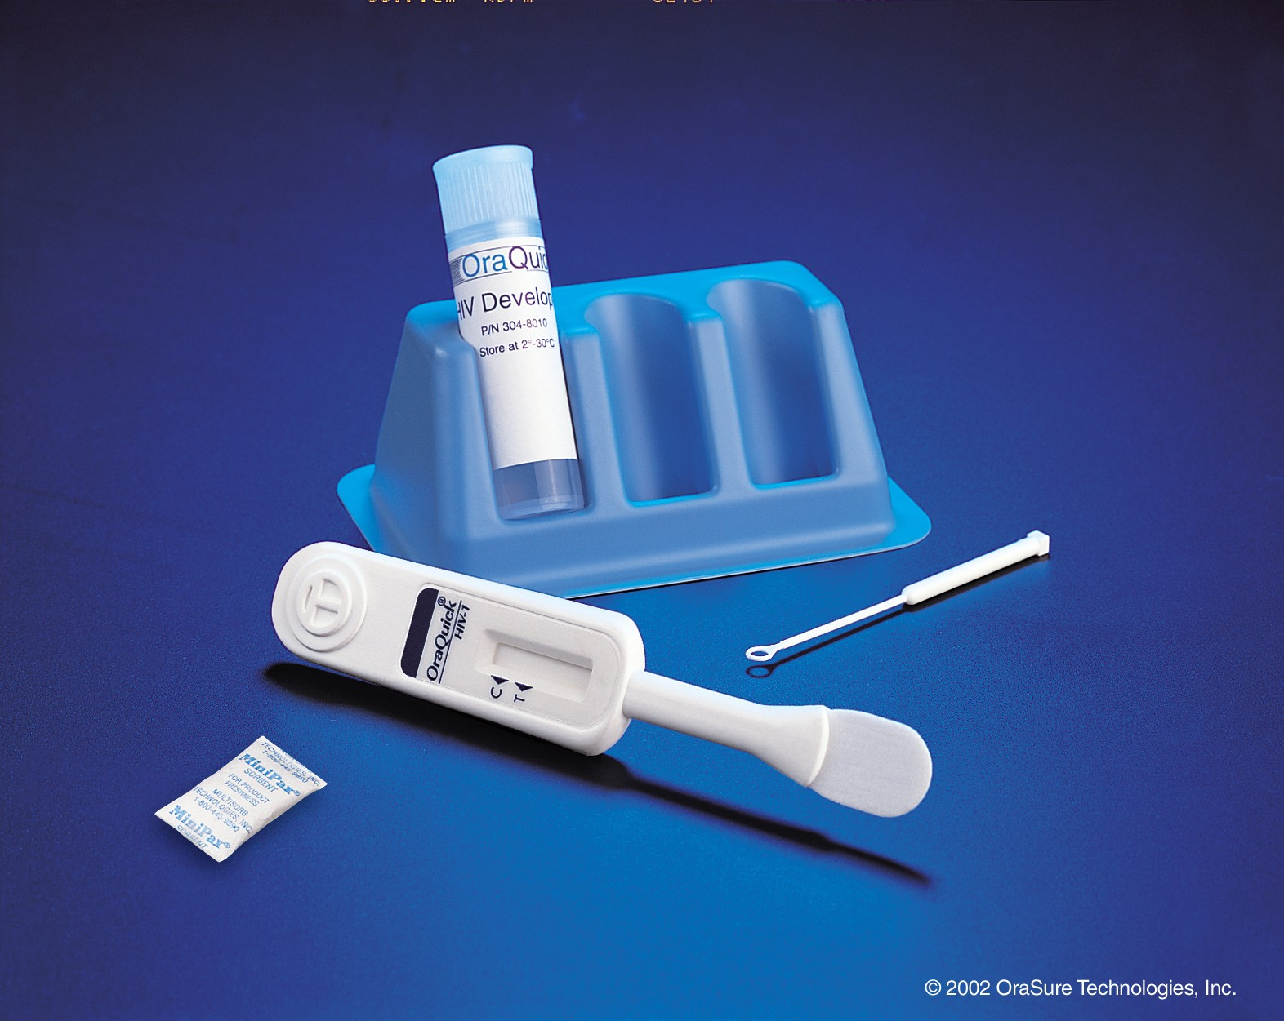

What Is self-testing?
Self-testing (ST) = process in which a person collects his or her own specimen (oral fluid or blood) and then performs a test using a simple rapid test kit and interprets their result, when and where they want. Many types of self-tests are available.
Collects
Performs
Interprets
Source and photo credits: WHO. Consolidated guidelines on HIV testing services, 2019.
.

Slide 14
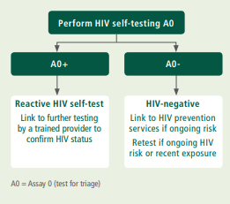
ST is a screening test and does not provide a definitive diagnosis
A reactive (positive) self-test result for HIV, HCV, or syphilis is not equivalent to a positive diagnosis
All reactive ST results, for any infection, require further testing by a trained provider to confirm the diagnosis using a validated national testing algorithm
Source: WHO. Consolidated guidelines on HIV testing services, 2019.
.

Slide 15



When is self-testing NOT recommended?
People who have previously been treated for HCV, or syphilis
People who are on ART for HIV
Persons uncertain how to perform the test or interpret the results
May cause a false positive result.
May cause a false negative result.
Access support prior to self-testing.

Slide 16

Integrating self-testing with network-based testing approaches
Secondary distribution: index clients can be given self-testing kits to take to their sexual or injecting partner(s) and network members so these partner(s)/network member(s) can test themselves
Benefits of integrating self-testing into network-based testing approaches
Allows index clients to introduce the topic of HIV, HCV, or syphilis testing with their partner(s) and network members without the need to disclose their own status first
Provides index client the option to test with their partner(s)/network members if they so choose.
Eliminates the need for the partner/network member come to the facility for testing (unless the self-test is reactive) and allows them to test where and when they choose

Slide 17
Key messages for secondary distribution of self-test kits
Where possible, provide a face-to-face demonstration on how to use the self-test kit and interpret results
Consider also providing physical instructions for use and/or a link to a video/website/hotline if the partner/network member has questions or needs support to ensure accurate performance
Emphasize that ST is voluntary; forcing or coercing partner(s) to test is unacceptable
Emphasize that individuals with a reactive (or positive) ST result must go to nearest clinic or testing site for confirmatory testing by a trained provider in line with national guidelines
Negative self-testers should be encouraged to access prevention services (e.g., PrEP, PEP, condoms, counselling, STI screening and VMMC)

Slide 18

Using technology to support integration of ST with NBT services
Website-Based Interventions
Provide index clients the option to order ST kits online for their partner(s)/network member(s) and receive via mail, at a pharmacy, a vending machine, or other pick-up point within the community
Online counselling and chatbots to provide real-time instructions and support interpretating the results and post-test counseling
Social Media or App-Based Innovations
Can create demand for ST using social media (Facebook, WeChat, Instagram) and dating apps (e.g., BluedTM, GrindrTM)
Partner/network member can use the app to get instructions on how to use the kit and real-time support from a counselor on how to interpret the result
Labeling self-test kits with QR codes to allow partner(s)/network member(s) to report their result to a counselor and receive post-test counseling

Slide 19
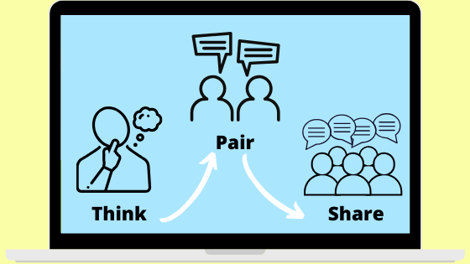
Sharing good practices for integrating NBT services with other testing strategies
Now, we would like to learn from you
THINK: Take a moment to identify at least one way your program has tried to integrate network-based testing with another testing strategy (2 minutes)
PAIR: with your neighbor to share your strategy and how it has helped strengthen testing services at your facility or community site (10 minutes)
SHARE: we will then ask you and your partner to share your strategy with the rest of the group so we can all learn from each other (20 minutes)

