Slide 1
Network-based testing toolkit training modules
Module 1: Introduction to Network-Based Testing Services

Slide 2
Learning objectives
By the end of this module, participants will be able to:
  Define network-based testing services and describe how these differ from other testing modalities
  Describe the importance of network-based testing as an effective strategy to find people in need of testing or other services
  List the 10 steps for conducting network-based testing services

Slide 3
Knowledge check
What is the most important aspect of network-based testing that distinguishes it from other case-finding approaches?
Select the best answer:
  it includes testing of children
  it allows for provider-initiated follow up
  it focuses on testing individuals who have a known exposure or risk
  it involves screening for intimate partner violence

Slide 4
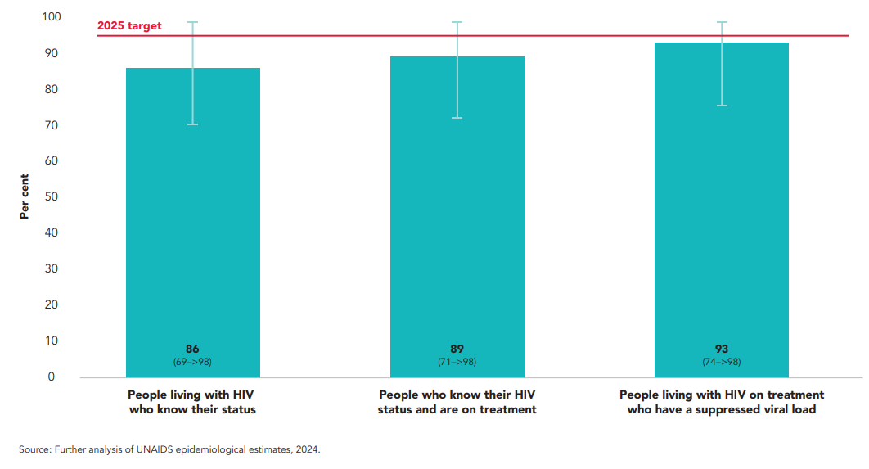
The 1st 95 goal is hardest to reach (2024)
More testing ≠ More people with HIV identified
As we get closer (and exceed) the first 95, finding new PLHIV will become more difficult
Network-based testing = effective strategy for identifying new cases of HIV infection

Slide 5
What is network-based testing?

Slide 6






What is network-based testing?
Testing based on social connections
Sex partners
Drug use partners
Main, casual, clients of sex workers
Anyone who uses or injects together, regardless of needle sharing
Social network contacts
Family & household
Any contacts perceived to be at risk
Biological children (HIV & HBV), other household contacts (HBV, TB)

Slide 7
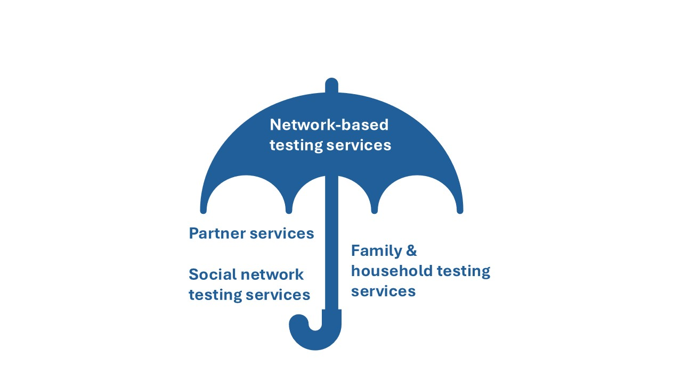
What is “network-based testing?”

Slide 8
What is “network-based testing?”
HIV
Other STIS
Hepatitis B
Hepatitis C

Slide 9
Terms associated with network-based testing
Partner Testing
Partner Notification Services
Index Testing
Risk Network Referral
Family Testing
Couples Counseling and Testing
Contact Tracing
Household Testing
Voluntary Partner Referral
Disclosure Counseling and Support
Social Network Strategy
Partner Management
Expedited Partner Treatment

Slide 10
Types of network-based testing
Partner Services | NBT approaches in which sexual and/or injection partners of clients who have been diagnosed with an infection are contacted, notified of potential exposure, and offered testing and other services
Social network testing services | NBT approaches in which individuals living with or at risk of infections encourage and support social contacts to seek testing and other services, or distribute self-testing kits to social contacts
Family & household testing services | NBT approaches in which family members (including biological children for HIV or HBV) and other household members (for HBV) are contacted, notified of potential exposure, and offered testing and other services
Secondary Distribution of Self-Test Kits | NBT approaches in which individuals are given self-testing kits to distribute to partners or other social contacts

Slide 11
Types of network-based testing
 | HIV | HBV | HCV | STIs
Partner Services | WHO recommended(1) | WHO recommended(2) | Some evidence | WHO recommended(3)
Social network testing services | WHO recommended |  |  | Some evidence
Family & household testing services | WHO recommended (biological children)(1) | WHO recommended (family & household)(2)
Secondary distribution of self-testing kits | WHO recommended(1) |  | Some evidence | WHO recommended (syphilis)(3)*
1. Consolidated Guidelines on Differentiated HIV Testing Services, 2024: https://www.who.int/publications/i/item/9789240096394
2. Guidelines on HBV and HCV Testing, 2017: https://www.who.int/publications/i/item/9789241549981
3. Updated recommendations for the treatment of Neisseria gonorrhoeae, Chlamydia trachomatis, and Treponema pallidum (‎syphilis)‎ and new recommendations on syphilis testing and partner services, 2024: https://www.who.int/publications/i/item/9789240090767
*Not widely available

Slide 12



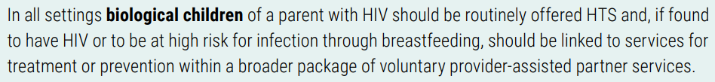
WHO Recommendations on NBT services for hIV
Consolidated Guidelines on Differentiated HIV Testing Services, 2024: https://www.who.int/publications/i/item/9789240096394

Slide 13
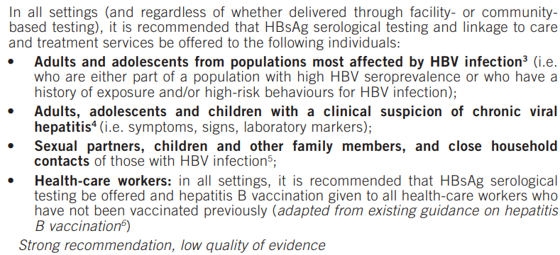


WHO Recommendations on NBT services for HBV & HCV
Guidelines on HBV and HCV Testing, 2017: https://www.who.int/publications/i/item/9789241549981
Recommendations and Guidance on Hepatitis C Virus Self-Testing, 2021: https://www.who.int/publications/i/item/9789240031128

Slide 14


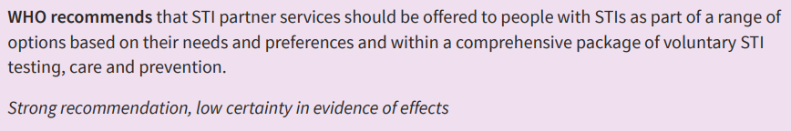
WHO recommendations on NBT services for STIs
3. Updated recommendations for the treatment of Neisseria gonorrhoeae, Chlamydia trachomatis, and Treponema pallidum (‎syphilis)‎ and new recommendations on syphilis testing and partner services, 2024: https://www.who.int/publications/i/item/9789240090767
*Not widely available

Slide 15
Importance of network-based testing

Slide 16





Why offer network-based testing?
Client | Partners, Children, Social Contacts, Household | Community
Provide support to people with infections to assist them in getting their partner(s), network contacts, and/or child(ren) tested Takes the onus off the index client as the sole person responsible for the notification | Maximizes the proportion of exposed people who are notified of their exposure Allows people at risk to get tested and access: Treatment services (if positive) Prevention services (if negative) | An effective case finding strategy Reduces future rates of transmission by aiding in early diagnosis, prevention, and treatment

Slide 17






Partner services are highly effective
Studies (mainly for HIV) have shown that partner services can:
    Increase uptake of HTS
    Identify PLHIV who were previously undiagnosed, including men and biological children
    Effectively link to care

Slide 18
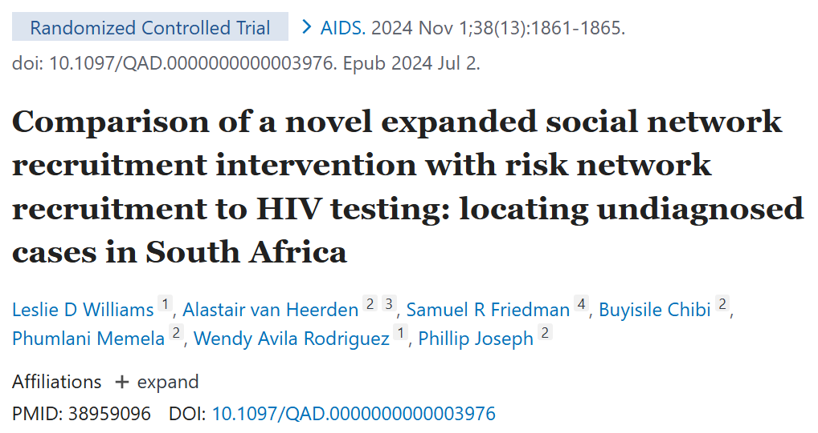

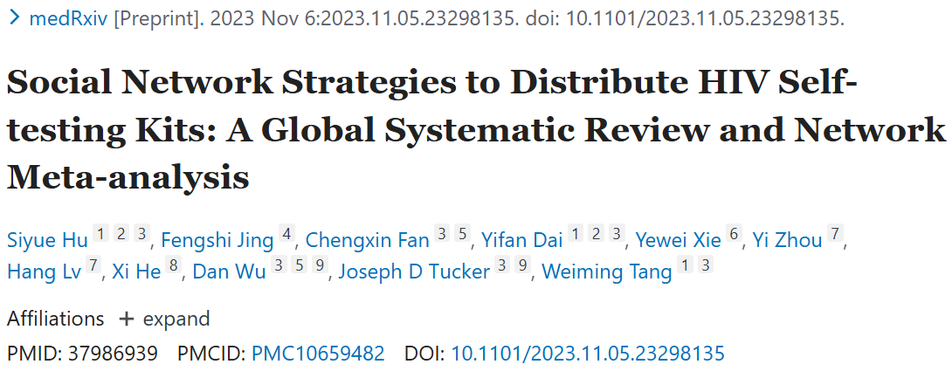



Social network testing is highly effective
Studies (mainly for HIV) have shown that social network testing can:
    Increase uptake of HTS
    Identify PLHIV who were previously undiagnosed
    Effectively link to care

Slide 19






Family/Household testing is highly effective
Studies have shown that family and household testing can:
    Identifying healthy children living with HIV (before they develop symptoms)
    Identify children, siblings, spouses, and parents living with HBV
    Effectively link to care

Slide 20
The 5 Cs

Slide 21
Network-based testing must follow the 5 Cs
1. Ensure Consent
2. Remain Confidential
3. Include Appropriate Counseling
4. Provide Correct Test Results
5. Connect Contacts Tested to Appropriate Services
https://apps.who.int/iris/handle/10665/179870

Slide 22
Network-based testing services should always be voluntary
Network-based testing is a completely voluntary service offered to people to support them in getting their partner(s), children, and other contacts tested for HIV, hepatitis B & C, and/or STIs.
Network-based testing testing should be person-centered and focused on the needs and safety of clients and their partner(s), network contacts, and children.
All testing clients should be provided with all available prevention, care, and treatment services, regardless of whether they provide details about their partners.
  Services may NEVER be withheld under any circumstances.
  Clients may NEVER be pressured into sharing the names of their partner(s), family, or other contacts
  Clients should be informed of their right to decline participation in network-based testing services throughout the process, not just during the elicitation interview.
Clients may opt-out of network-based testing services FOR ANY OR NO REASON.
Clients do not need to provide a reason for not participating in network-based testing services.

Slide 23


Network-Based Testing Should Always Be Confidential
Confidentiality = protection of personal information.
You need to give your client an assurance that what is said will be in confidence because, unless you are able to do that, the client is unlikely to be open with you.
It is our duty to never reveal the information that clients tell us.
Both the confidentiality of the index client and all named partners, network contacts, and children should be maintained at all times.
The partner’s status should not be revealed to the index client
The identity of the index client should never be revealed to the partner unless agreed to by the index
Unless Explicit Consent Is Obtained from All Parties
Index Client
Partner or contact

Slide 24

What Personal Information Should Be Kept Confidential*?
Information that would allow others to identify the index client
  Their name, date of birth, address, phone number, etc.
Any medical diagnosis, including diagnosis and treatment plan
Anything they talked about during their interview and/or clinical exam

Slide 25
Scenarios
Check your understanding by considering the following situations

Slide 26
Scenario 1
You call John, a named sexual partner that you are contacting as part of provider-assisted partner services for STIs. You explain to John that he may have been exposed to chlamydia and you are calling to offer him a test and/or presumptive treatment. During the session, John asks which of his partners gave you his name.
How can you respond?

Slide 27
Scenario 1
There are several different ways to respond to John's question, but the most important thing is that you do not share any information about the identity of the index client who named him. Possible ways to respond include:
"By law, I am not able to give you that information."
"I cannot give you any more information."
Or, simply:
"I do not have any more information about how we got your contact information"

Slide 28
Scenario 2
You are a seeing Mary, a 32 year-old woman who is in her first trimester of pregnancy. As per the guidelines in your country, you test her for HIV, syphilis, and hepatitis B at the first visit. Her rapid hepatitis B surface antigen (HBsAg) test is positive.
When you discuss network-based testing services with her, which of the people in her life would you recommend contacting and testing?

Slide 29
Scenario 2
For hepatitis B, WHO recommends that all sexual and injecting partners, all biological children, and any other household contacts be tested. In this case you can offer assisted partner services and family and household testing services to Mary, and discuss her preferences for how to conduct testing for each contact.

Slide 30
Scenario 3
Aneal was recently diagnosed HIV-positive, and you are conducting the elicitation interview. He names 2 sex partners and 3 injecting partners. Aneal chooses to distribute self-testing kits to all his partners.
What other services can you offer to Aneal and his partners as part of network-based testing?

Slide 31
Scenario 3
Aneal and his partners may have several additional needs. People who inject drugs are at increased risk of HCV, so both Aneal and his partners should be offered HCV testing. He can be given HCV self-testing kits to offer to partners, along with the HIV self-testing kits. Additionally, both Aneal and his partners should be offered linkage to care. Aneal needs linkage to ART, and should also be offered harm reduction services. Aneal's partners may benefit from PrEP if they test negative for HIV. Aneal and his partners should also be offered condoms and lubricant.

Slide 32
The 10 Steps

Slide 33
What are the 10 steps of network-based testing?
1 | Introduce concept of network-based testing at any visit, and determine readiness and timing | 6 | Determine which infections each contact should be offered testing for, based on risk and epidemiology (HIV, other STIs, hepatitis)
2 | Offer network-based testing as a voluntary service to all clients with HIV, hepatitis B or C, or an STI, and obtain consent | 7 | Contact and offer integrated testing to partners and contacts using preferred approach, including self-test distribution
3 | Obtain a list of sex and injecting partners, social network contacts, biological children < 19 years old, and other household members (for HBV) | 8 | Record outcomes of network-based testing services
4 | Conduct an intimate partner violence (IPV) risk assessment | 9 | Link partners, contacts, children and household members to appropriate treatment and/or prevention services
5 | Determine the preferred method (partner services, social network testing, or family/household testing) for each contact | 10 | Follow-up with client to assess for any adverse events associated with network-based testing services

